Slide 1
Chapter 7 C Pointers

Slide 2
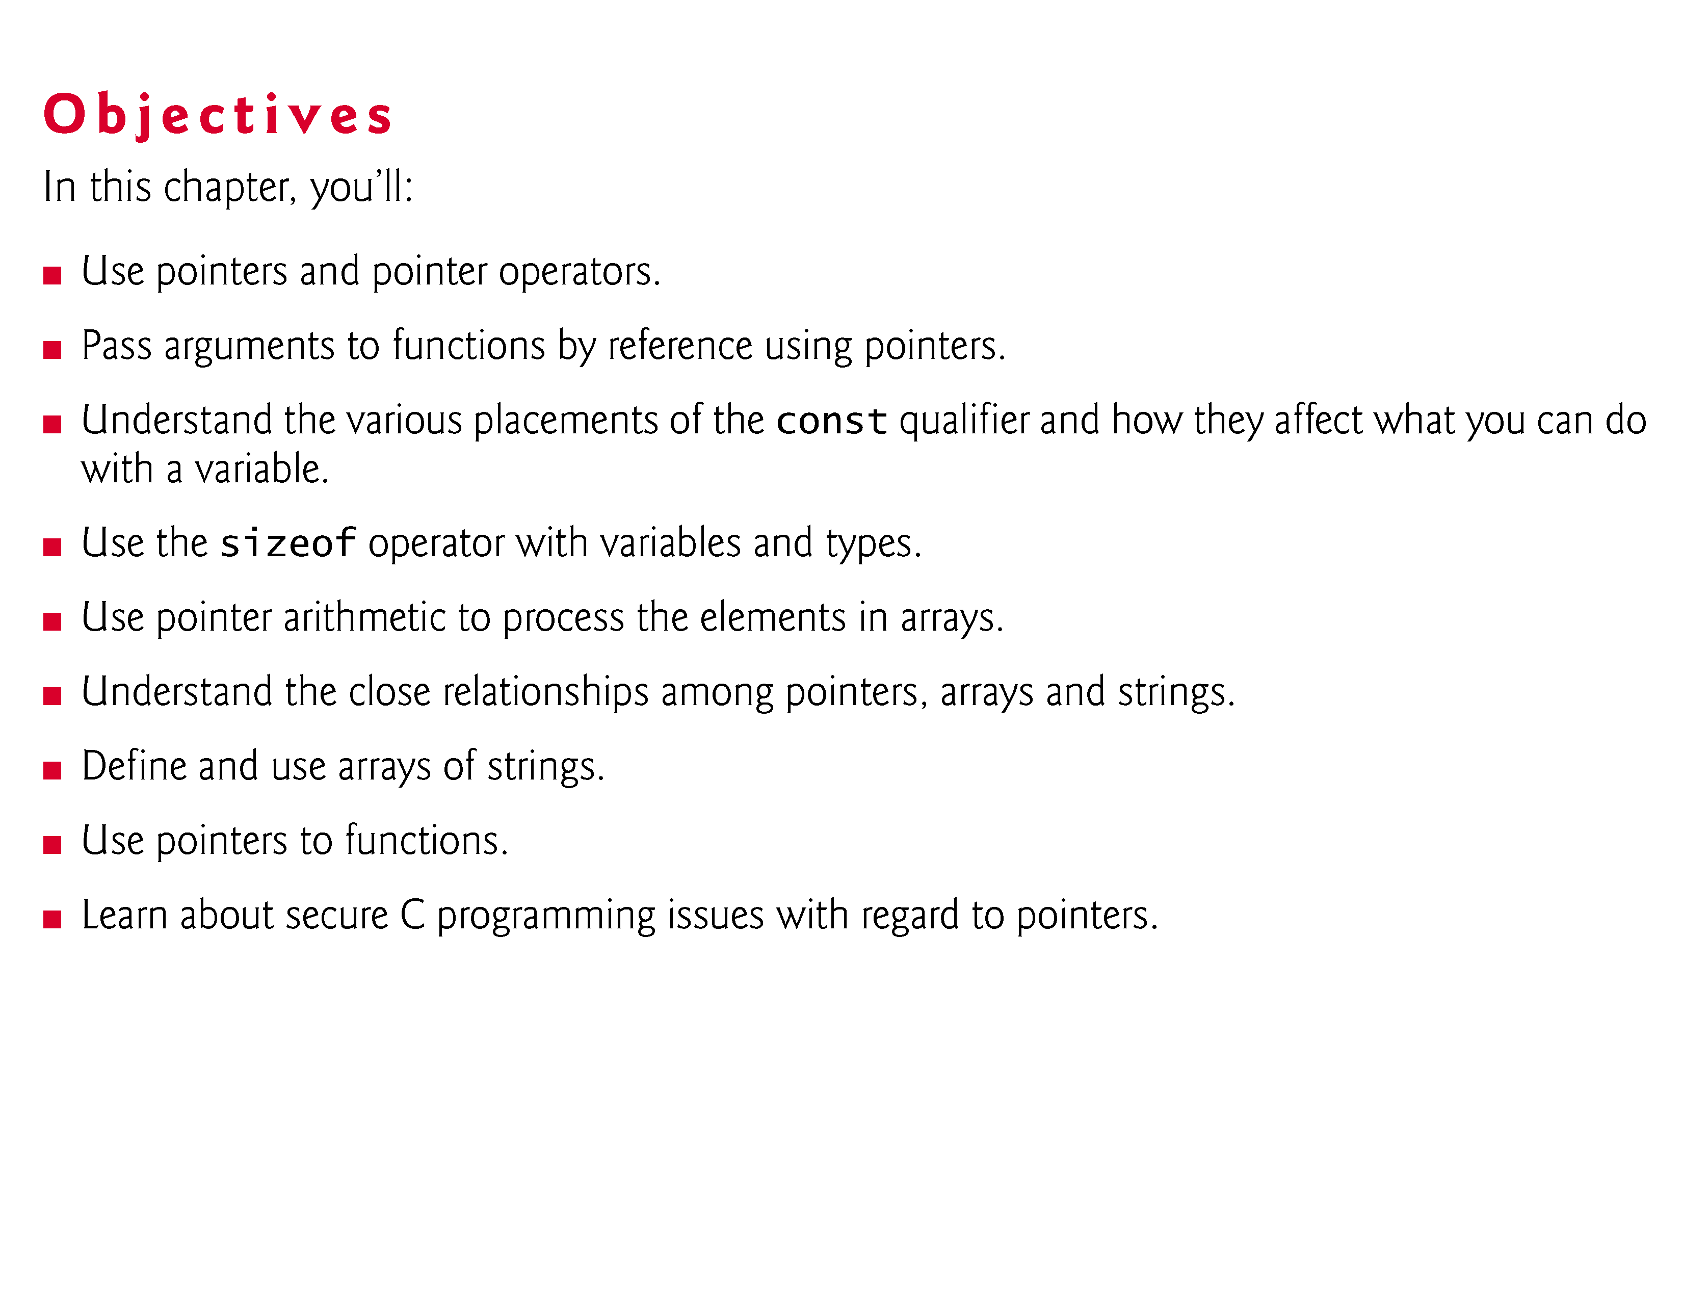

Slide 3
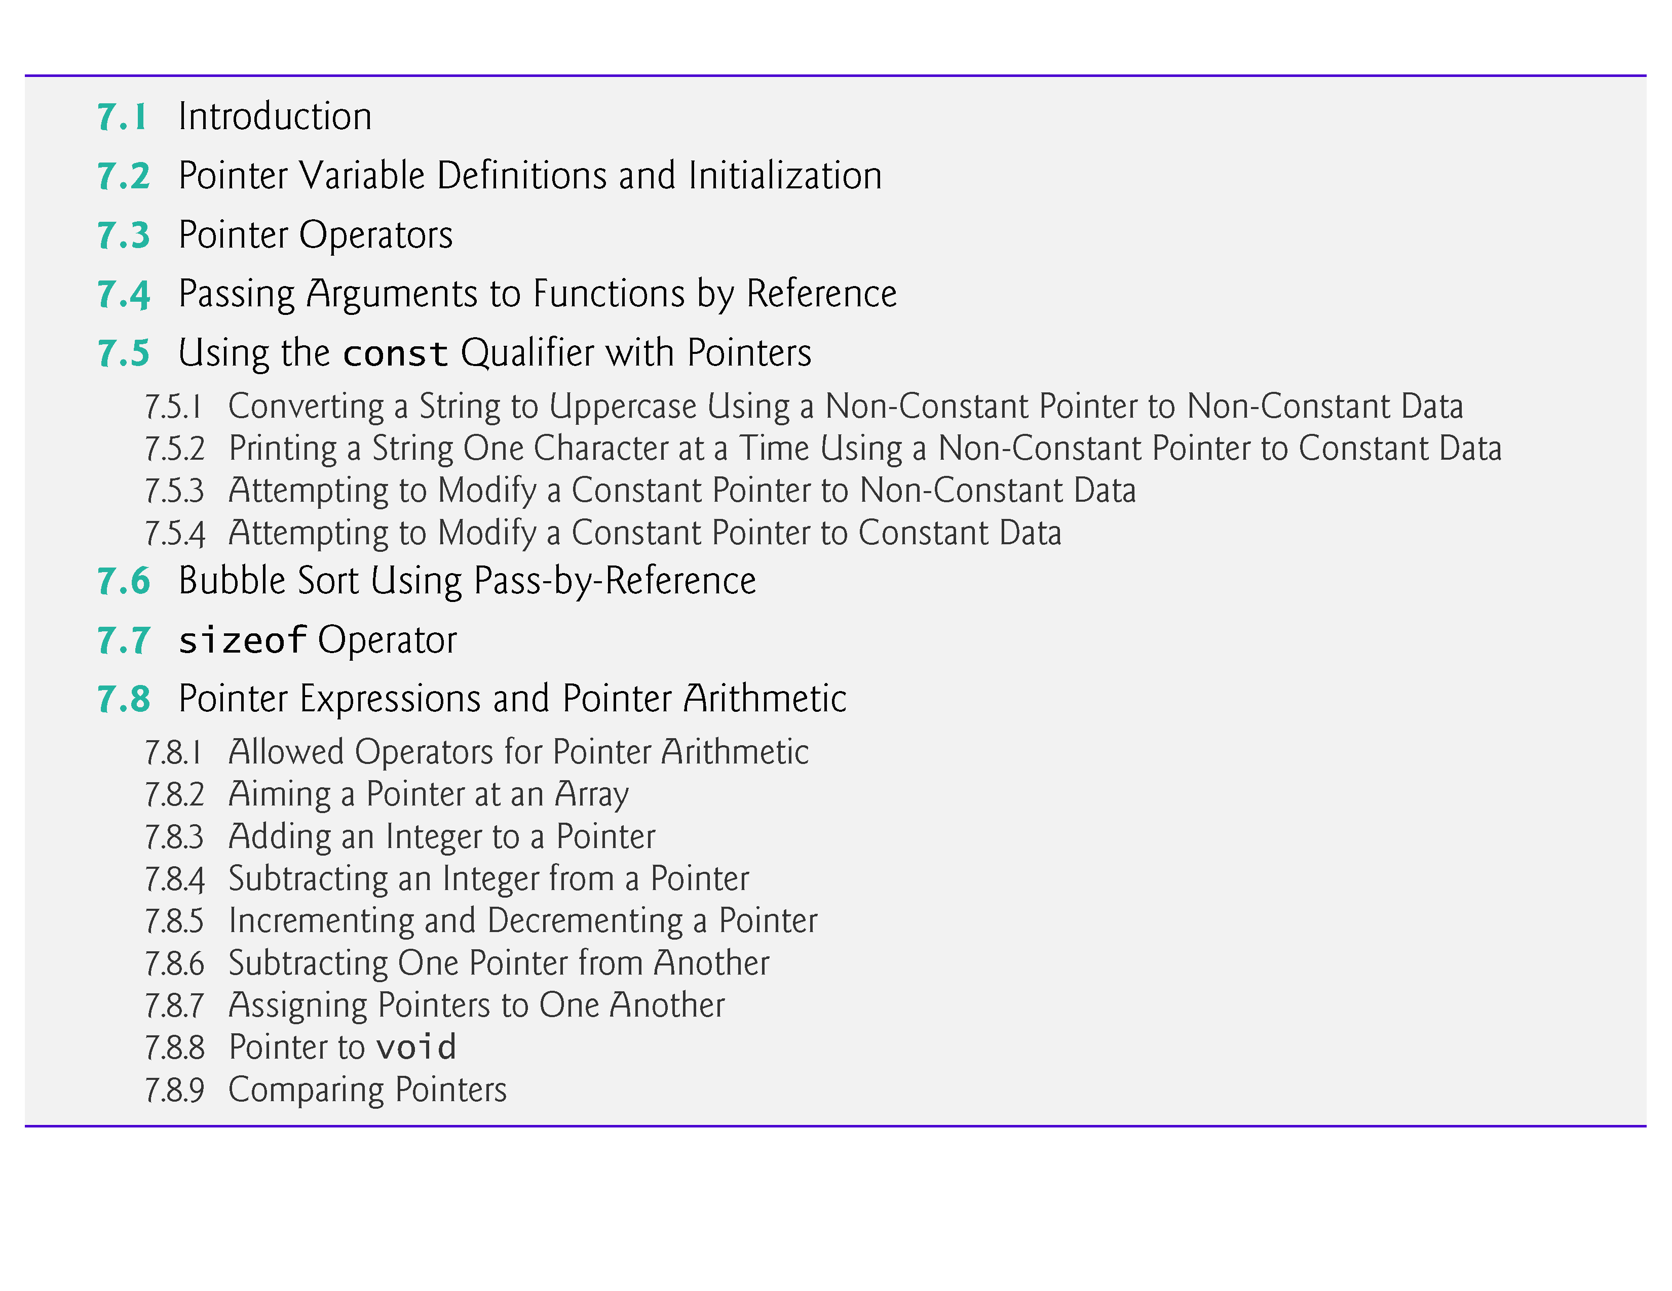

Slide 4
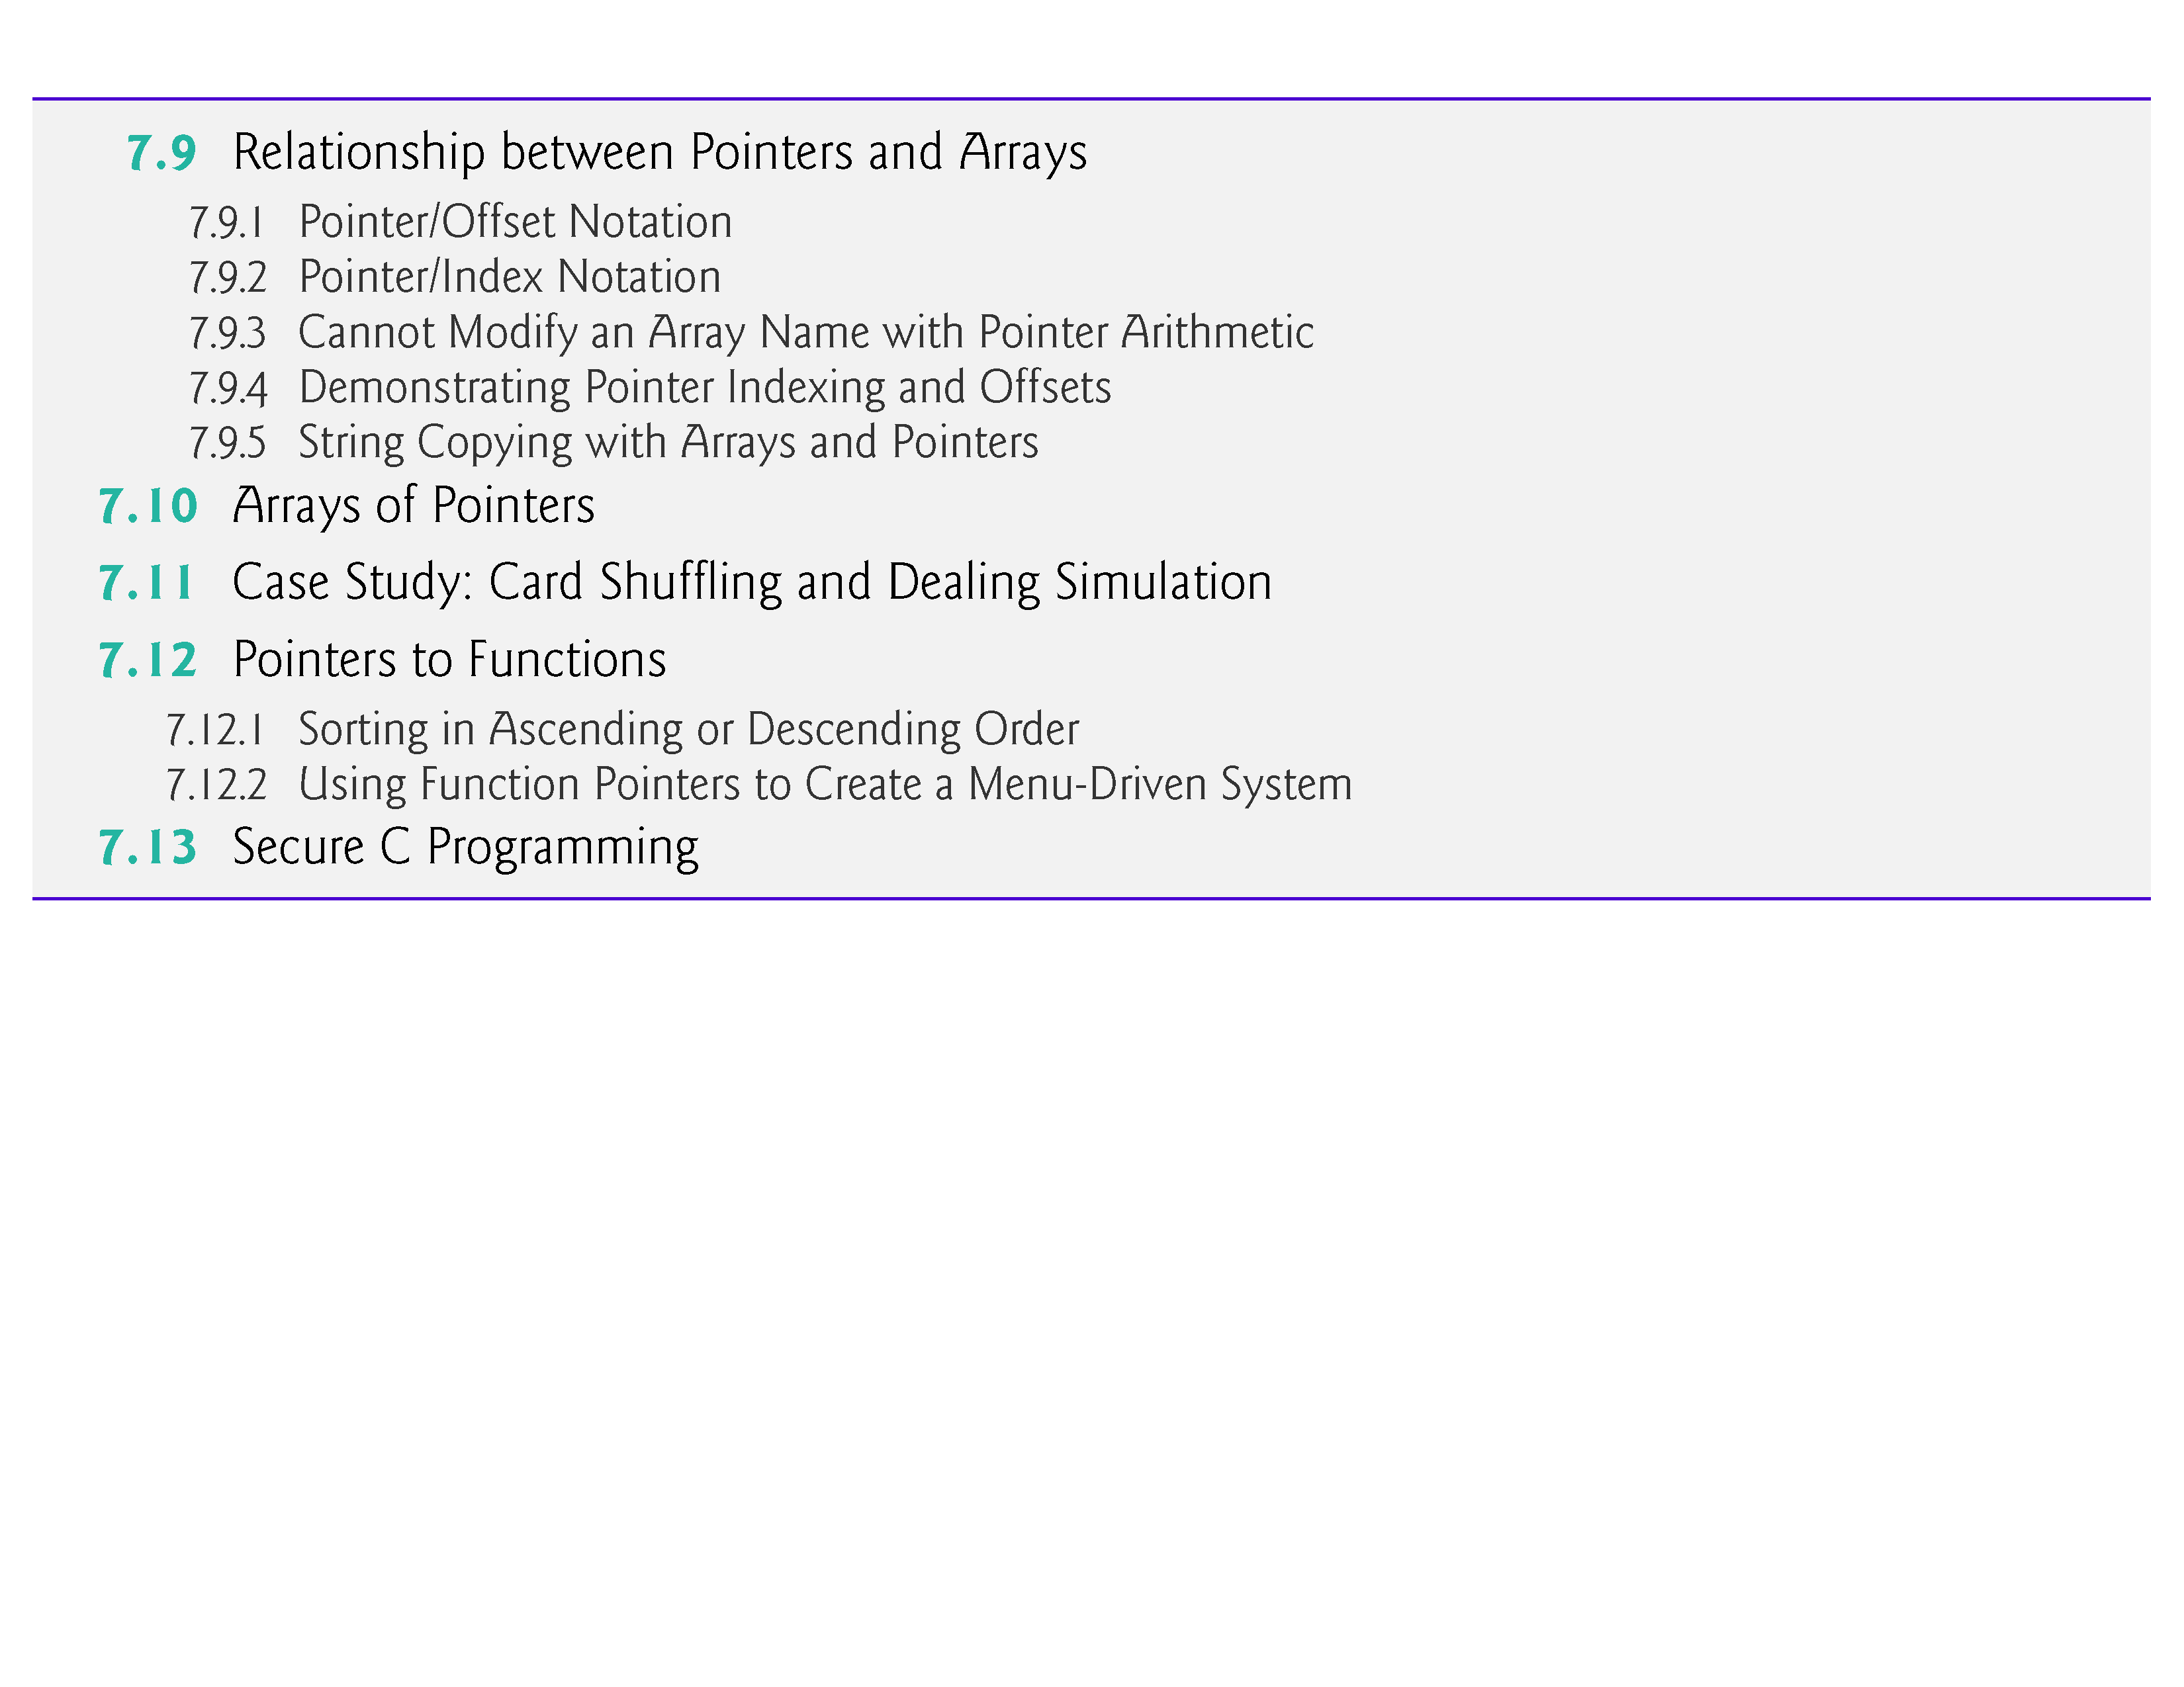

Slide 5
7.1 Introduction
In this chapter, we discuss one of the most powerful features of the C programming language, the pointer.
Pointers enable programs to simulate pass-by-reference, to pass functions between functions, and to create and manipulate dynamic data structures, i.e., data structures that can grow and shrink at execution time, such as linked lists, queues, stacks and trees.
Chapter 10 examines the use of pointers with structures.
Chapter 12 introduces dynamic memory management techniques and presents examples of creating and using dynamic data structures.

Slide 6
7.2 Pointer Variable Definitions and Initialization
Pointers are variables whose values are memory addresses.
Normally, a variable directly contains a specific value.
A pointer, on the other hand, contains an address of a variable that contains a specific value.
In this sense, a variable name directly references a value, and a pointer indirectly references a value (Fig. 7.1).
Referencing a value through a pointer is called indirection.

Slide 7
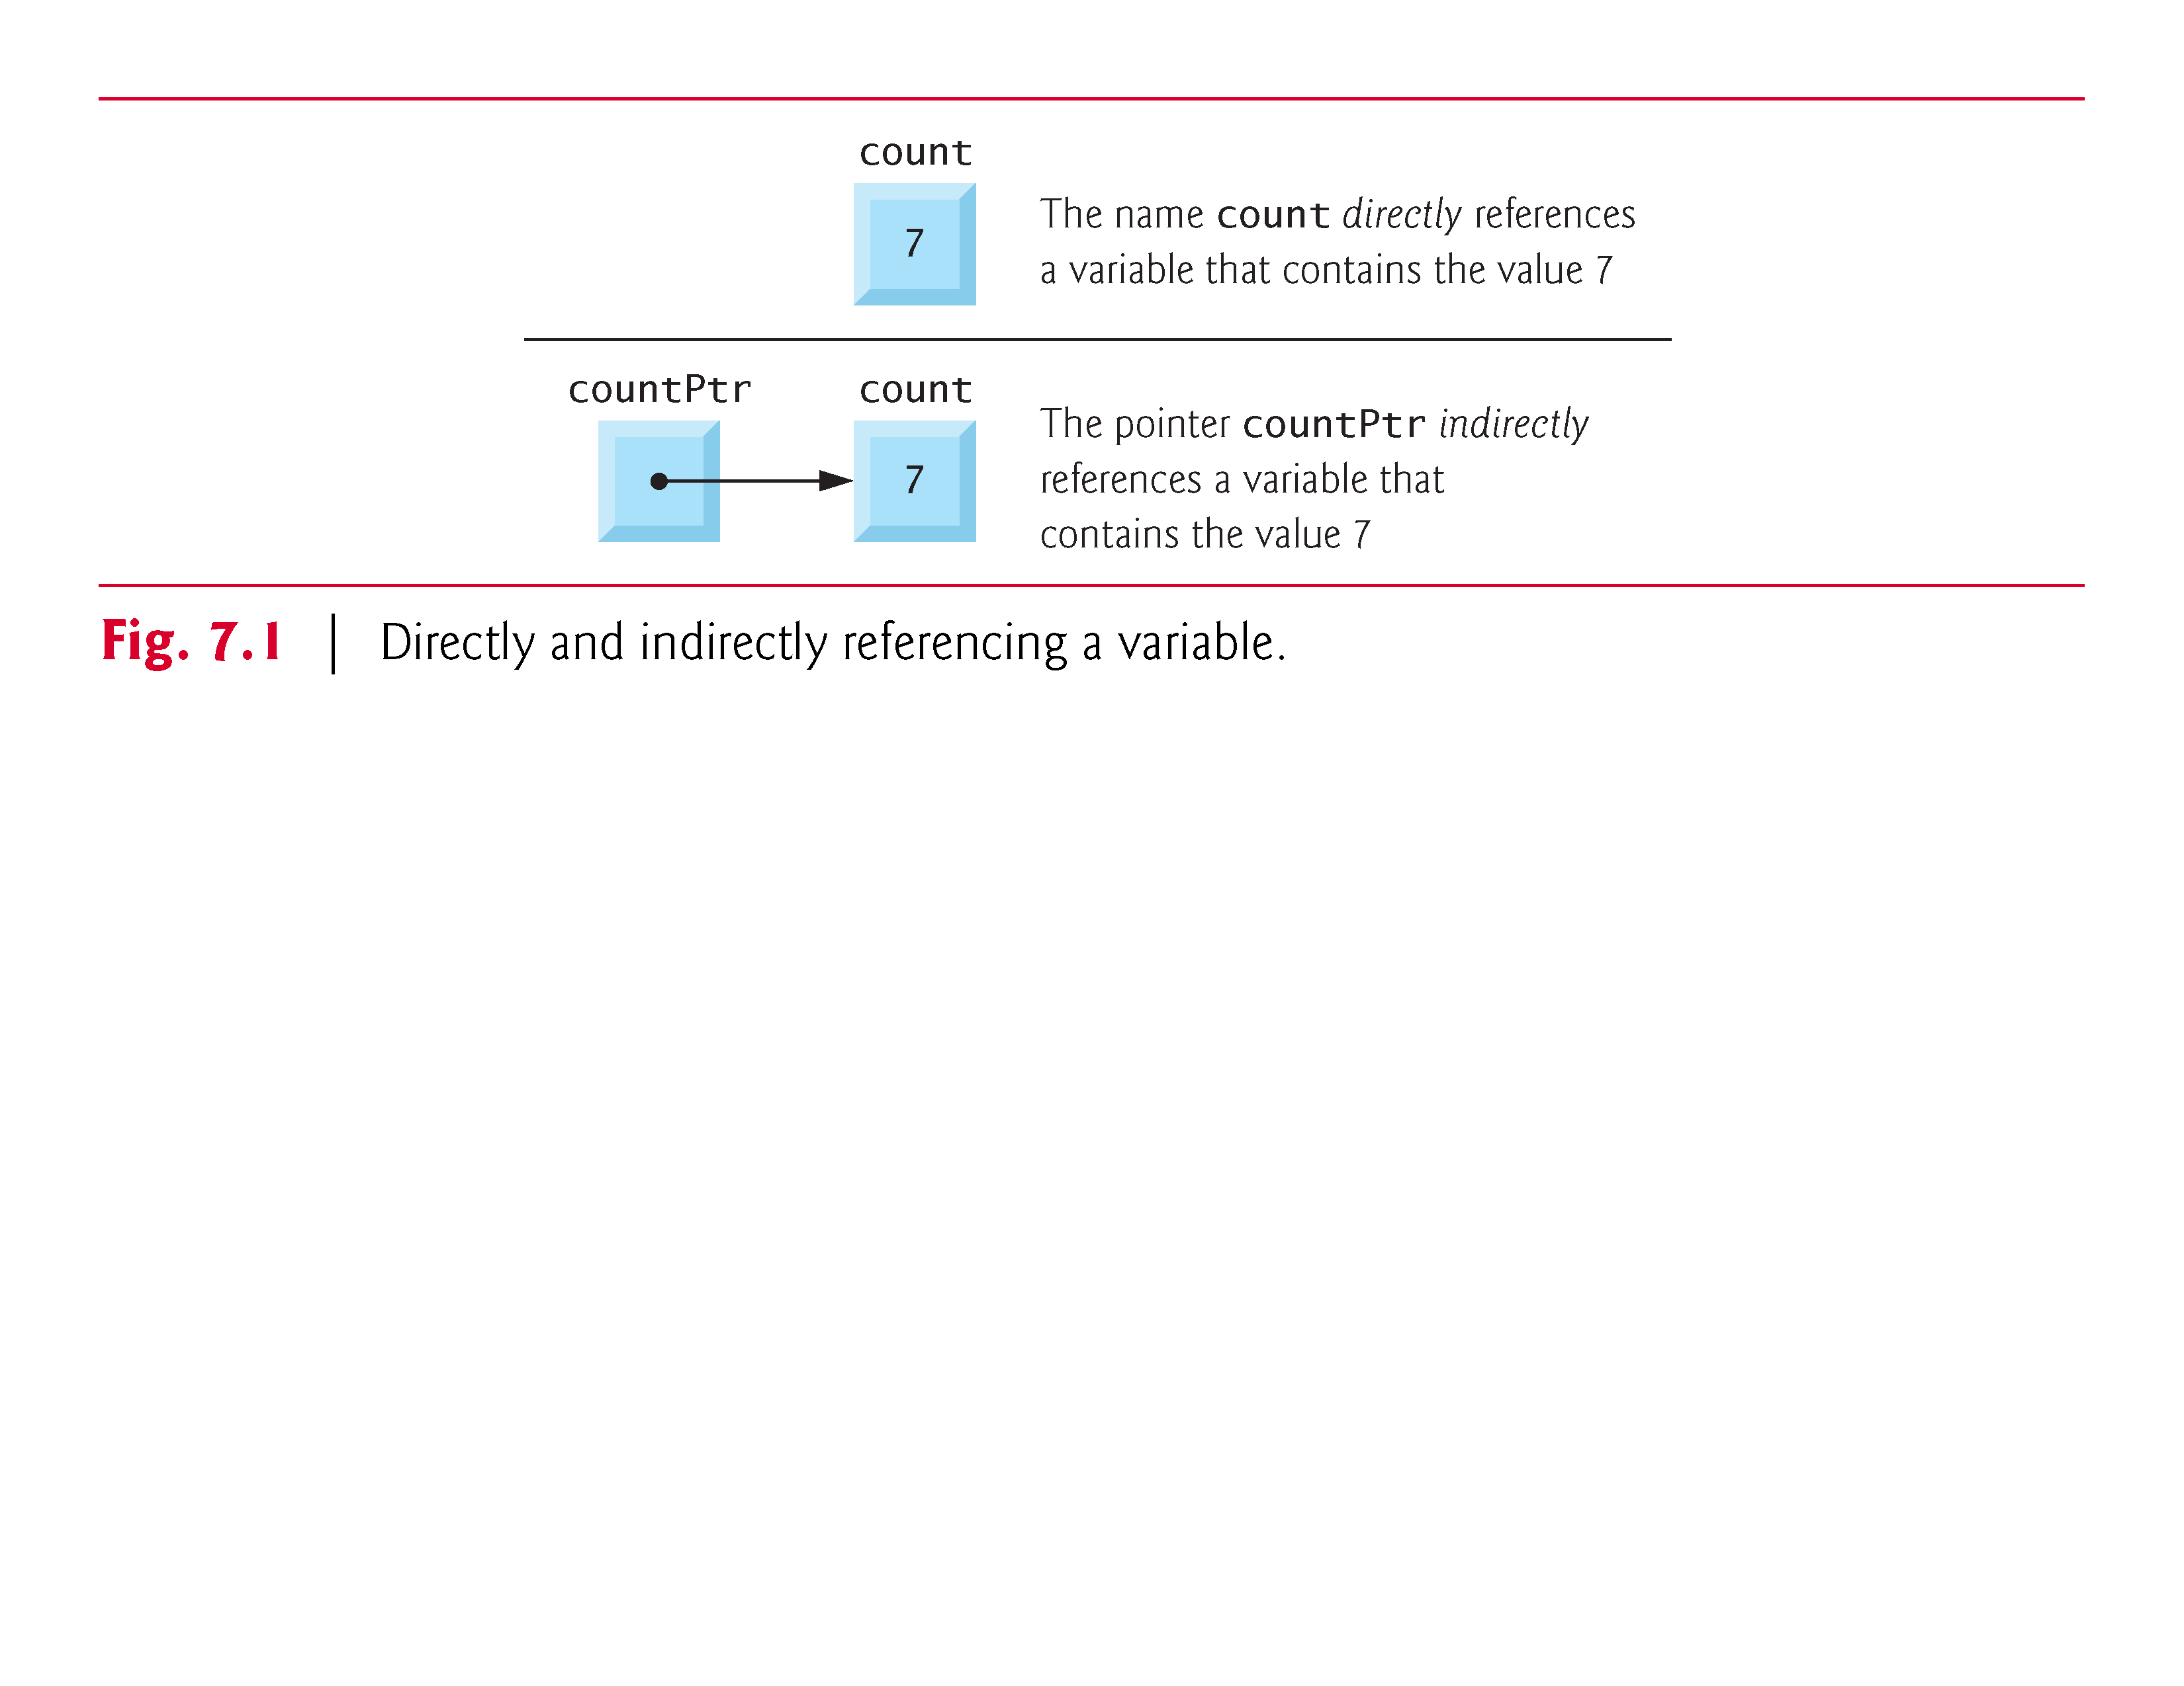

Slide 8
7.2 Pointer Variable Definitions and Initialization (cont.)
Declaring Pointers
Pointers, like all variables, must be defined before they can be used.
The definition
int *countPtr, count;
specifies that variable countPtr is of type int * (i.e., a pointer to an integer) and is read (right to left), “countPtr is a pointer to int” or “countPtr points to an object of type int.”
Also, the variable count is defined to be an int, not a pointer to an int.

Slide 9
7.2 Pointer Variable Definitions and Initialization (cont.)
The * applies only to countPtr in the definition.
When * is used in this manner in a definition, it indicates that the variable being defined is a pointer.
Pointers can be defined to point to objects of any type.
To prevent the ambiguity of declaring pointer and non-pointer variables in the same declaration as shown above, you should always declare only one variable per declaration.

Slide 10
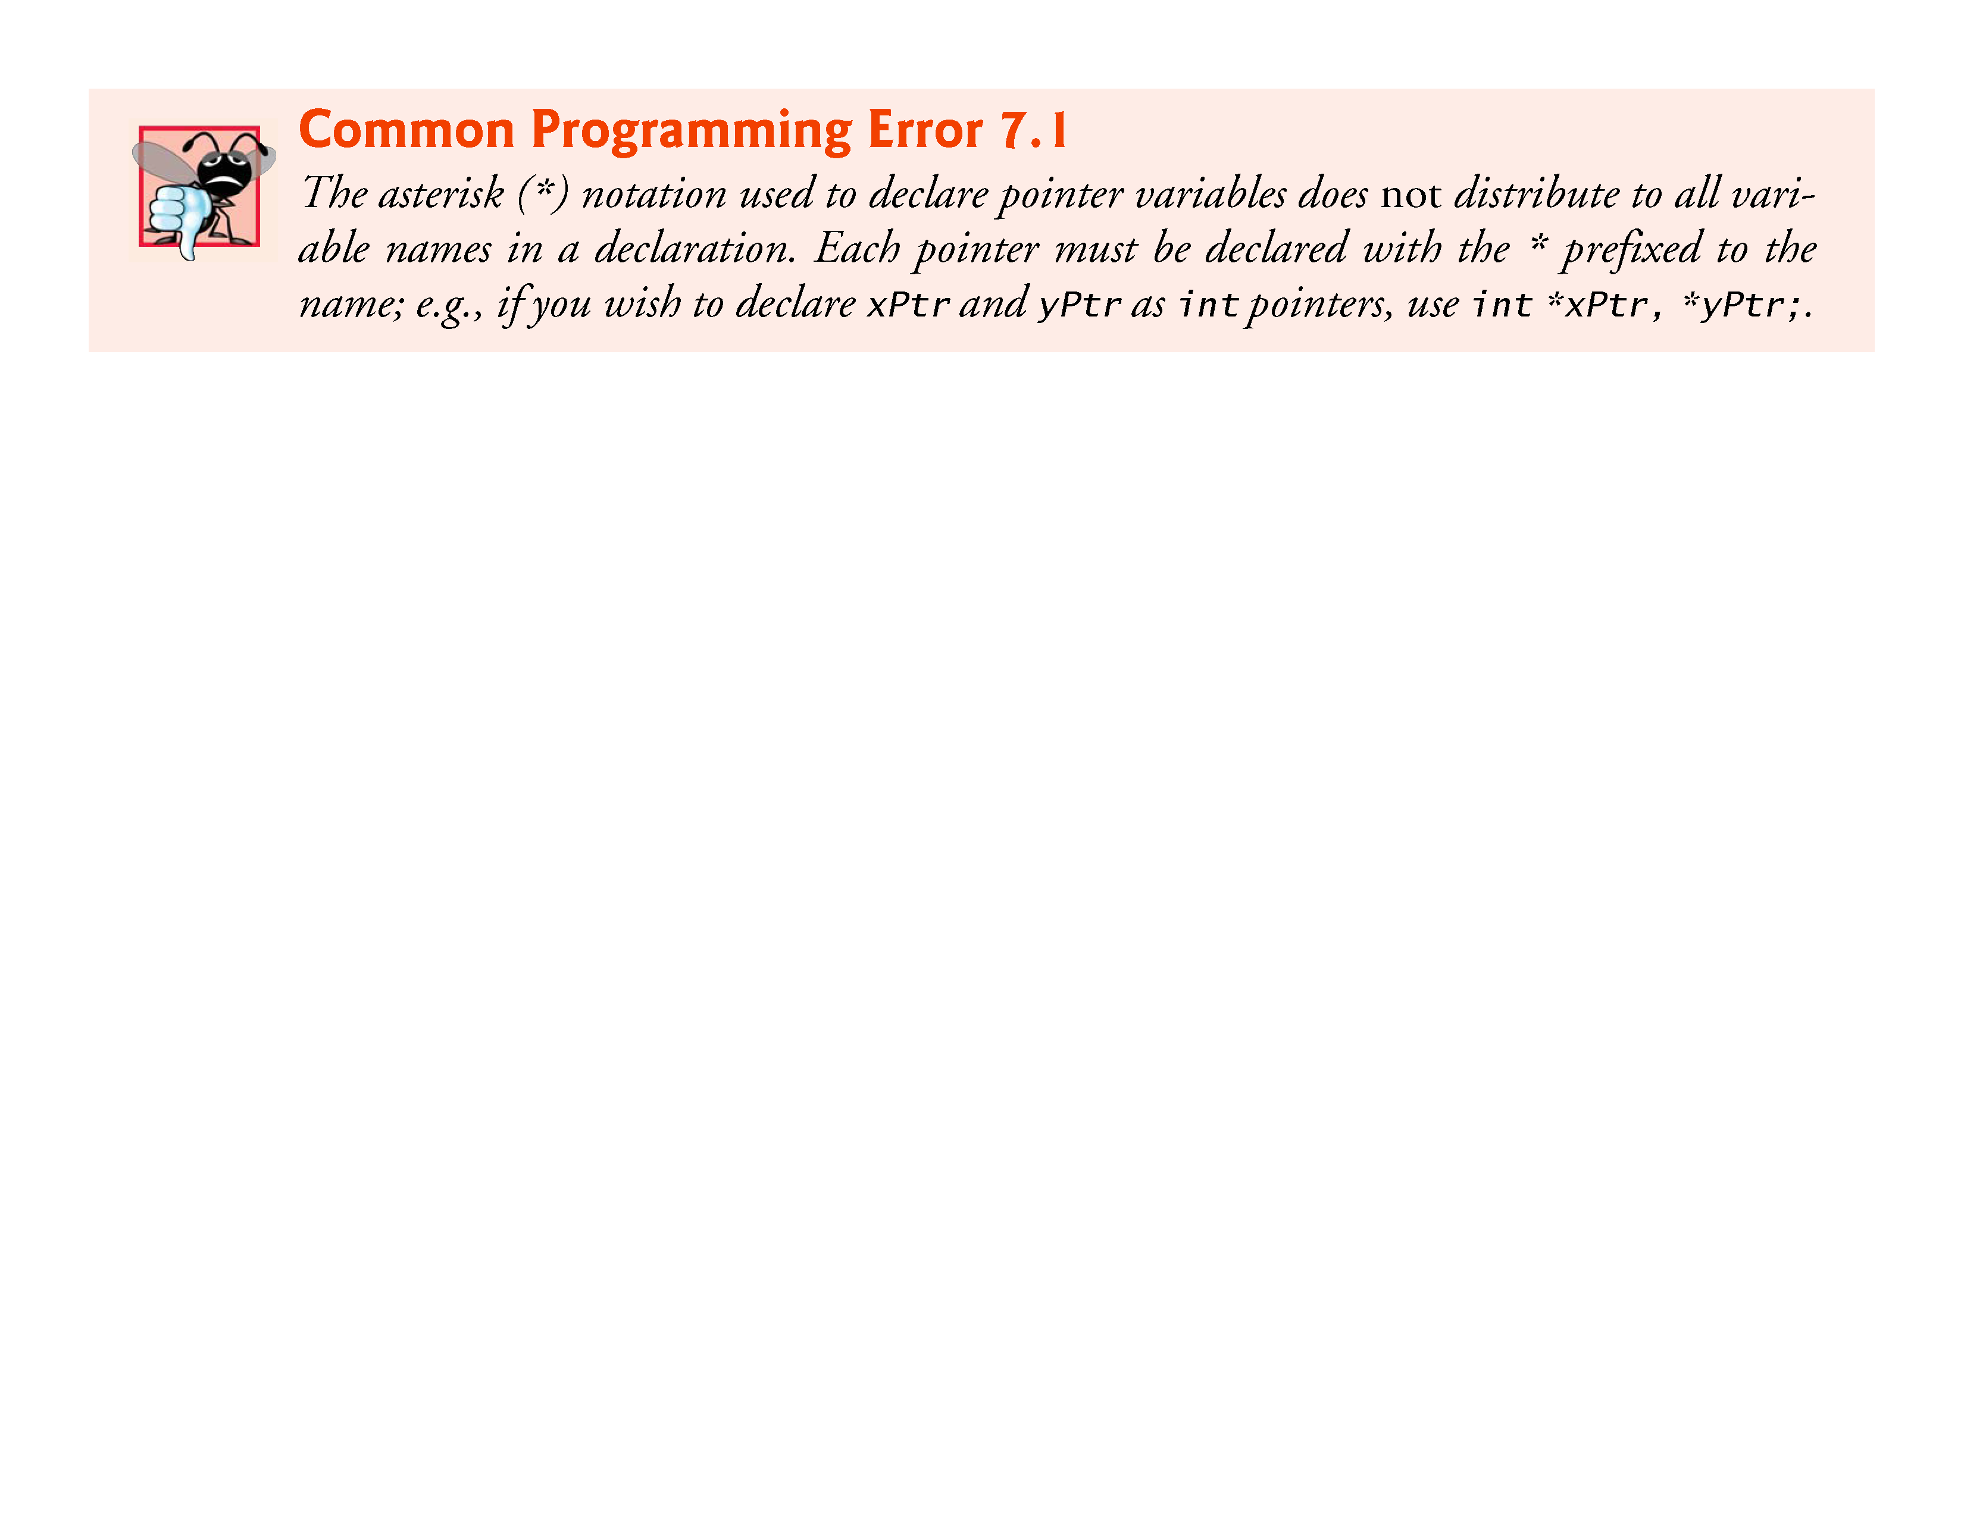

Slide 11
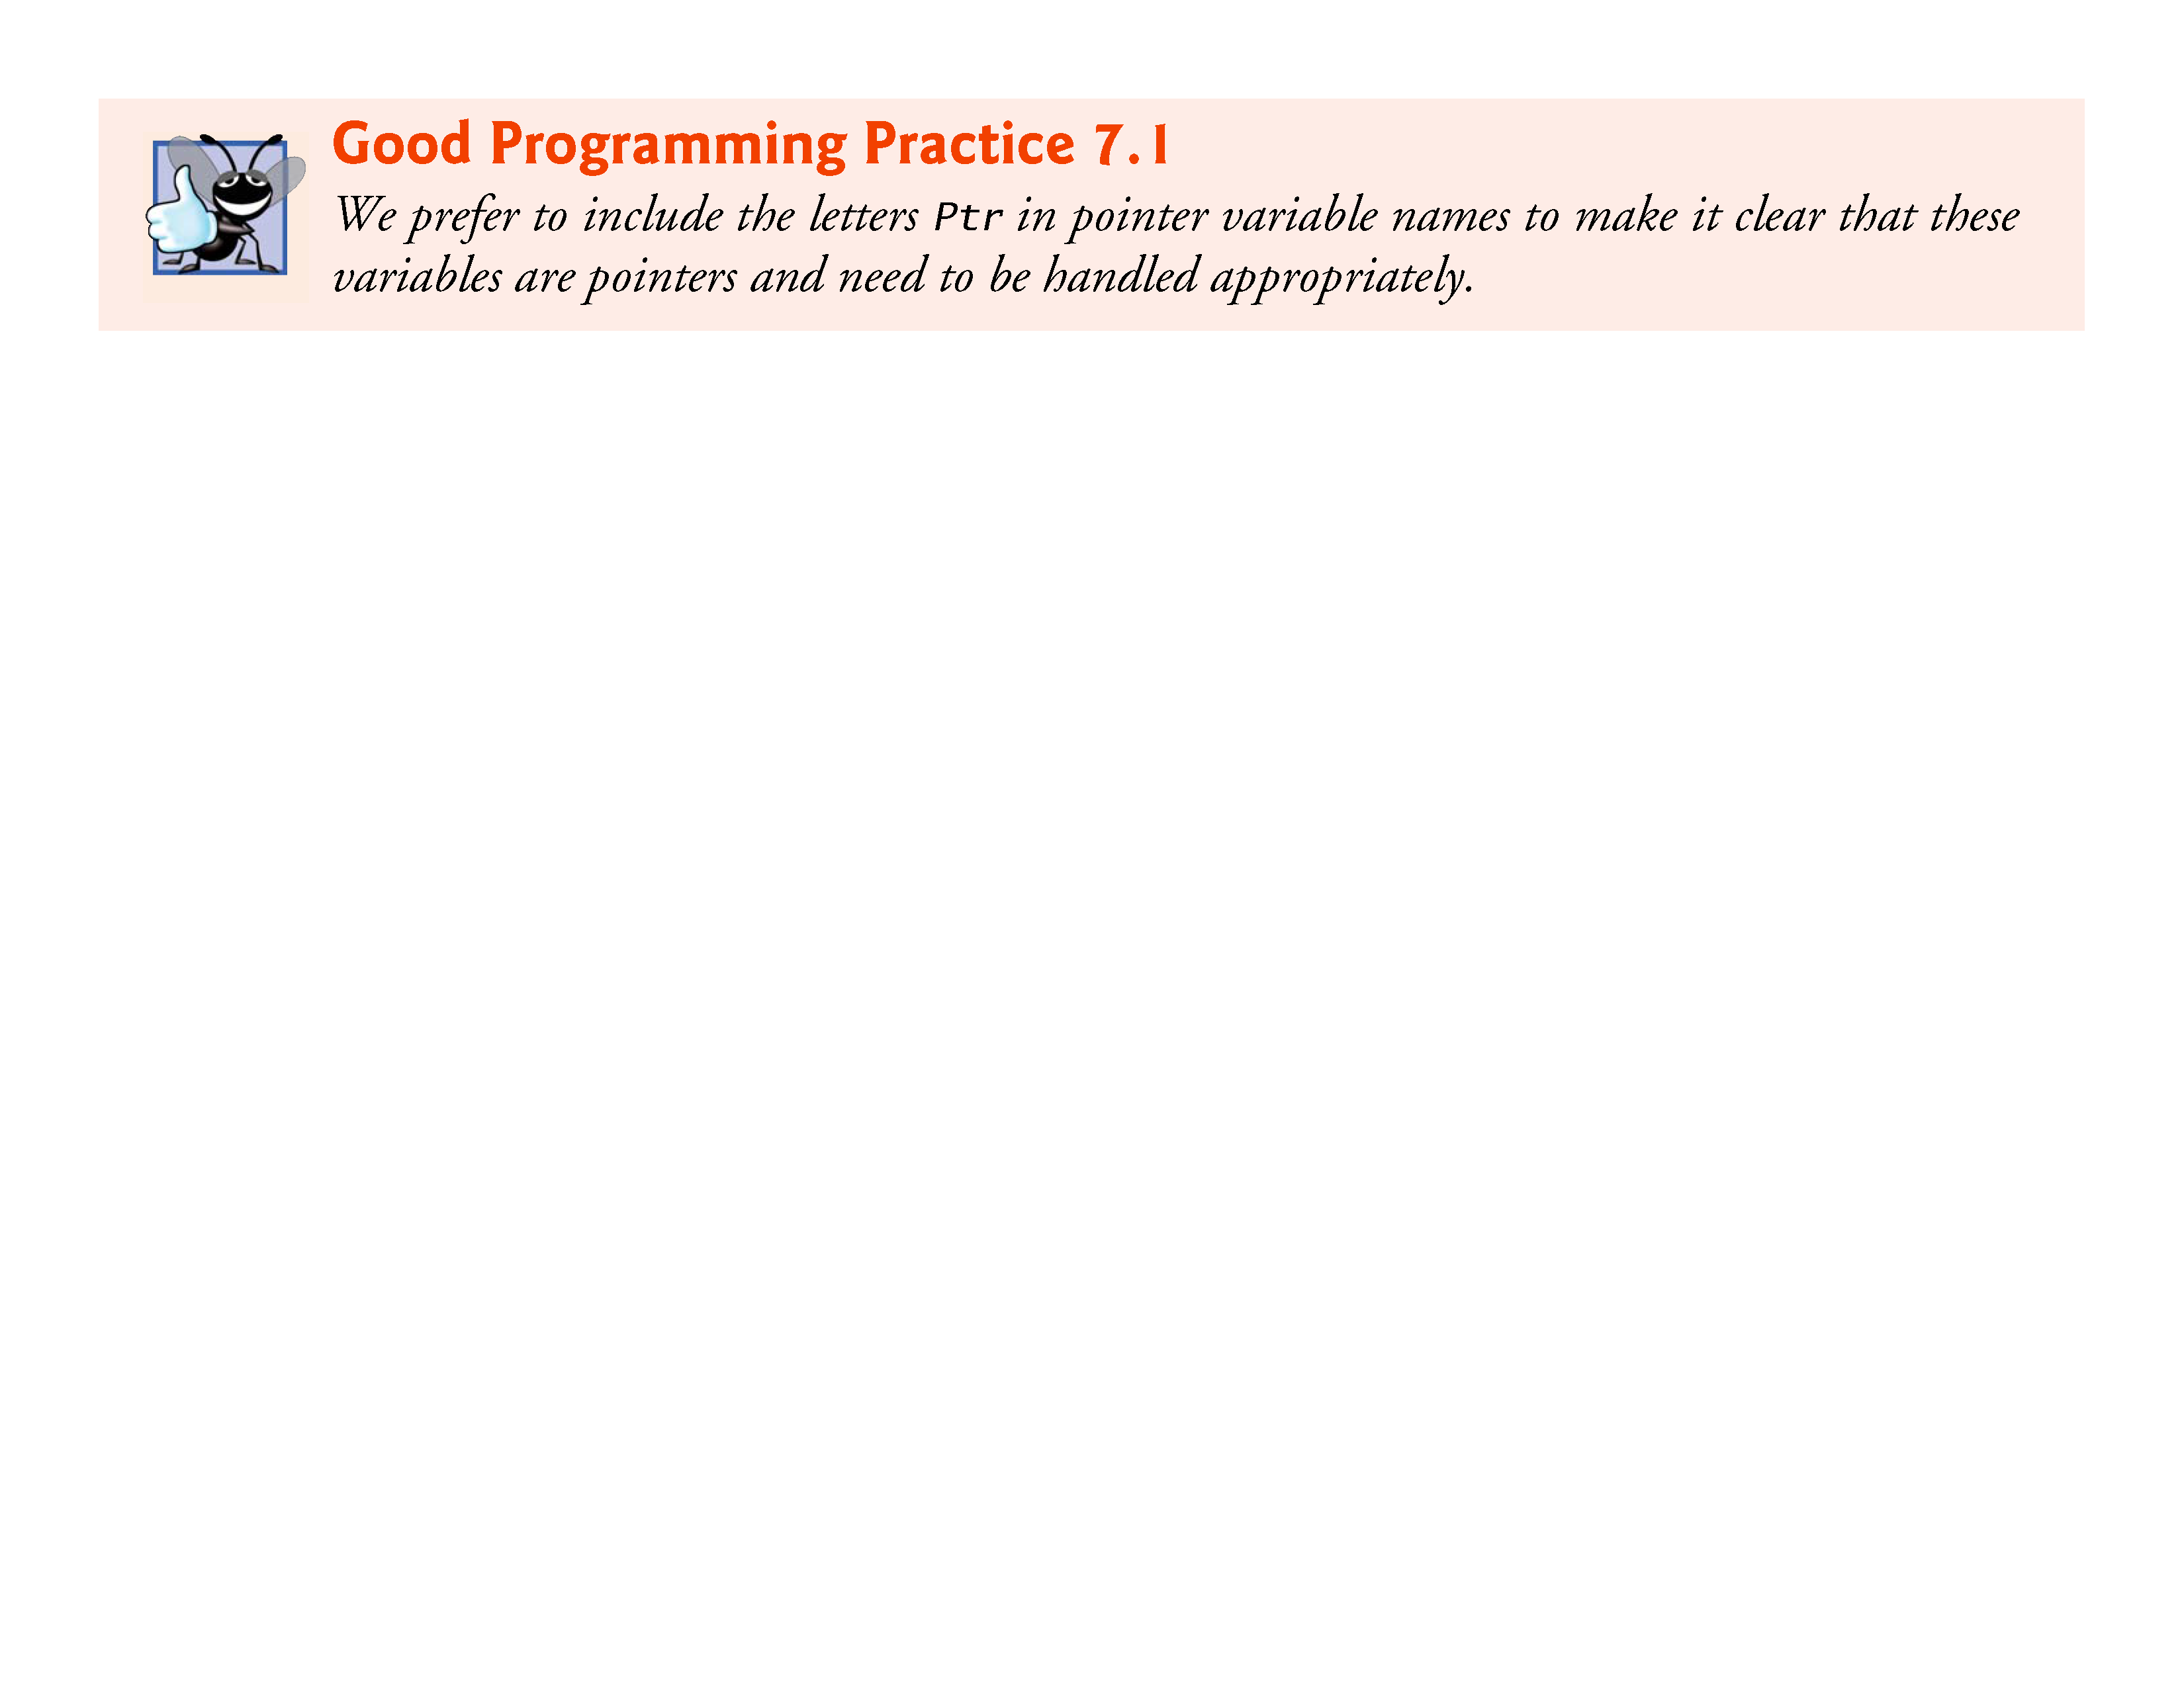

Slide 12
7.2 Pointer Variable Definitions and Initialization (cont.)
Initializing and Assigning Values to Pointers
Pointers should be initialized when they’re defined or they can be assigned a value.
A pointer may be initialized to NULL, 0 or an address.
A pointer with the value NULL points to nothing.
NULL is a symbolic constant defined in the <stddef.h> header (and several other headers, such as <stdio.h>).

Slide 13
7.2 Pointer Variable Definitions and Initialization (cont.)
Initializing a pointer to 0 is equivalent to initializing a pointer to NULL, but NULL is preferred.
When 0 is assigned, it’s first converted to a pointer of the appropriate type.
The value 0 is the only integer value that can be assigned directly to a pointer variable.

Slide 14
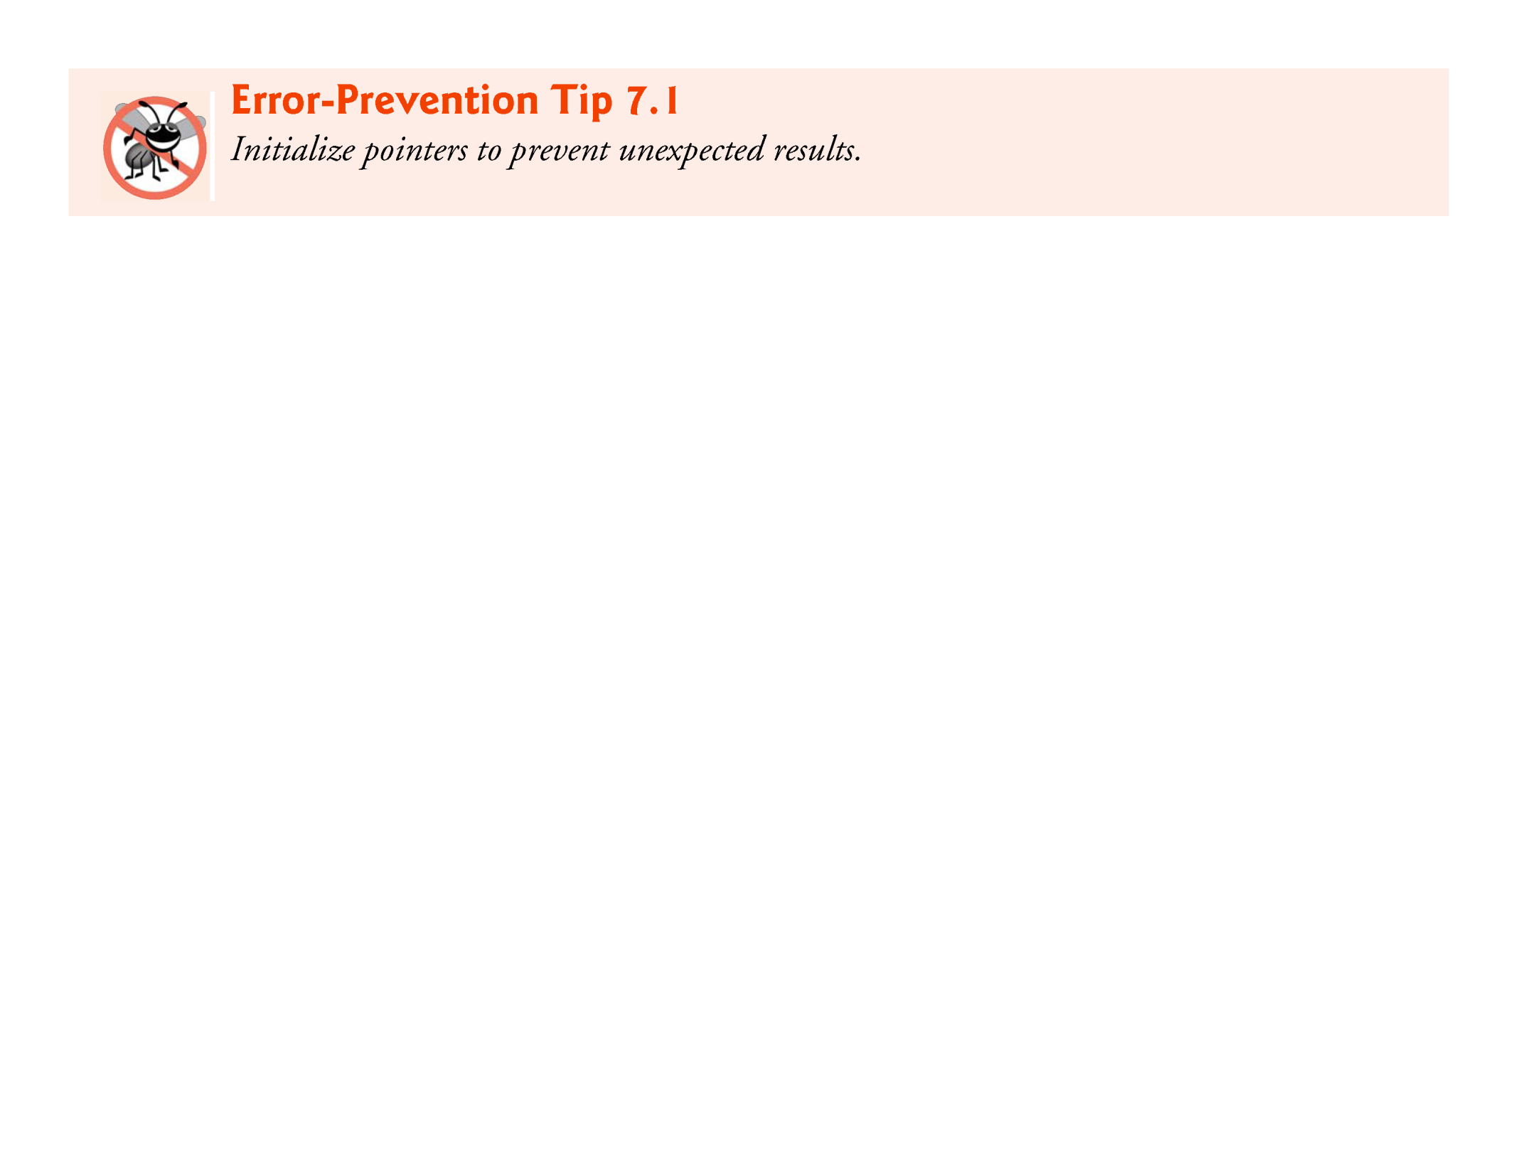

Slide 15
7.3 Pointer Operators
The &, or address operator, is a unary operator that returns the address of its operand.
For example, assuming the definitions
int y = 5; int *yPtr;
the statement
yPtr = &y;
assigns the address of the variable y to pointer variable yPtr.
Variable yPtr is then said to “point to” y.
Figure 7.2 shows a schematic representation of memory after the preceding assignment is executed.

Slide 16
7.3 Pointer Operators (Cont.)
Pointer Representation in Memory
Figure 7.3 shows the representation of the pointer in memory, assuming that integer variable y is stored at location 600000, and pointer variable yPtr is stored at location 500000.
The operand of the address operator must be a variable; the address operator cannot be applied to constants or expressions.

Slide 17
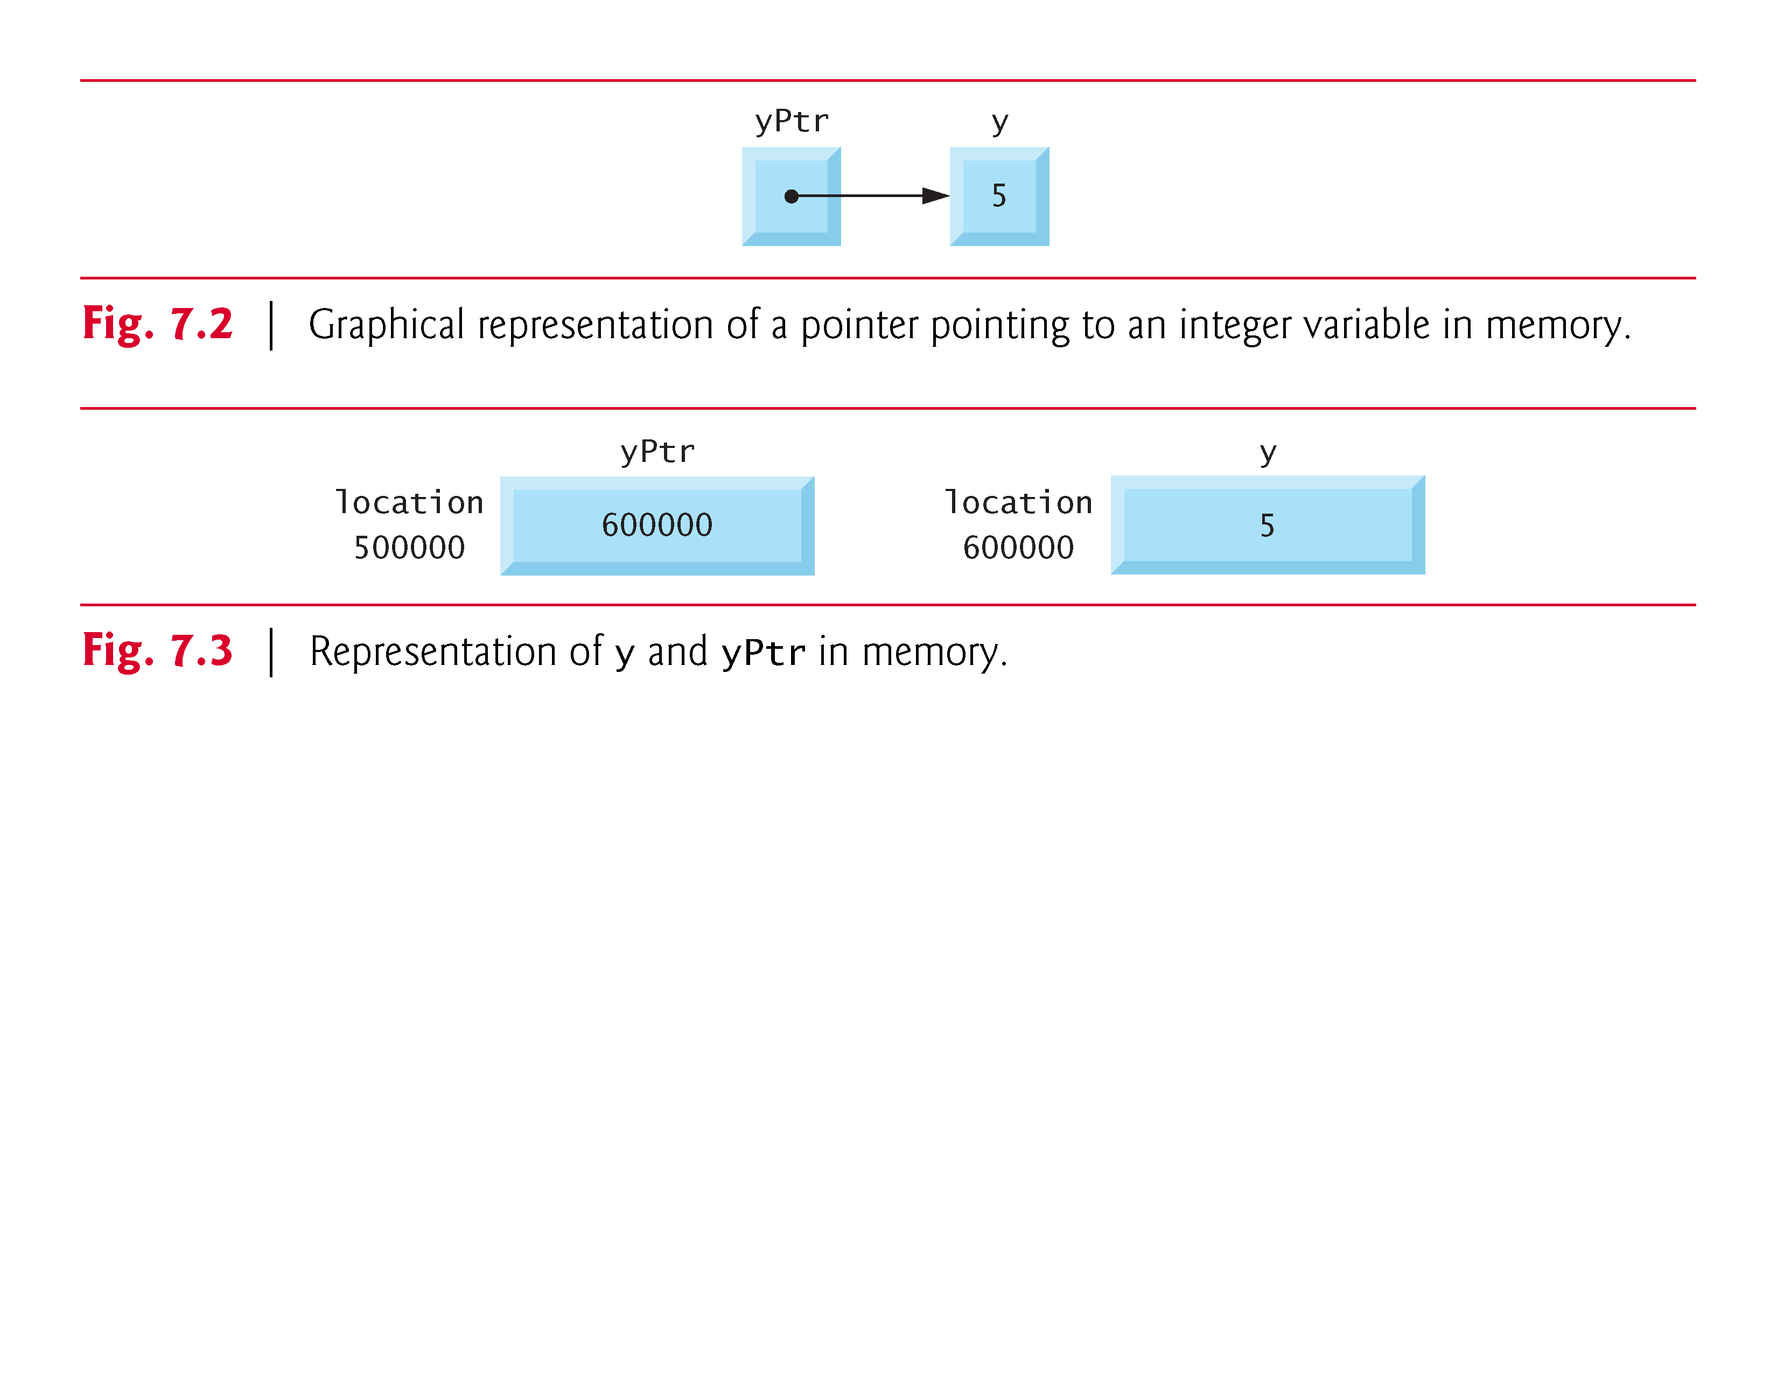

Slide 18
7.3 Pointer Operators (Cont.)
The Indirection (*) Operator
The unary * operator, commonly referred to as the indirection operator or dereferencing operator, returns the value of the object to which its operand (i.e., a pointer) points.
For example, the statement
printf("%d", *yPtr);
prints the value of variable y, namely 5.
Using * in this manner is called dereferencing a pointer.

Slide 19
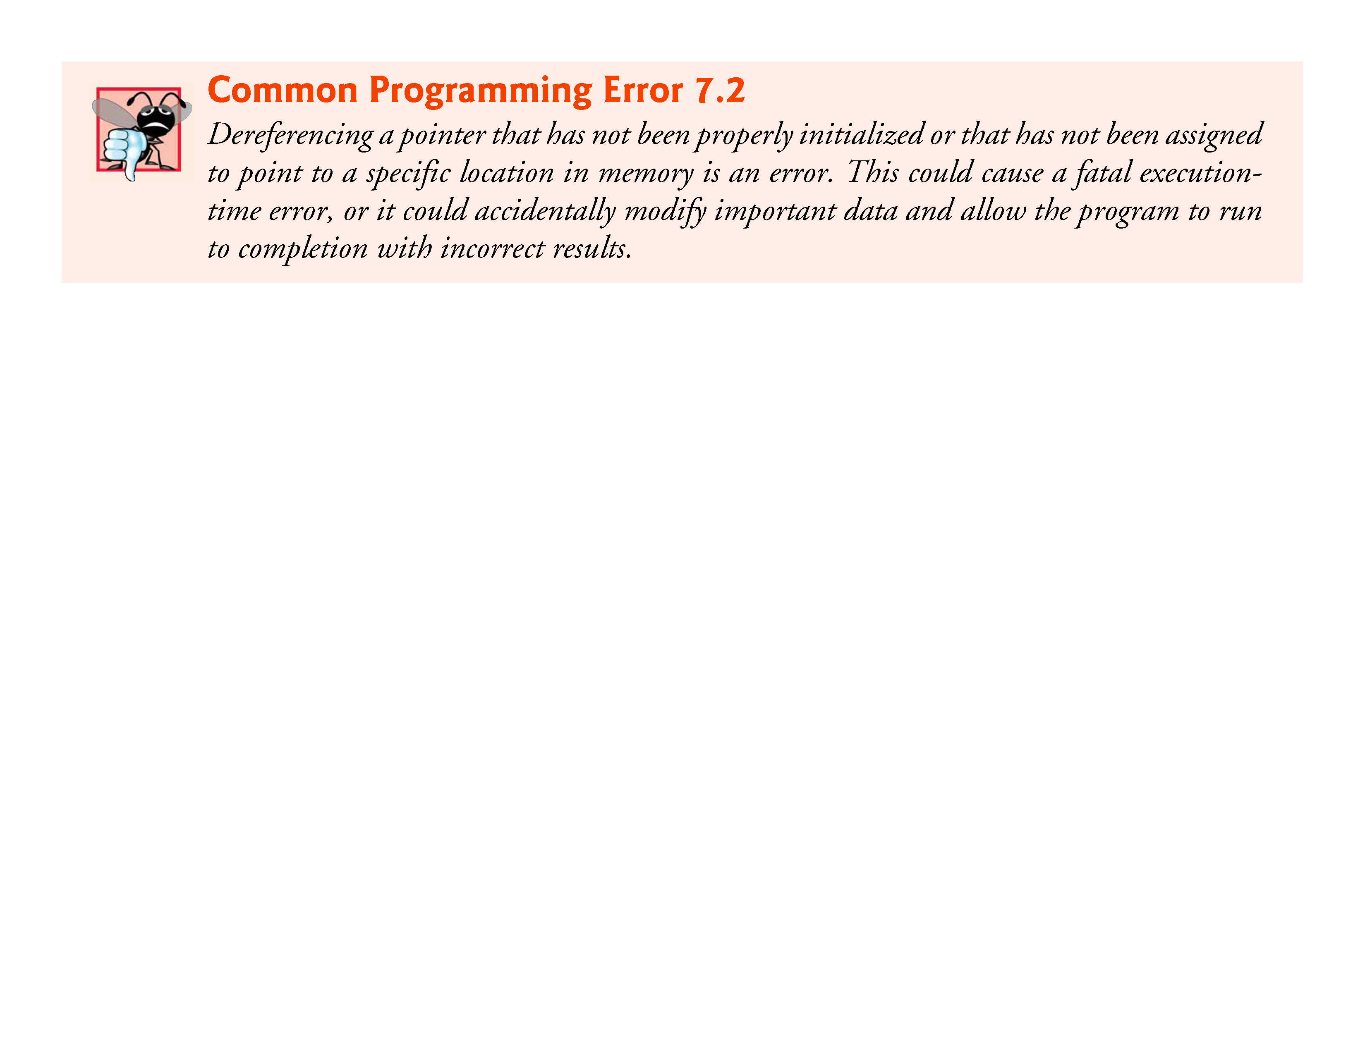

Slide 20
7.3 Pointer Operators (Cont.)
Demonstrating the & and * Operators
Figure 7.4 demonstrates the pointer operators & and *.
The printf conversion specifier %p outputs the memory location as a hexadecimal integer on most platforms.
(See Appendix C, for more information on hexadecimal integers.)
Notice that the address of a and the value of aPtr are identical in the output, thus confirming that the address of a is indeed assigned to the pointer variable aPtr
The & and * operators are complements of one another—when they’re both applied consecutively to aPtr in either order, the same result is printed.
Figure 7.5 lists the precedence and associativity of the operators introduced to this point.

Slide 21
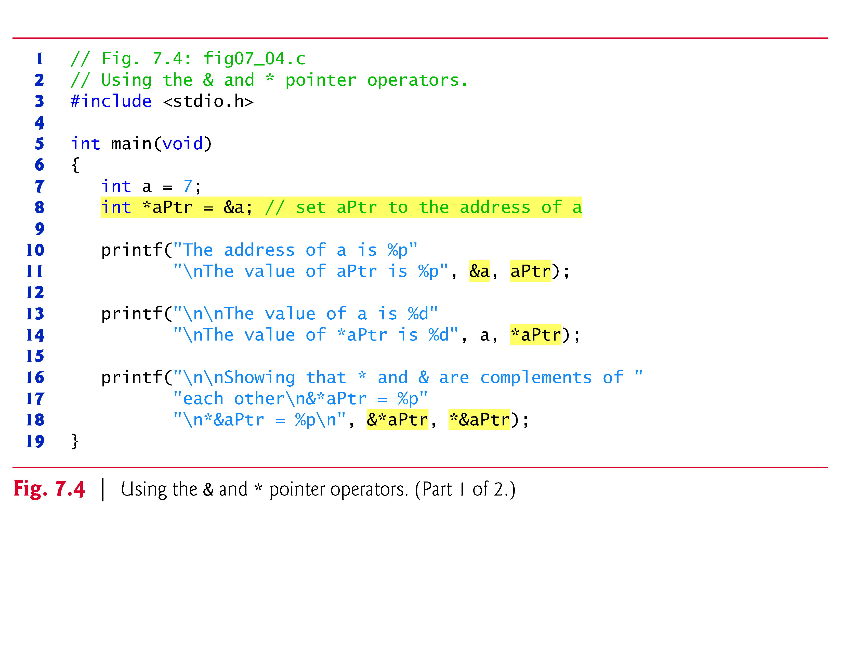

Slide 22
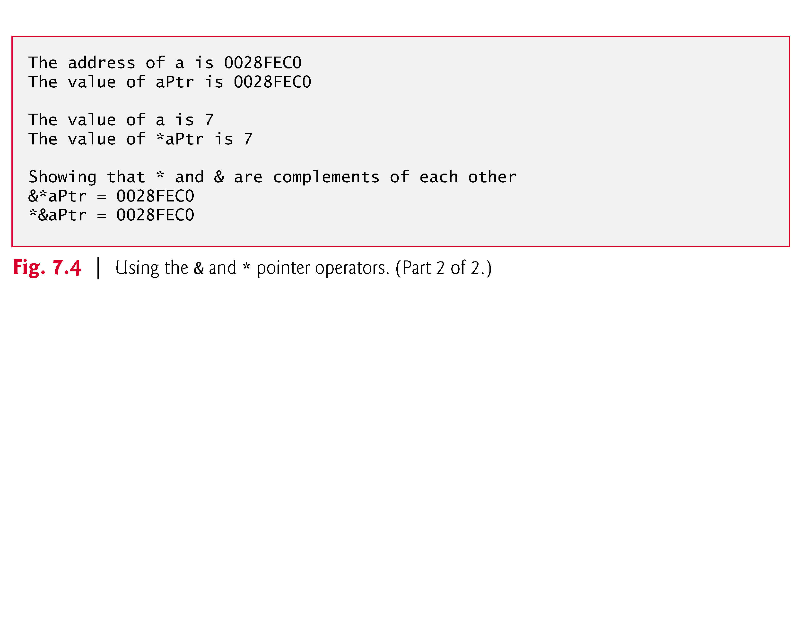

Slide 23
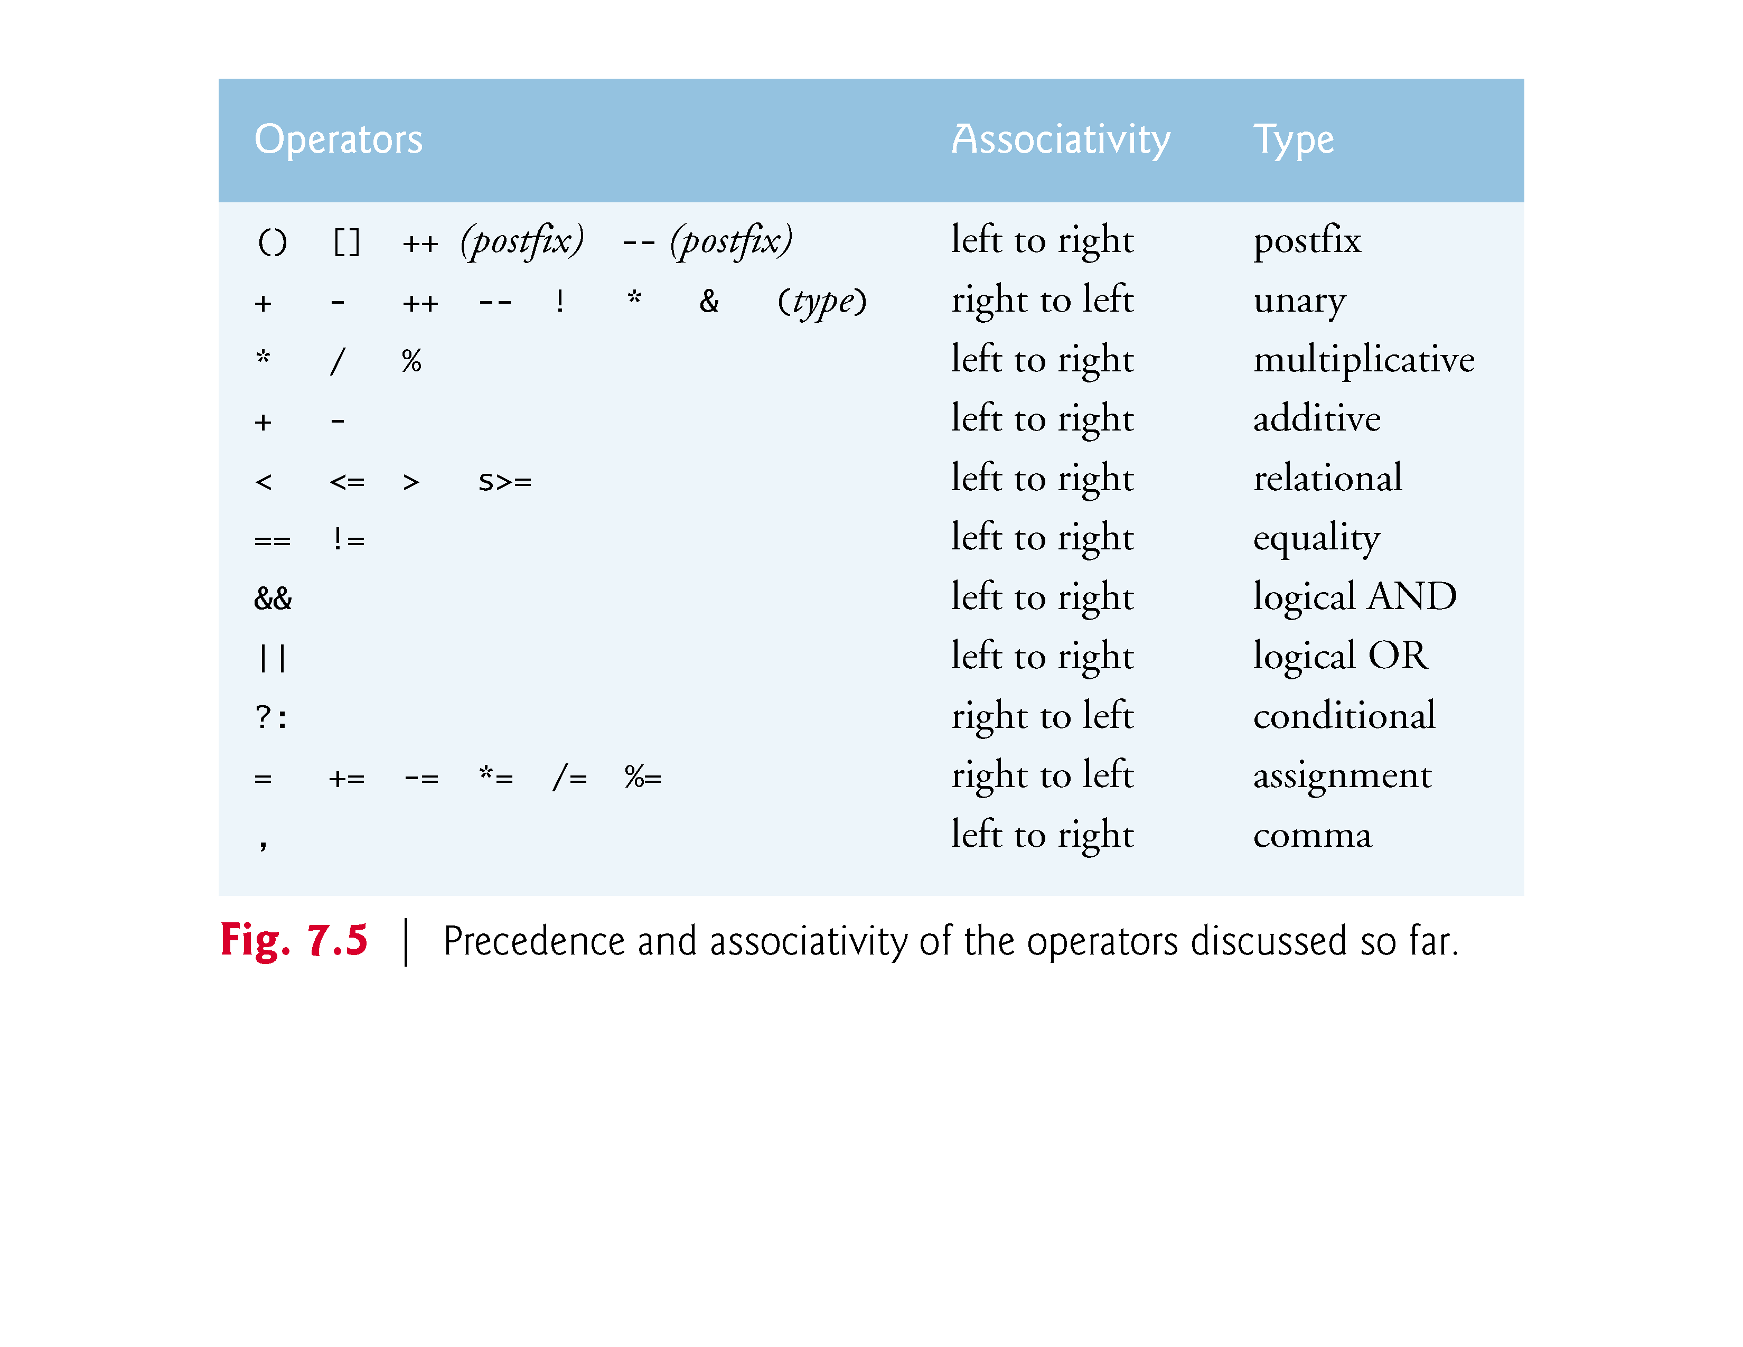

Slide 24
7.4 Passing Arguments to Functions by Reference
There are two ways to pass arguments to a function—pass-by-value and pass-by-reference.
All arguments in C are passed by value.
Many functions require the capability to modify variables in the caller or to pass a pointer to a large data object to avoid the overhead of passing the object by value (which incurs the time and memory overheads of making a copy of the object).
In C, you use pointers and the indirection operator to simulate pass-by-reference.

Slide 25
7.4 Passing Arguments to Functions by Reference (Cont.)
When calling a function with arguments that should be modified, the addresses of the arguments are passed.
This is normally accomplished by applying the address operator (&) to the variable (in the caller) whose value will be modified.
As we saw in Chapter 6, arrays are not passed using operator & because C automatically passes the starting location in memory of the array (the name of an array is equivalent to &arrayName[0]).
When the address of a variable is passed to a function, the indirection operator (*) may be used in the function to modify the value at that location in the caller’s memory.

Slide 26
7.4 Passing Arguments to Functions by Reference (Cont.)
Pass-By-Value
The programs in Fig. 7.6 and Fig. 7.7 present two versions of a function that cubes an integer—cubeByValue and cubeByReference.
Figure 7.6 passes the variable number by value to function cubeByValue
The cubeByValue function cubes its argument and passes the new value back to main using a return statement.
The new value is assigned to number in main

Slide 27
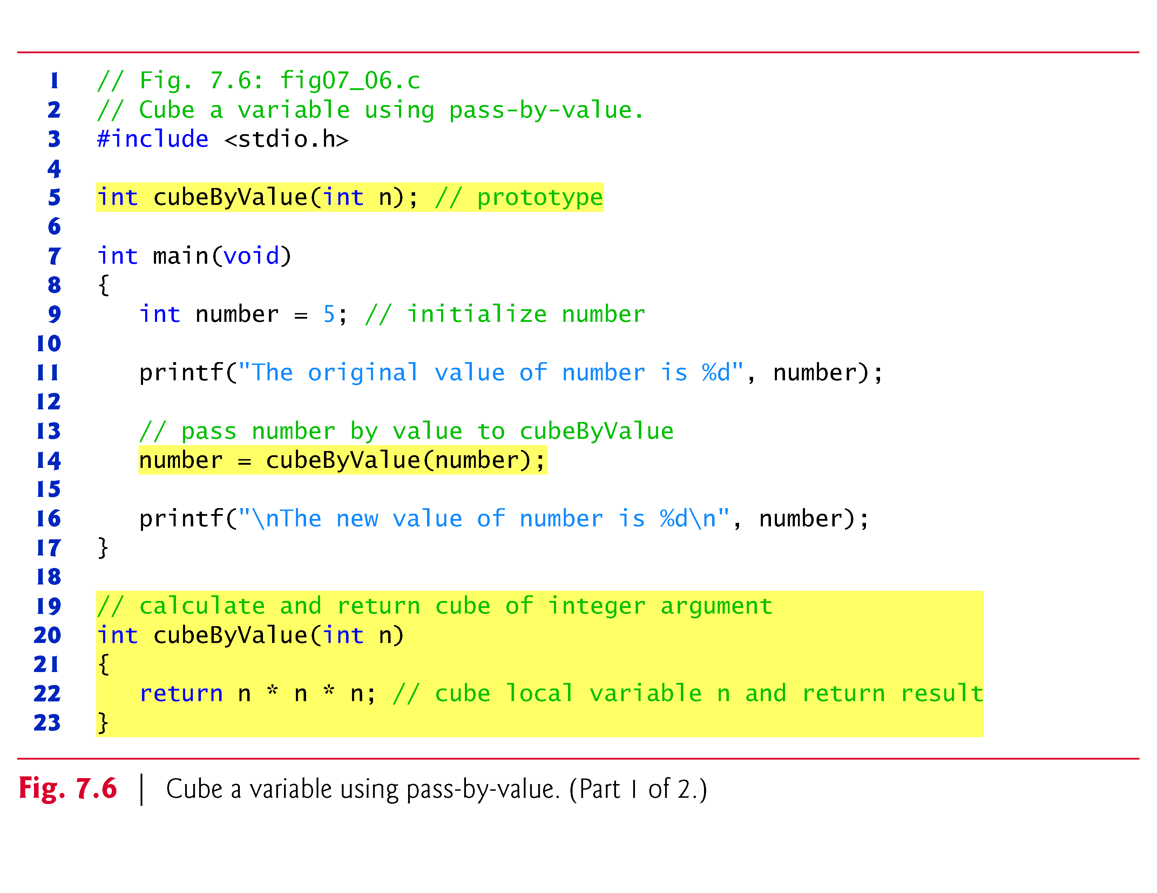

Slide 28
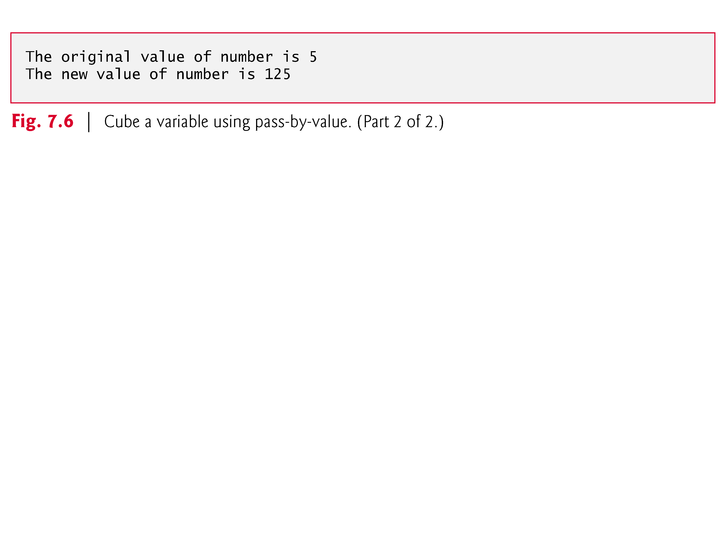

Slide 29
7.4 Passing Arguments to Functions by Reference (Cont.)
Pass-By-Reference
Figure 7.7 passes the variable number by reference—the address of number is passed—to function cubeByReference.
Function cubeByReference takes as a parameter a pointer to an int called nPtr.
The function dereferences the pointer and cubes the value to which nPtr points, then assigns the result to *nPtr (which is really number in main), thus changing the value of number in main.
Figure 7.8 and Fig. 7.9 analyze graphically and step-by-step the programs in Fig. 7.6 and Fig. 7.7, respectively.

Slide 30
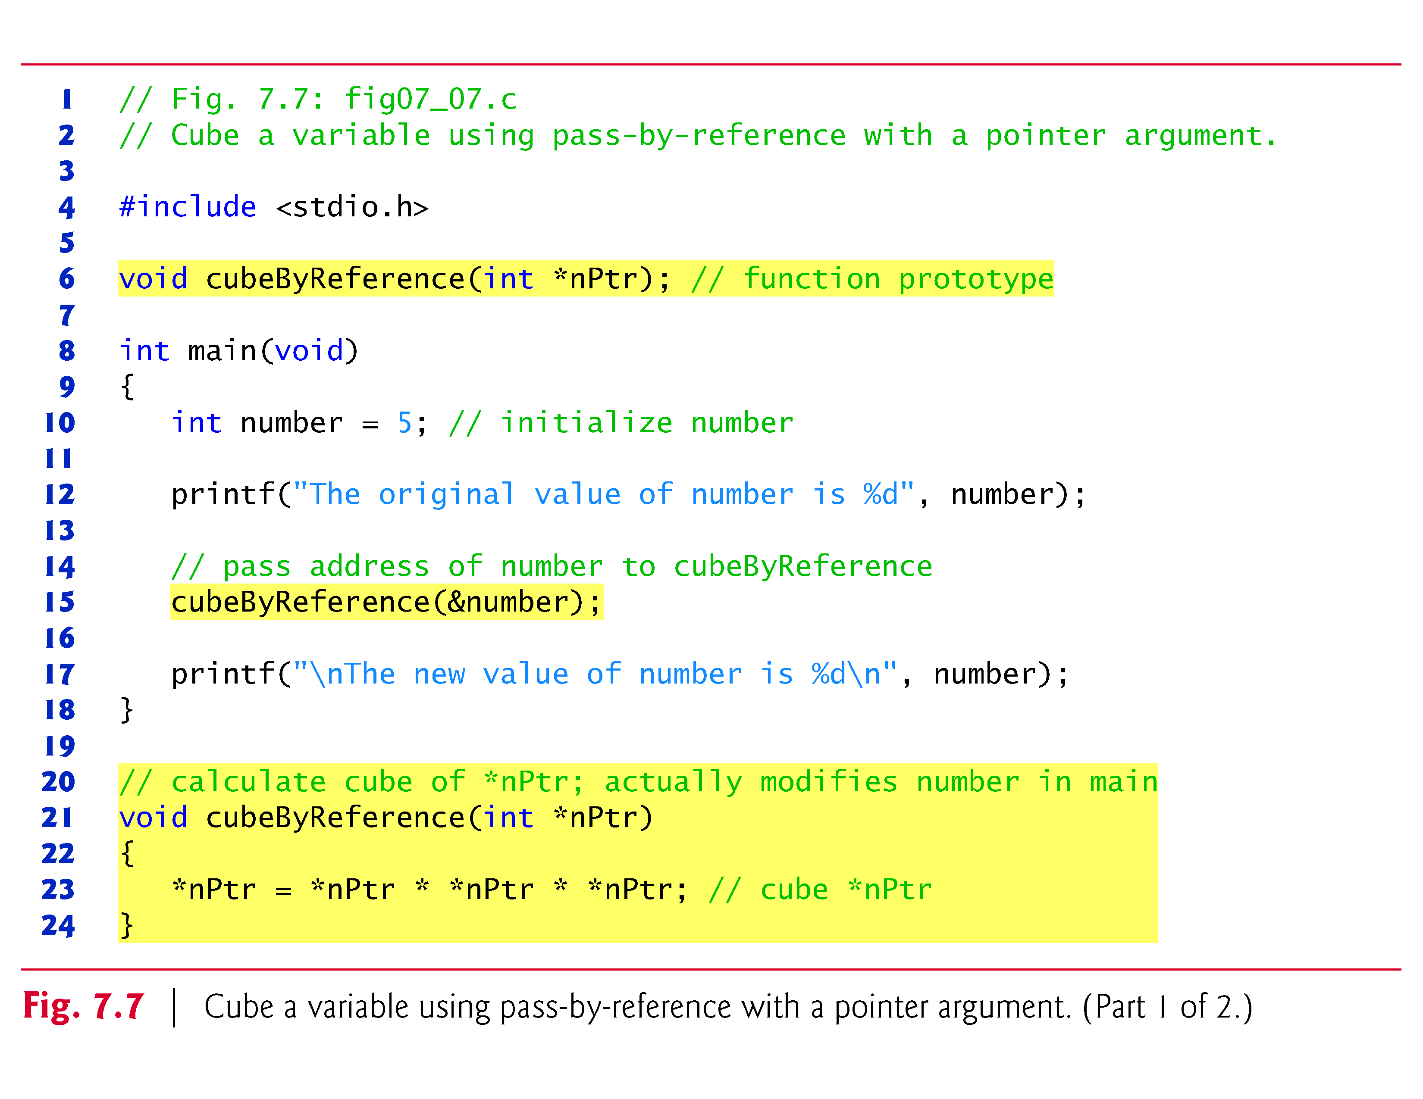

Slide 31
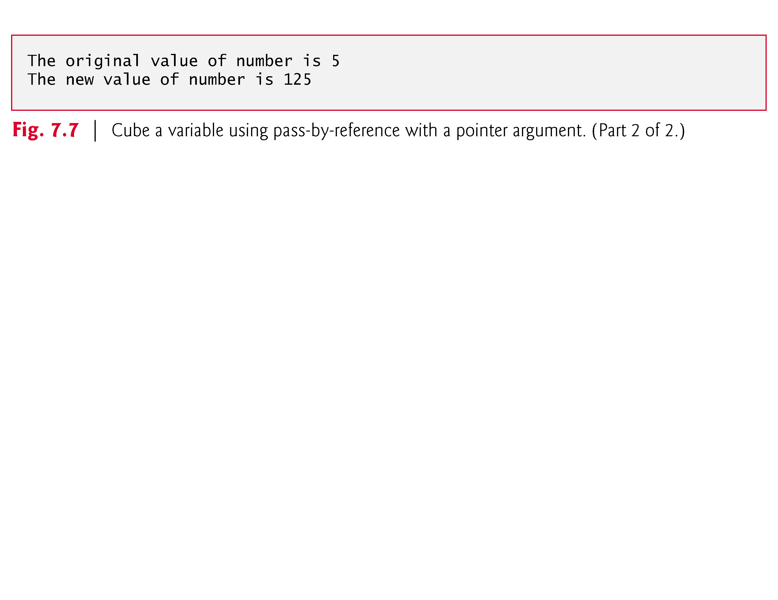

Slide 32
7.4 Passing Arguments to Functions by Reference (Cont.)
A function receiving an address as an argument must define a pointer parameter to receive the address.
For example, in Fig. 7.7 the header for function cubeByReference is:
void cubeByReference(int *nPtr)
The header specifies that cubeByReference receives the address of an integer variable as an argument, stores the address locally in nPtr and does not return a value.
The function prototype for cubeByReference contains int * in parentheses.
Names included for documentation purposes are ignored by the C compiler.

Slide 33
7.4 Passing Arguments to Functions by Reference (Cont.)
For a function that expects a one-dimensional array as an argument, the function’s prototype and header can use the pointer notation shown in the parameter list of function cubeByReference.
The compiler does not differentiate between a function that receives a pointer and one that receives a one-dimensional array.
This, of course, means that the function must “know” when it’s receiving an array or simply a single variable for which it’s to perform pass-by-reference.
When the compiler encounters a function parameter for a one-dimensional array of the form int b[], the compiler converts the parameter to the pointer notation int *b.
The two forms are interchangeable.

Slide 34
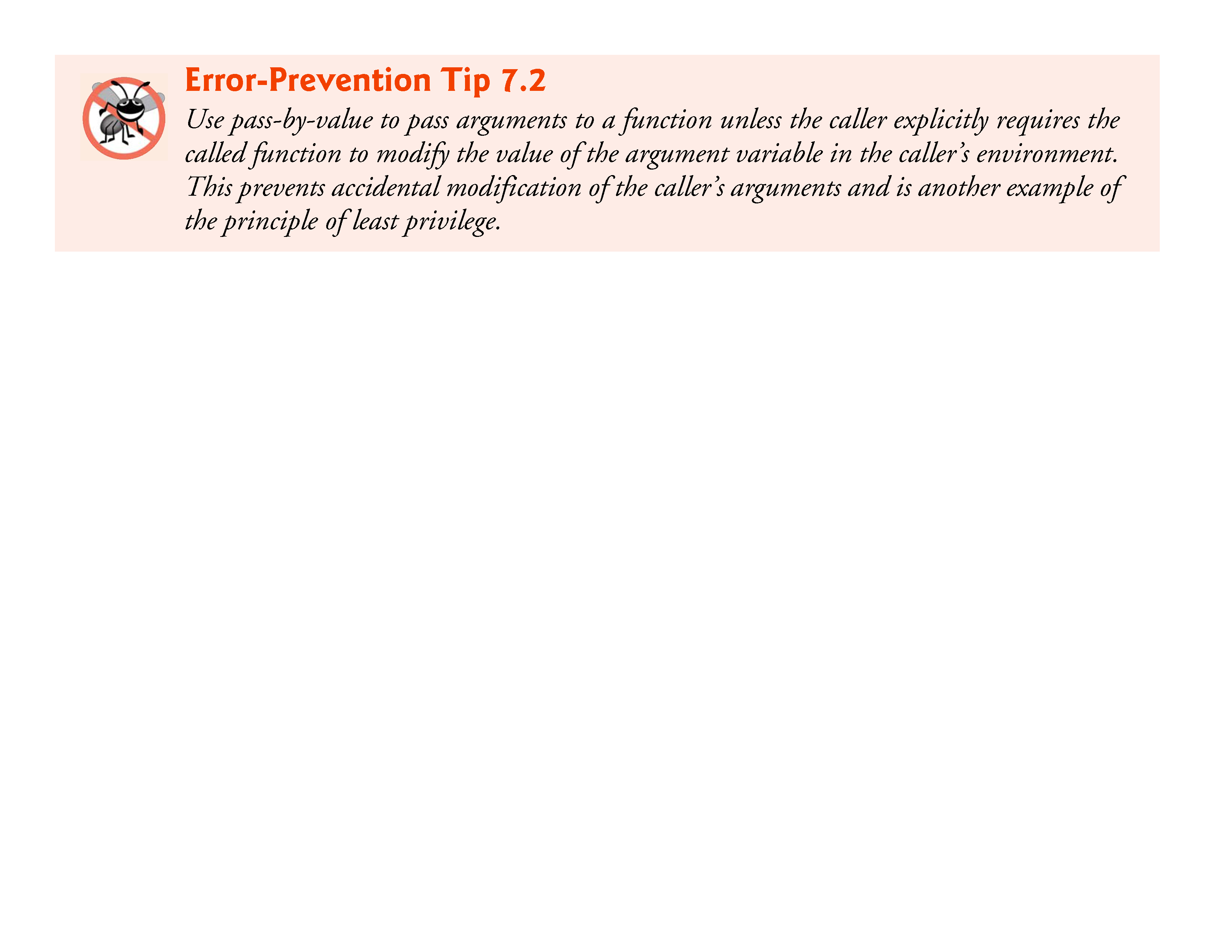

Slide 35
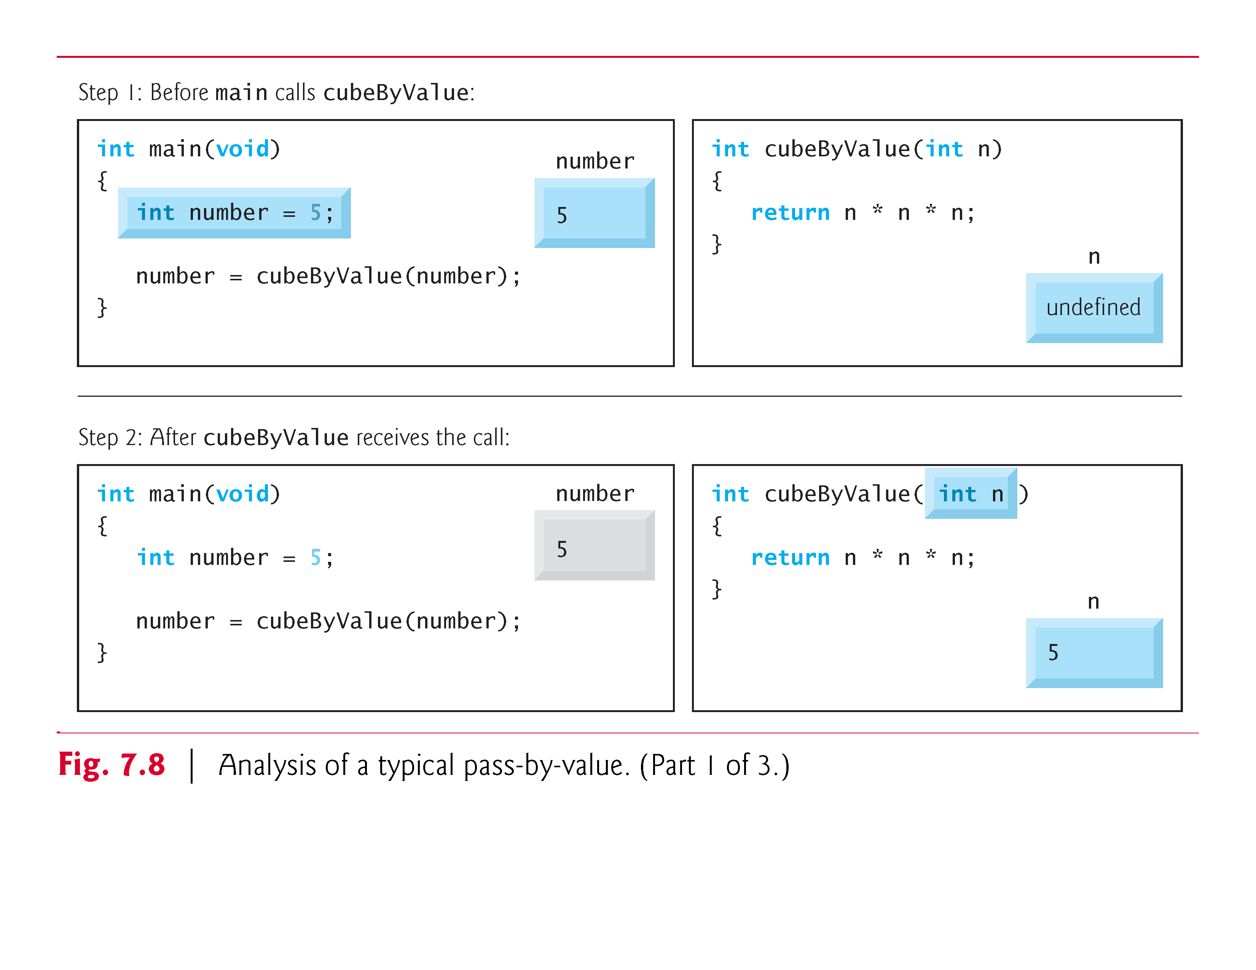

Slide 36
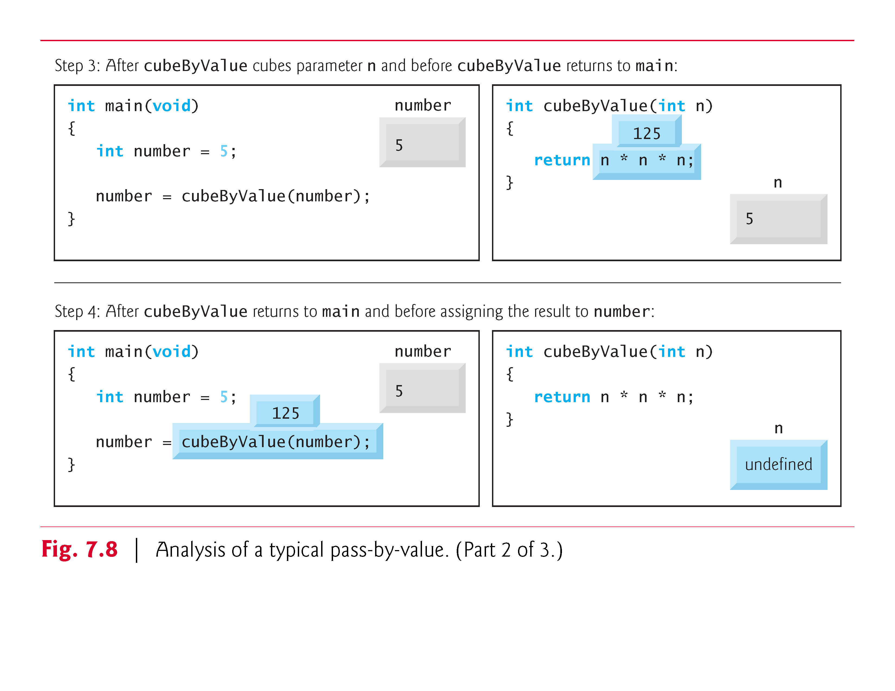

Slide 37
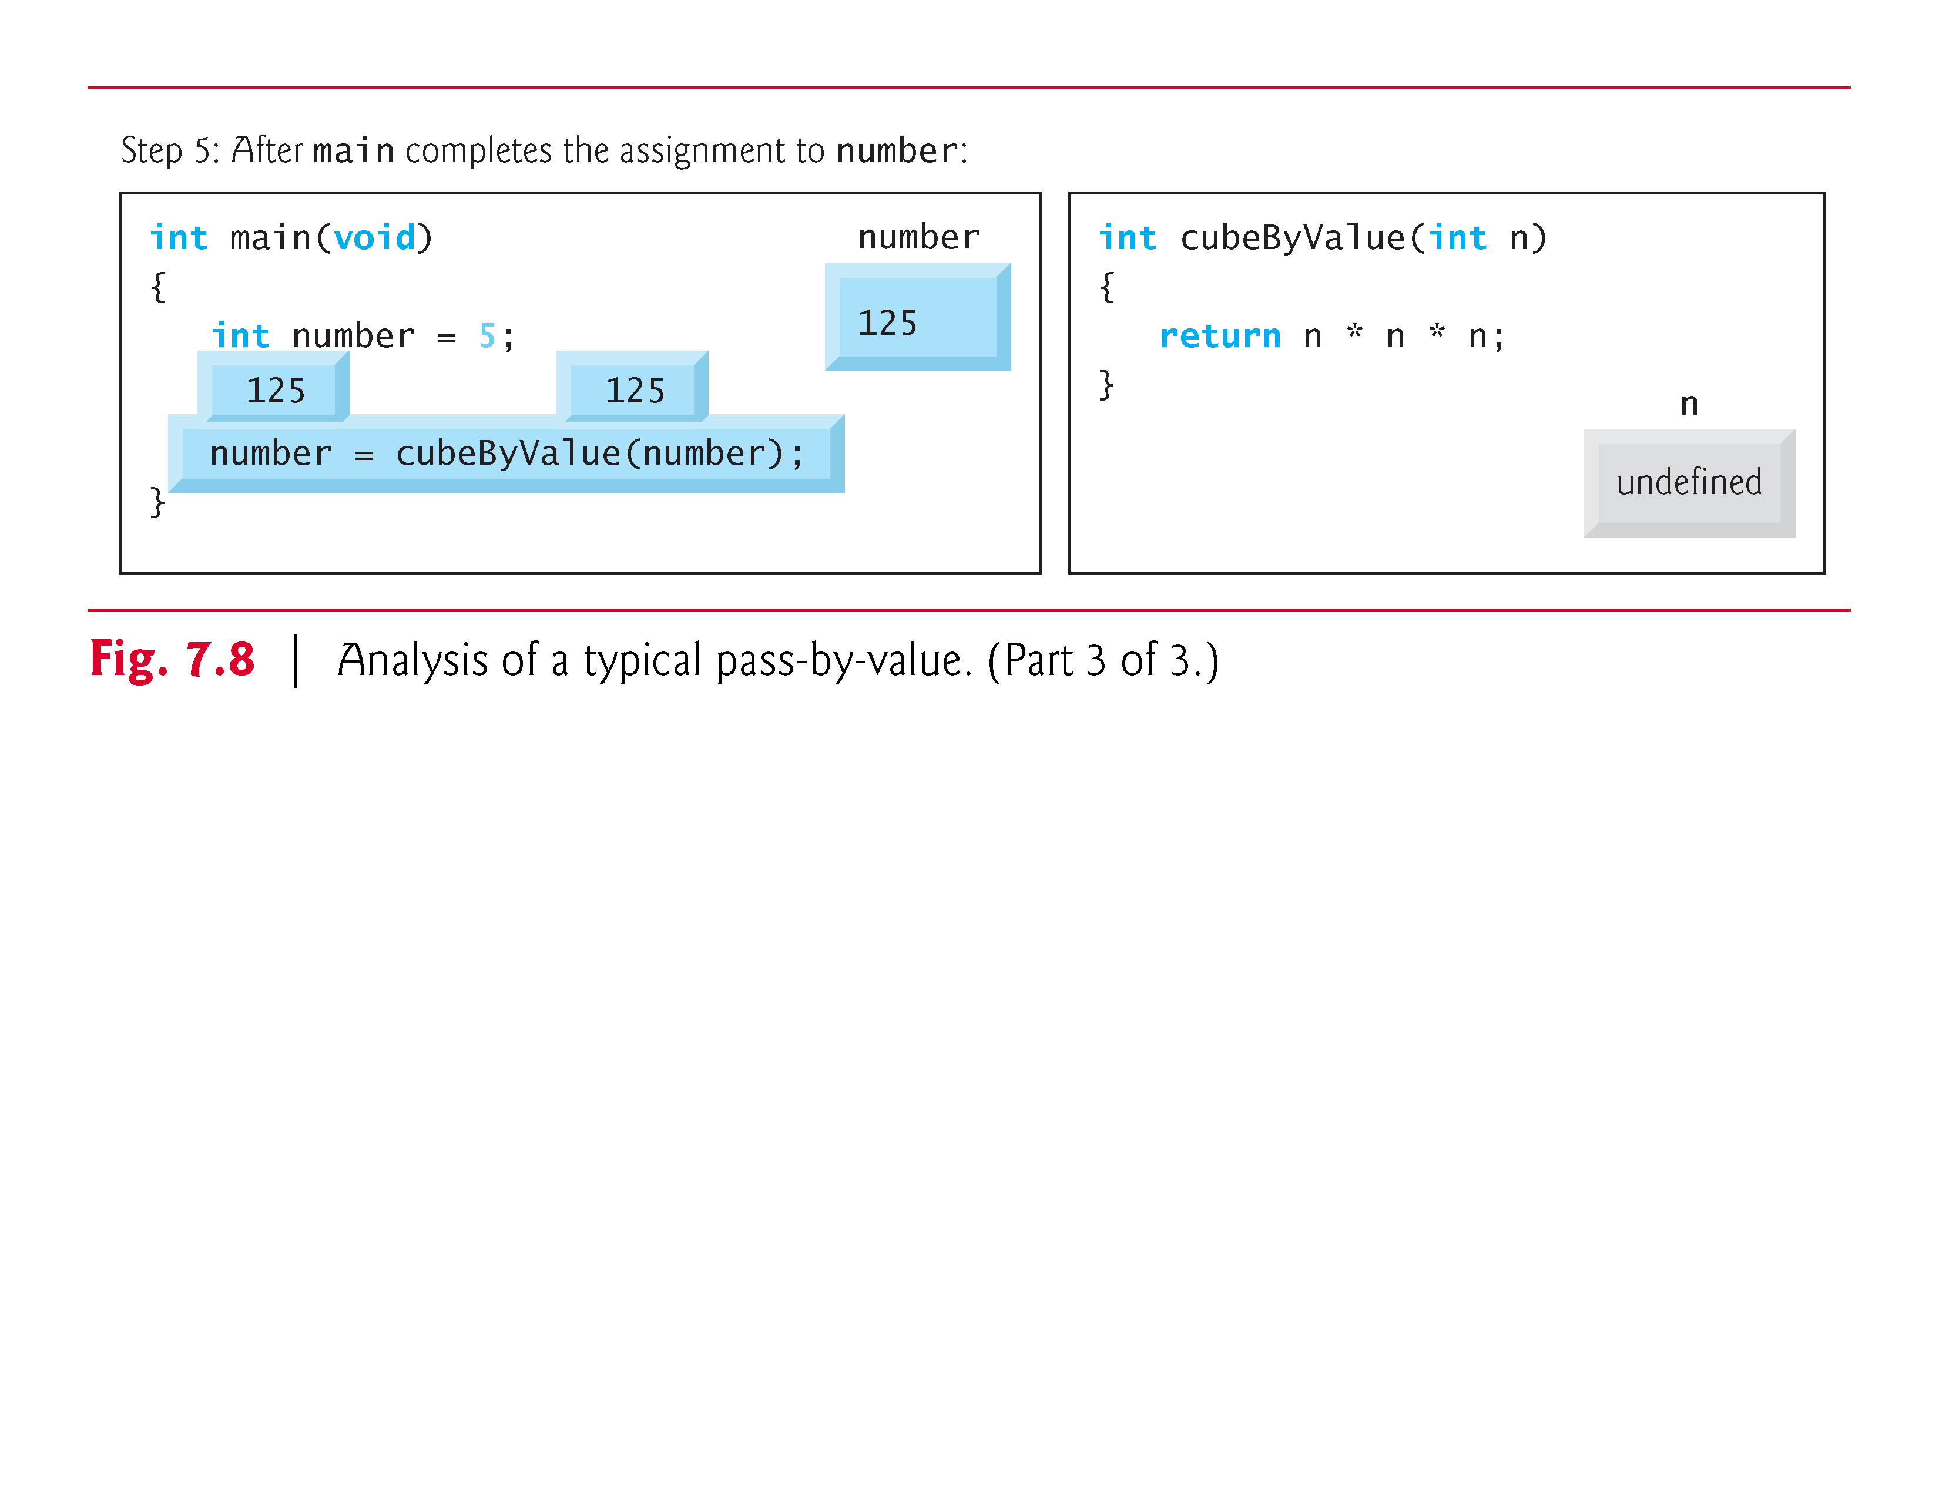

Slide 38
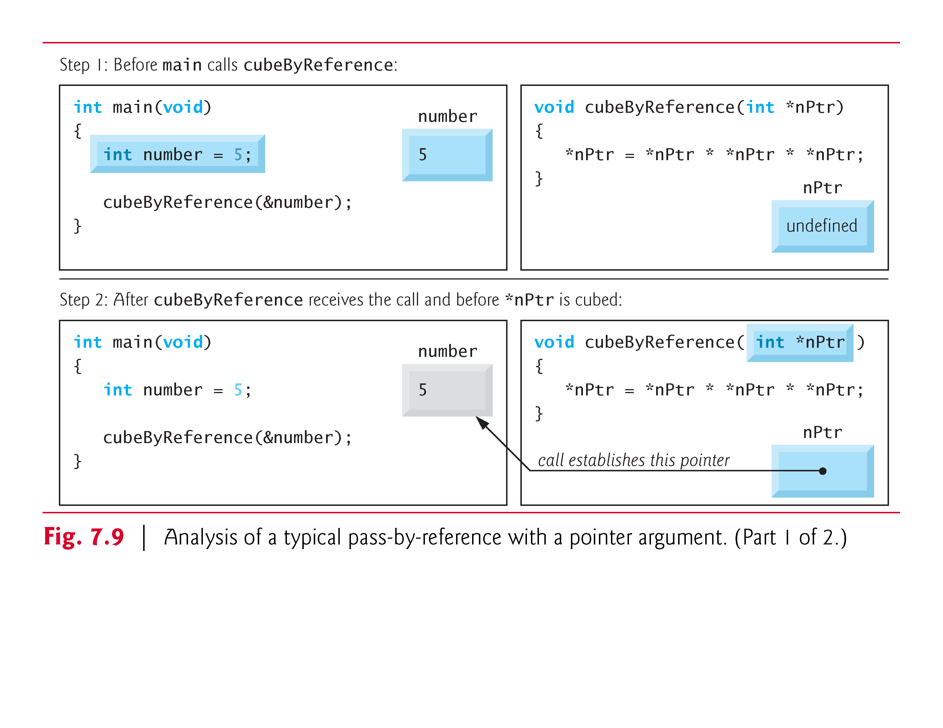

Slide 39
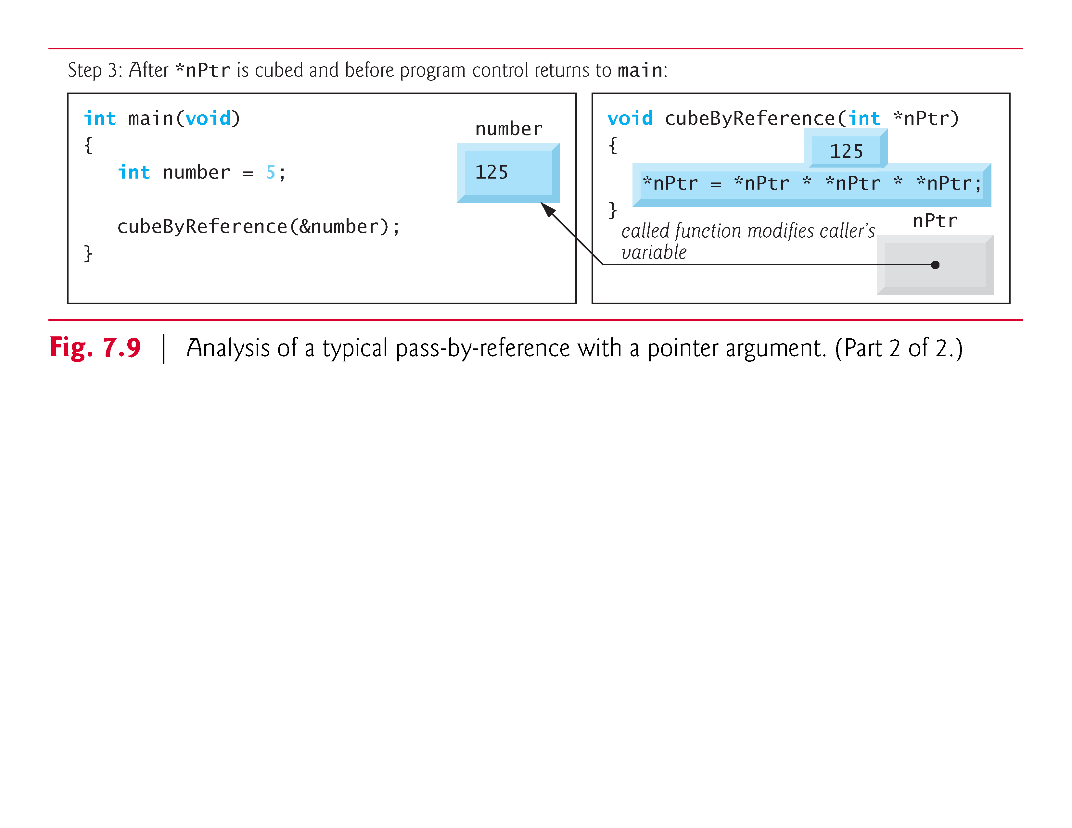

Slide 40
7.5 Using the const Qualifier with Pointers
The const qualifier enables you to inform the compiler that the value of a particular variable should not be modified.

Slide 41
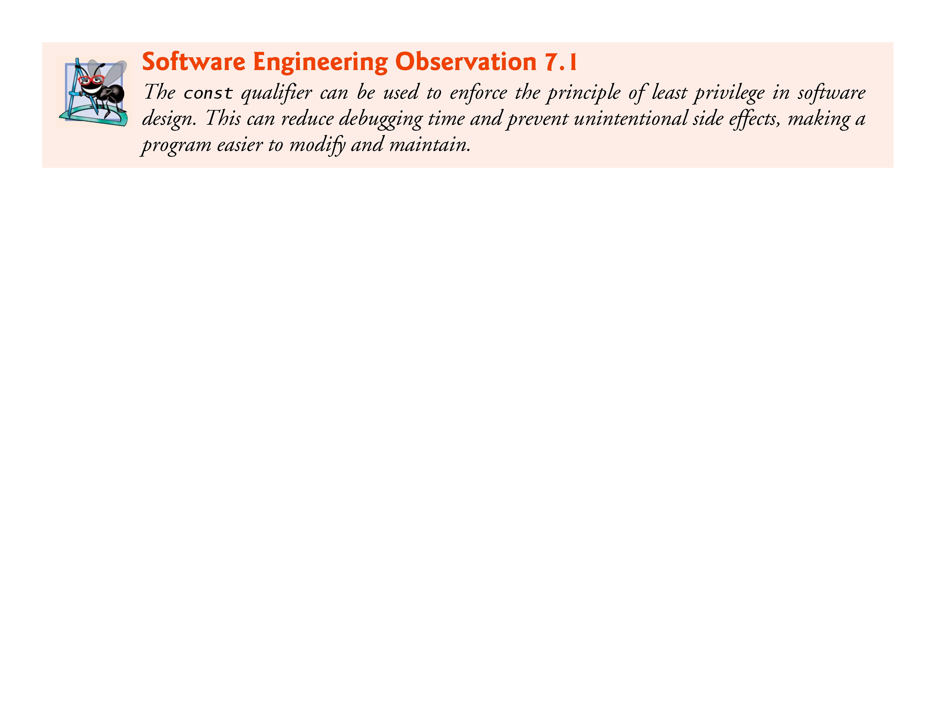

Slide 42
7.5 Using the const Qualifier with Pointers (Cont.)
Over the years, a large base of legacy code was written in early versions of C that did not use const because it was not available.
For this reason, there are significant opportunities for improvement by reengineering old C code.
Six possibilities exist for using (or not using) const with function parameters—two with pass-by-value parameter passing and four with pass-by-reference parameter passing.
How do you choose one of the six possibilities? Let the principle of least privilege be your guide.
Always award a function enough access to the data in its parameters to accomplish its specified task, but absolutely no more.

Slide 43
7.5 Using the const Qualifier with Pointers (Cont.)
In Chapter 5, we explained that all function calls in C are pass-by-value—a copy of the argument in the function call is made and passed to the function.
If the copy is modified in the function, the original value in the caller does not change.
In many cases, a value passed to a function is modified so the function can accomplish its task.
However, in some instances, the value should not be altered in the called function, even though it manipulates only a copy of the original value.
Consider a function that takes a one-dimensional array and its size as arguments and prints the array.

Slide 44
7.5 Using the const Qualifier with Pointers (Cont.)
Such a function should loop through the array and output each array element individually.
The size of the array is used in the function body to determine the high index of the array, so the loop can terminate when the printing is completed.
Neither the size of the array nor its contents should change in the function body.

Slide 45
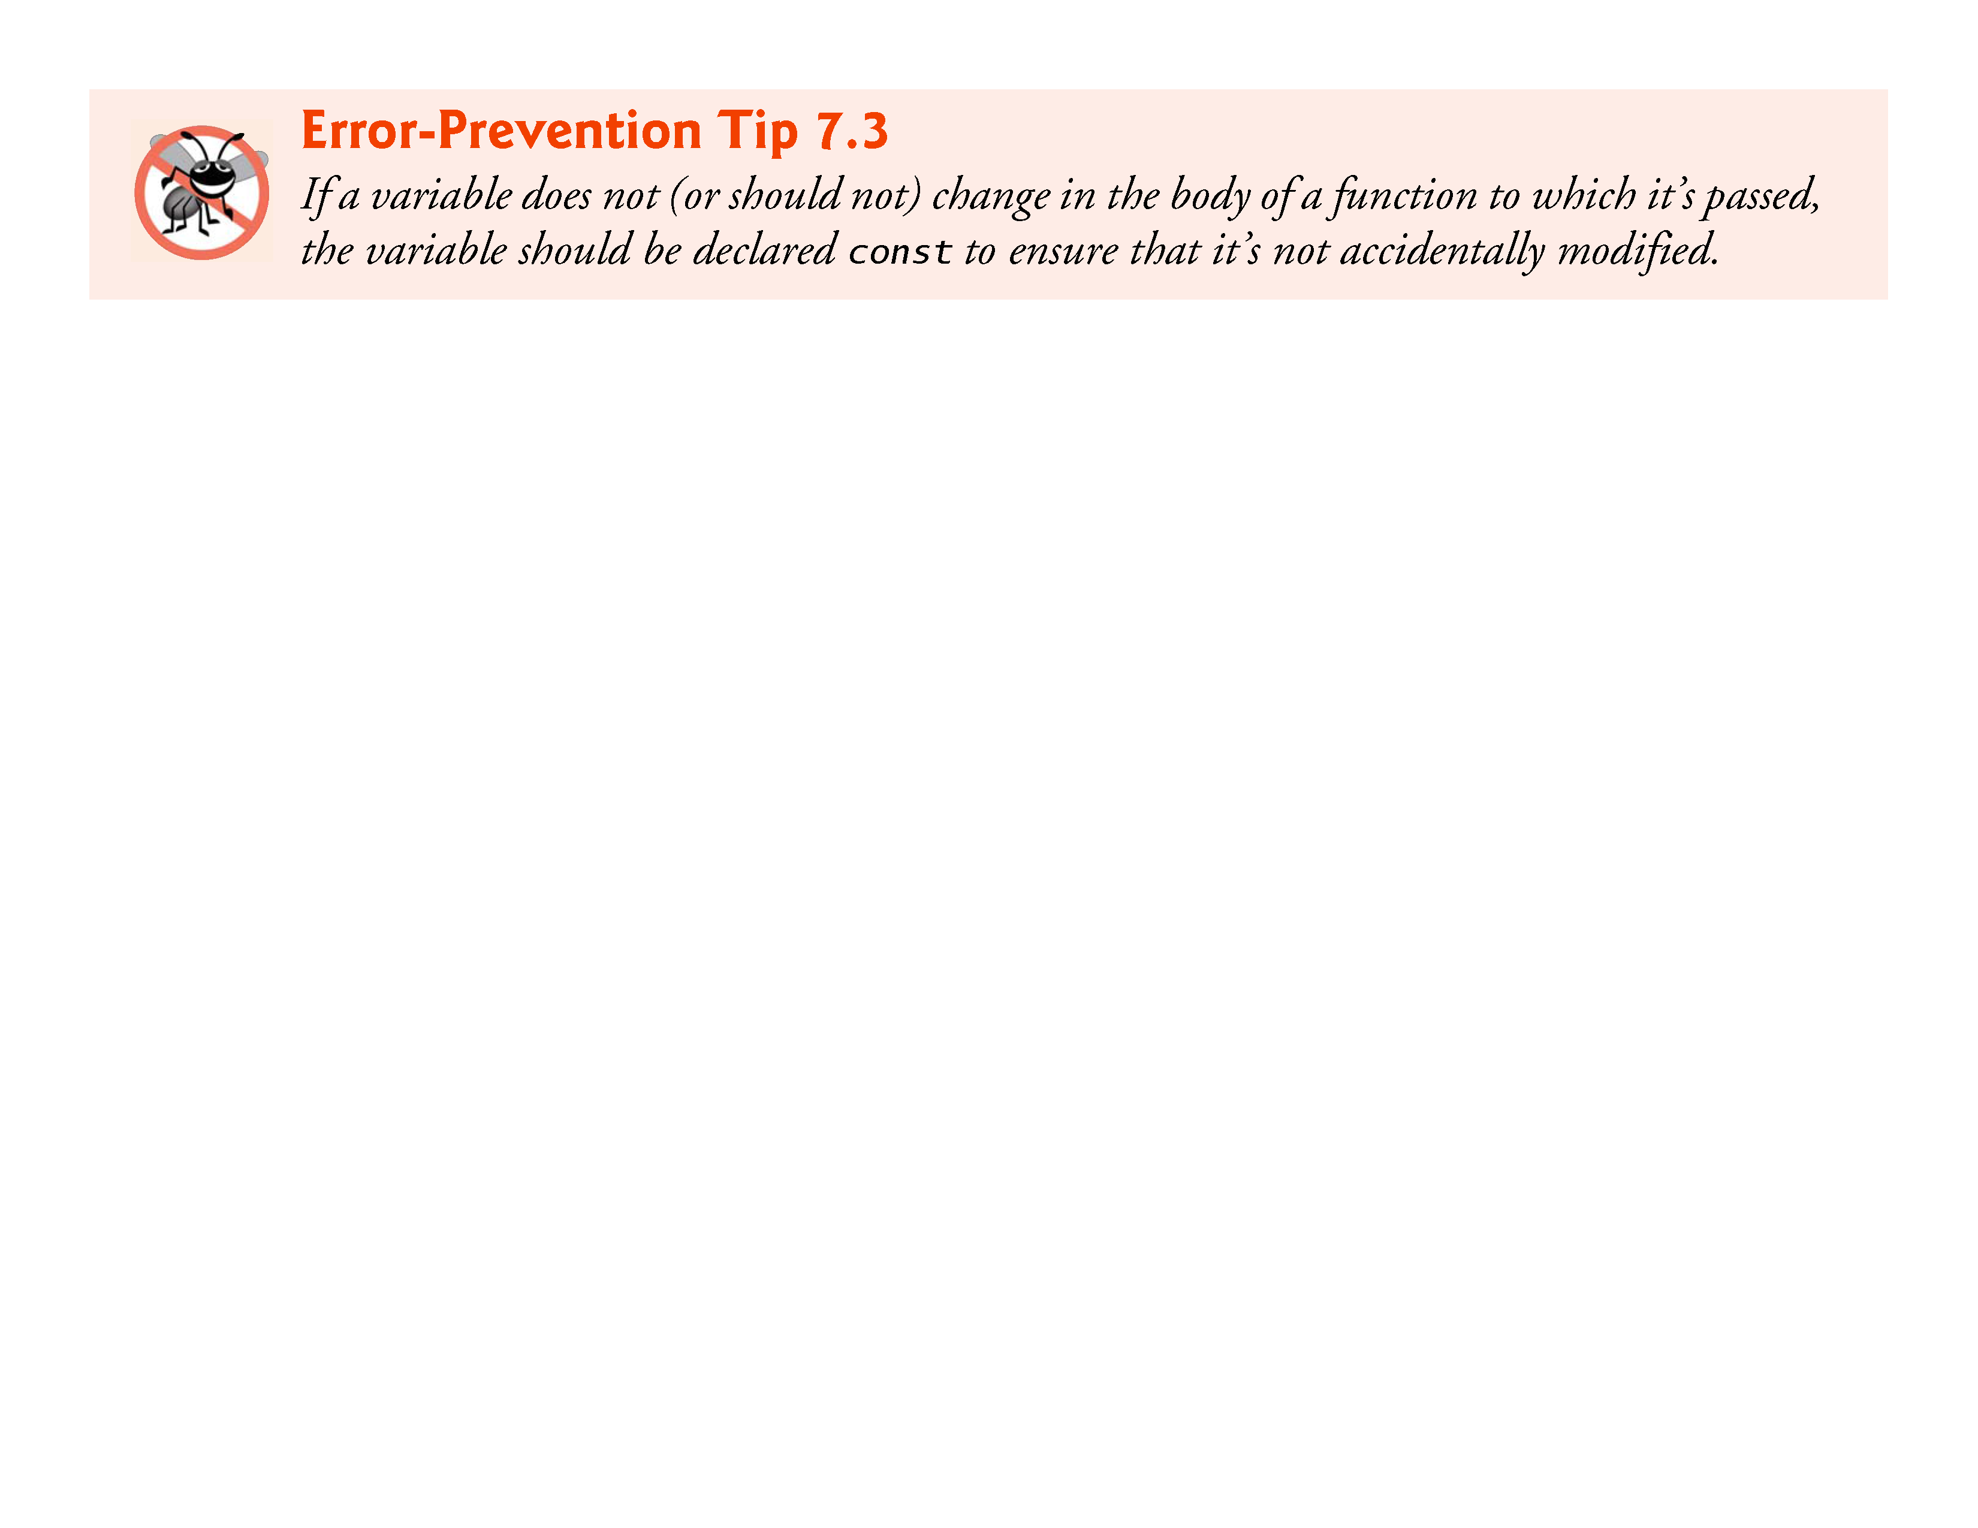

Slide 46
7.5 Using the const Qualifier with Pointers (Cont.)
If an attempt is made to modify a value that’s declared const, the compiler catches it and issues either a warning or an error, depending on the particular compiler.

Slide 47
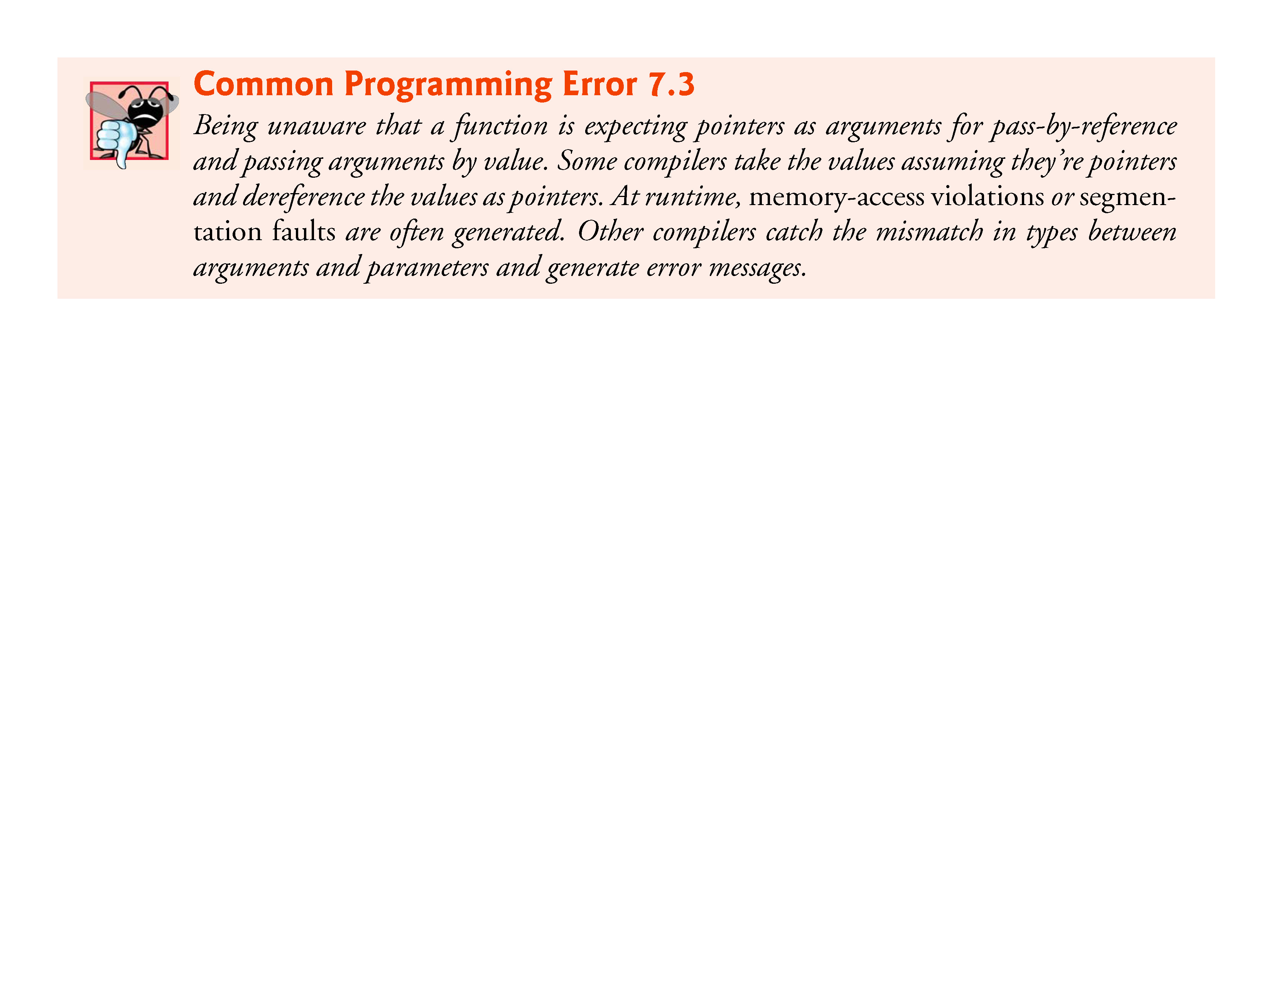

Slide 48
7.5 Using the const Qualifier with Pointers (Cont.)
There are four ways to pass a pointer to a function: a non-constant pointer to non-constant data, a constant pointer to nonconstant data, a non-constant pointer to constant data, and a constant pointer to constant data.
Each of the four combinations provides different access privileges.
These are discussed in the next several examples.

Slide 49
7.5.1 Converting a String to Uppercase Using a Non-Constant Pointer to Non-Constant Data
The highest level of data access is granted by a non-constant pointer to non-constant data.
In this case, the data can be modified through the dereferenced pointer, and the pointer can be modified to point to other data items.
A declaration for a non-constant pointer to non-constant data does not include const.
Such a pointer might be used to receive a string as an argument to a function that processes (and possibly modifies) each character in the string.

Slide 50
7.5.1 Converting a String to Uppercase Using a Non-Constant Pointer to Non-Constant Data (Cont.)
Function convertToUppercase of Fig. 7.10 declares its parameter, a non-constant pointer to non-constant data called sPtr (char *sPtr)
The function processes the array string (pointed to by sPtr) one character at a time.
C standard library function touper from the <ctype.h> header is called to convert each character to its corresponding uppercase letter—if the original character is not a letter or is already uppercase, toupper returns the original character.
Line 23 moves the pointer to the next character in the string.

Slide 51
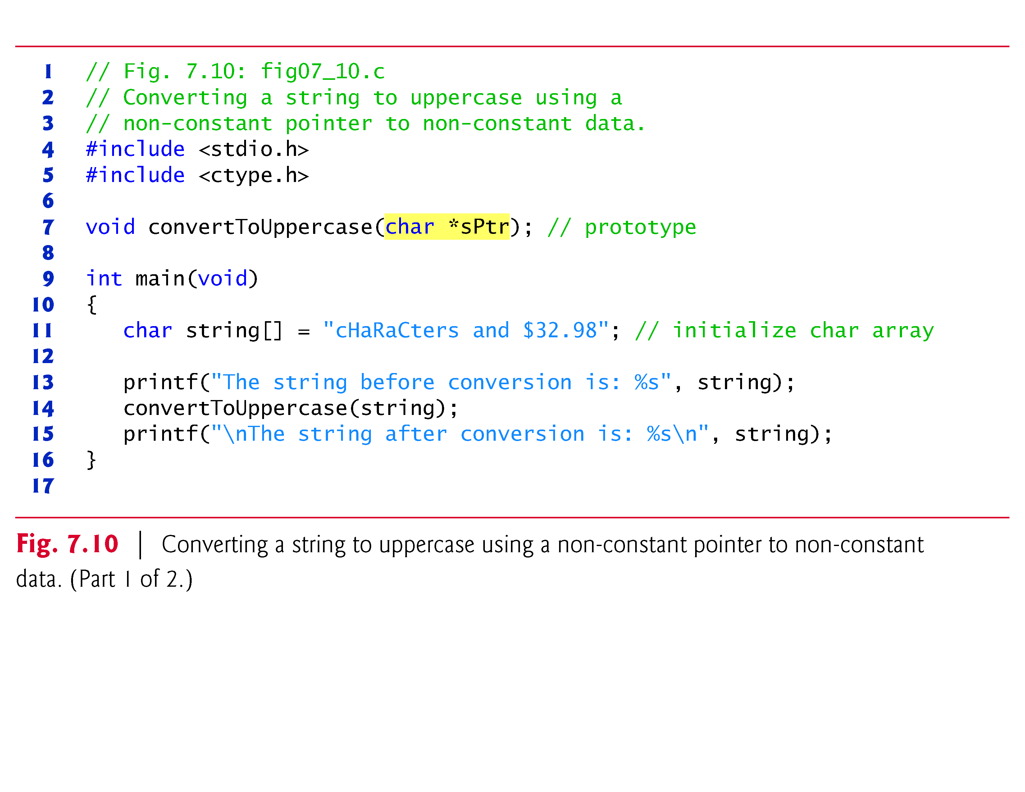

Slide 52
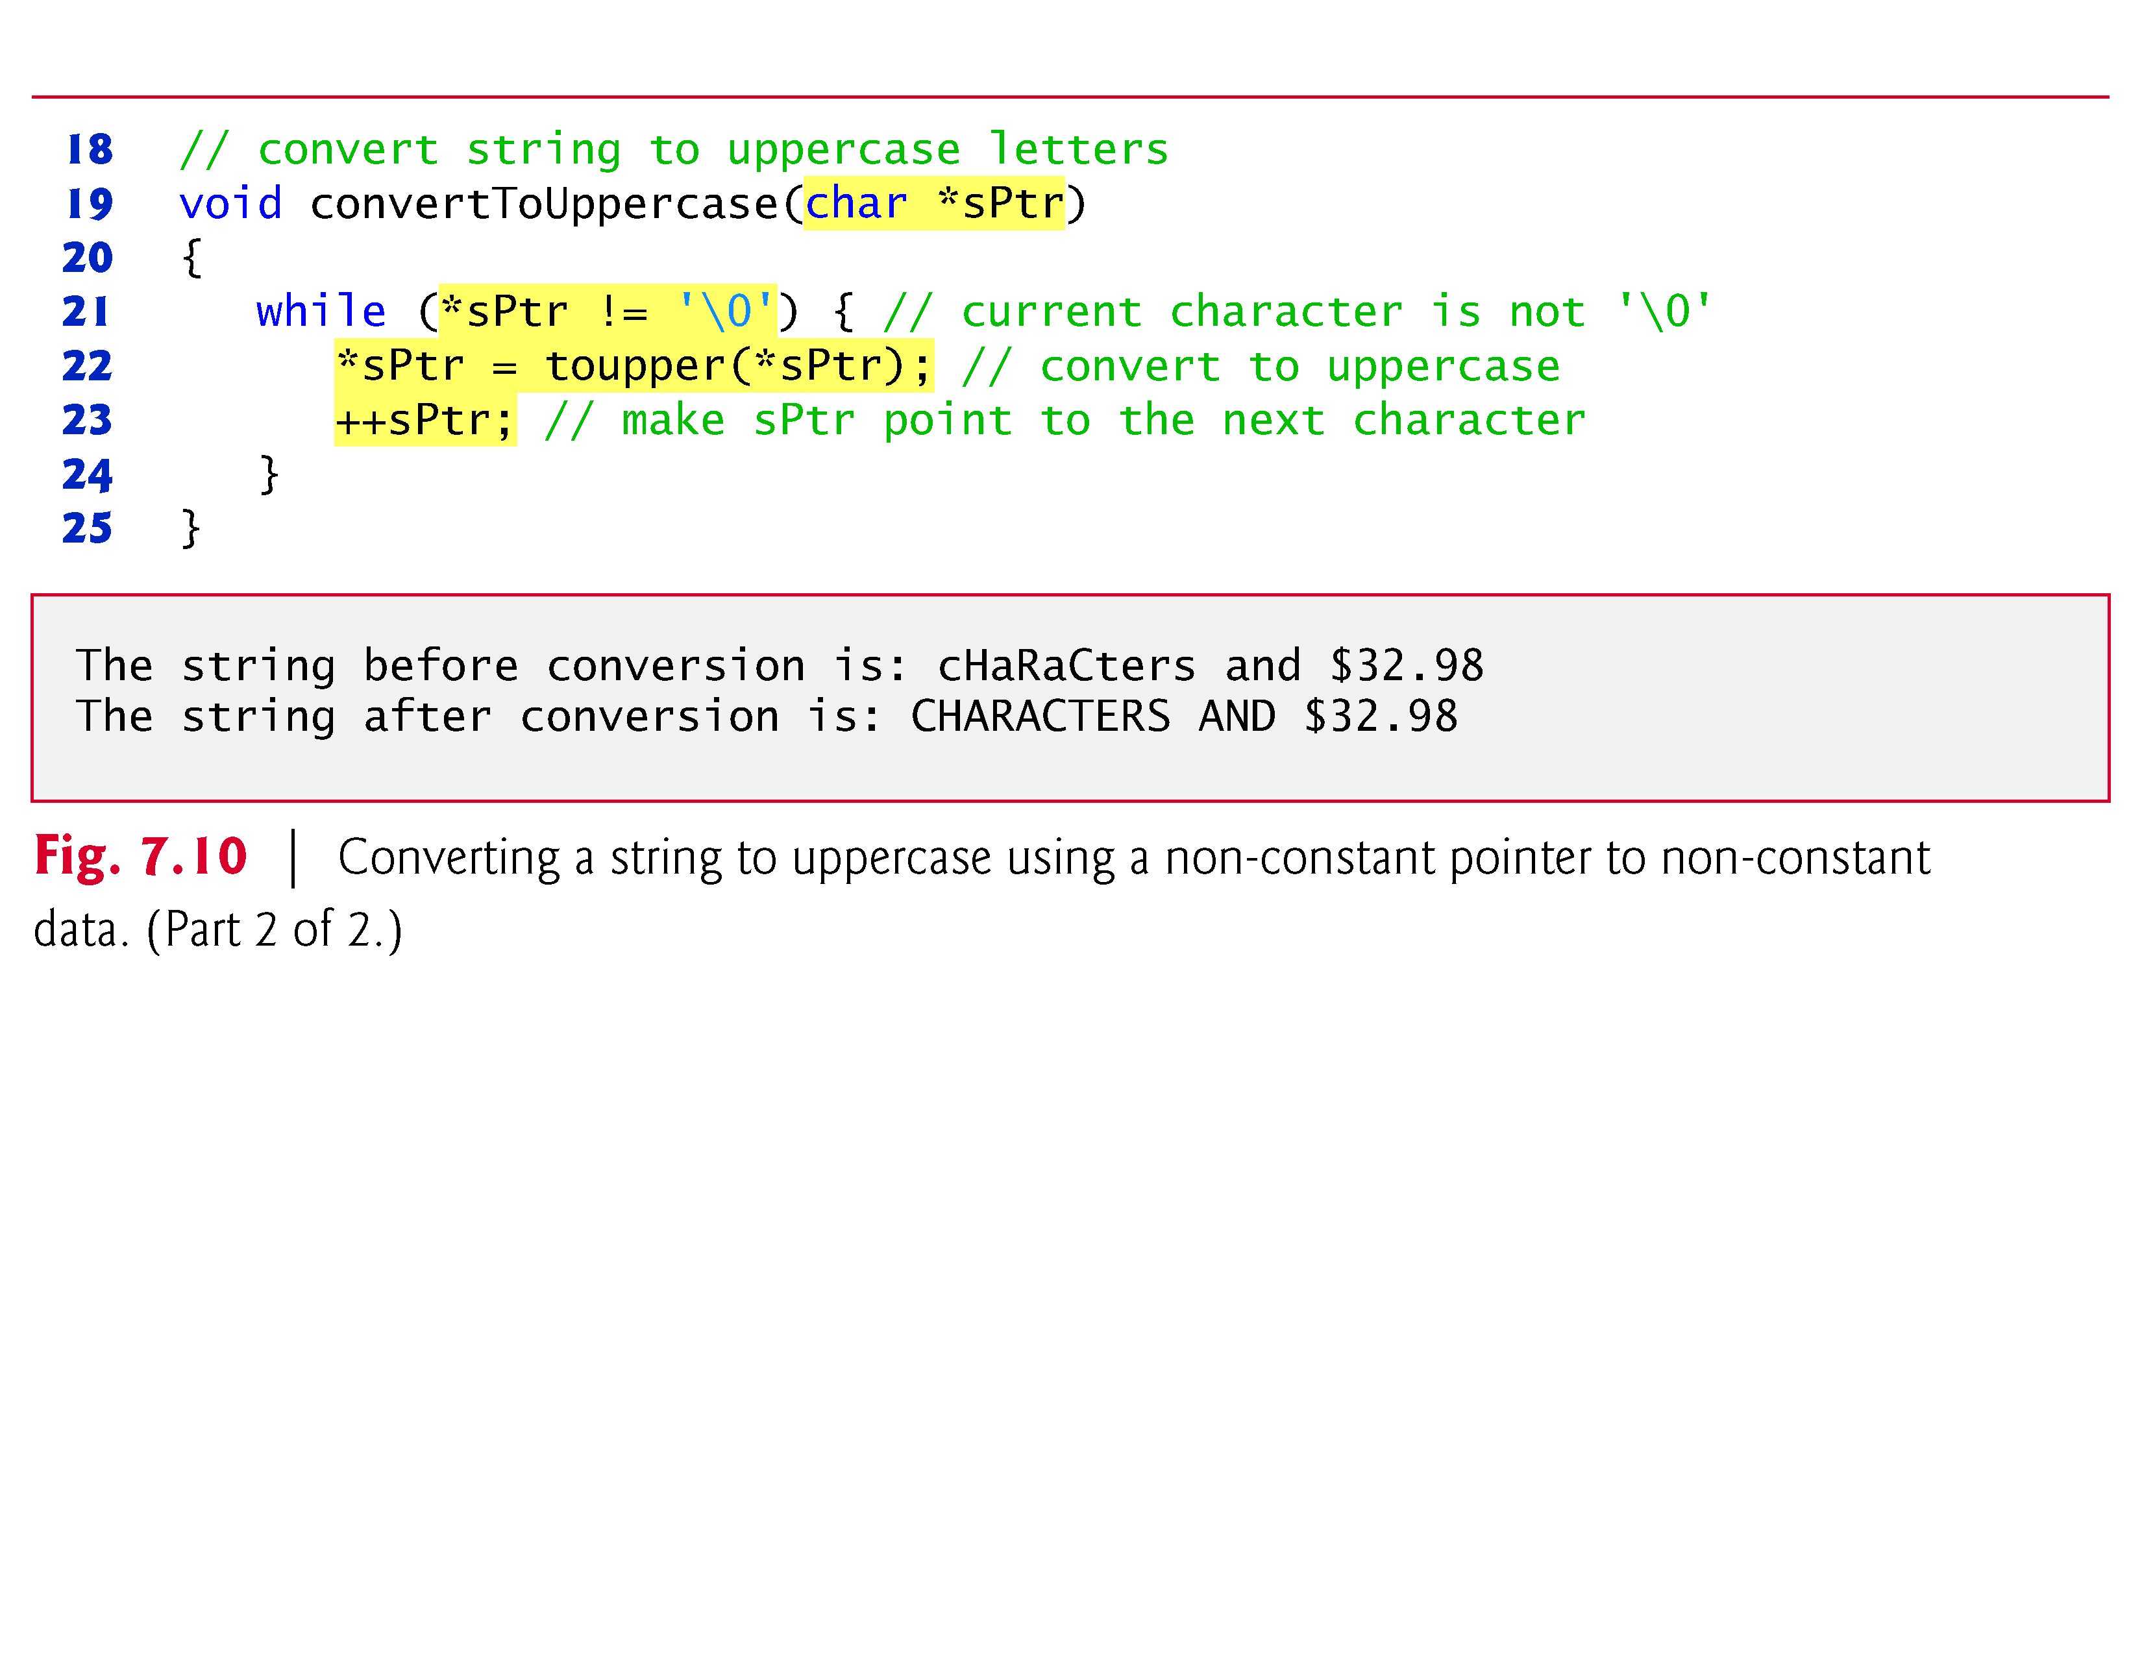

Slide 53
7.5.2 Printing a String One Character at a Time Using a Non-Constant Pointer to Constant Data
A non-constant pointer to constant data can be modified to point to any data item of the appropriate type, but the data to which it points cannot be modified.
Such a pointer might be used to receive an array argument to a function that will process each element without modifying the data.

Slide 54
7.5.2 Printing a String One Character at a Time Using a Non-Constant Pointer to Constant Data (Cont.)
For example, function printCharacters (Fig. 7.11) declares parameter sPtr to be of type const char *
The declaration is read from right to left as “sPtr is a pointer to a character constant.” The function uses a for statement to output each character in the string until the null character is encountered.
After each character is printed, pointer sPtr is incremented to point to the next character in the string.

Slide 55
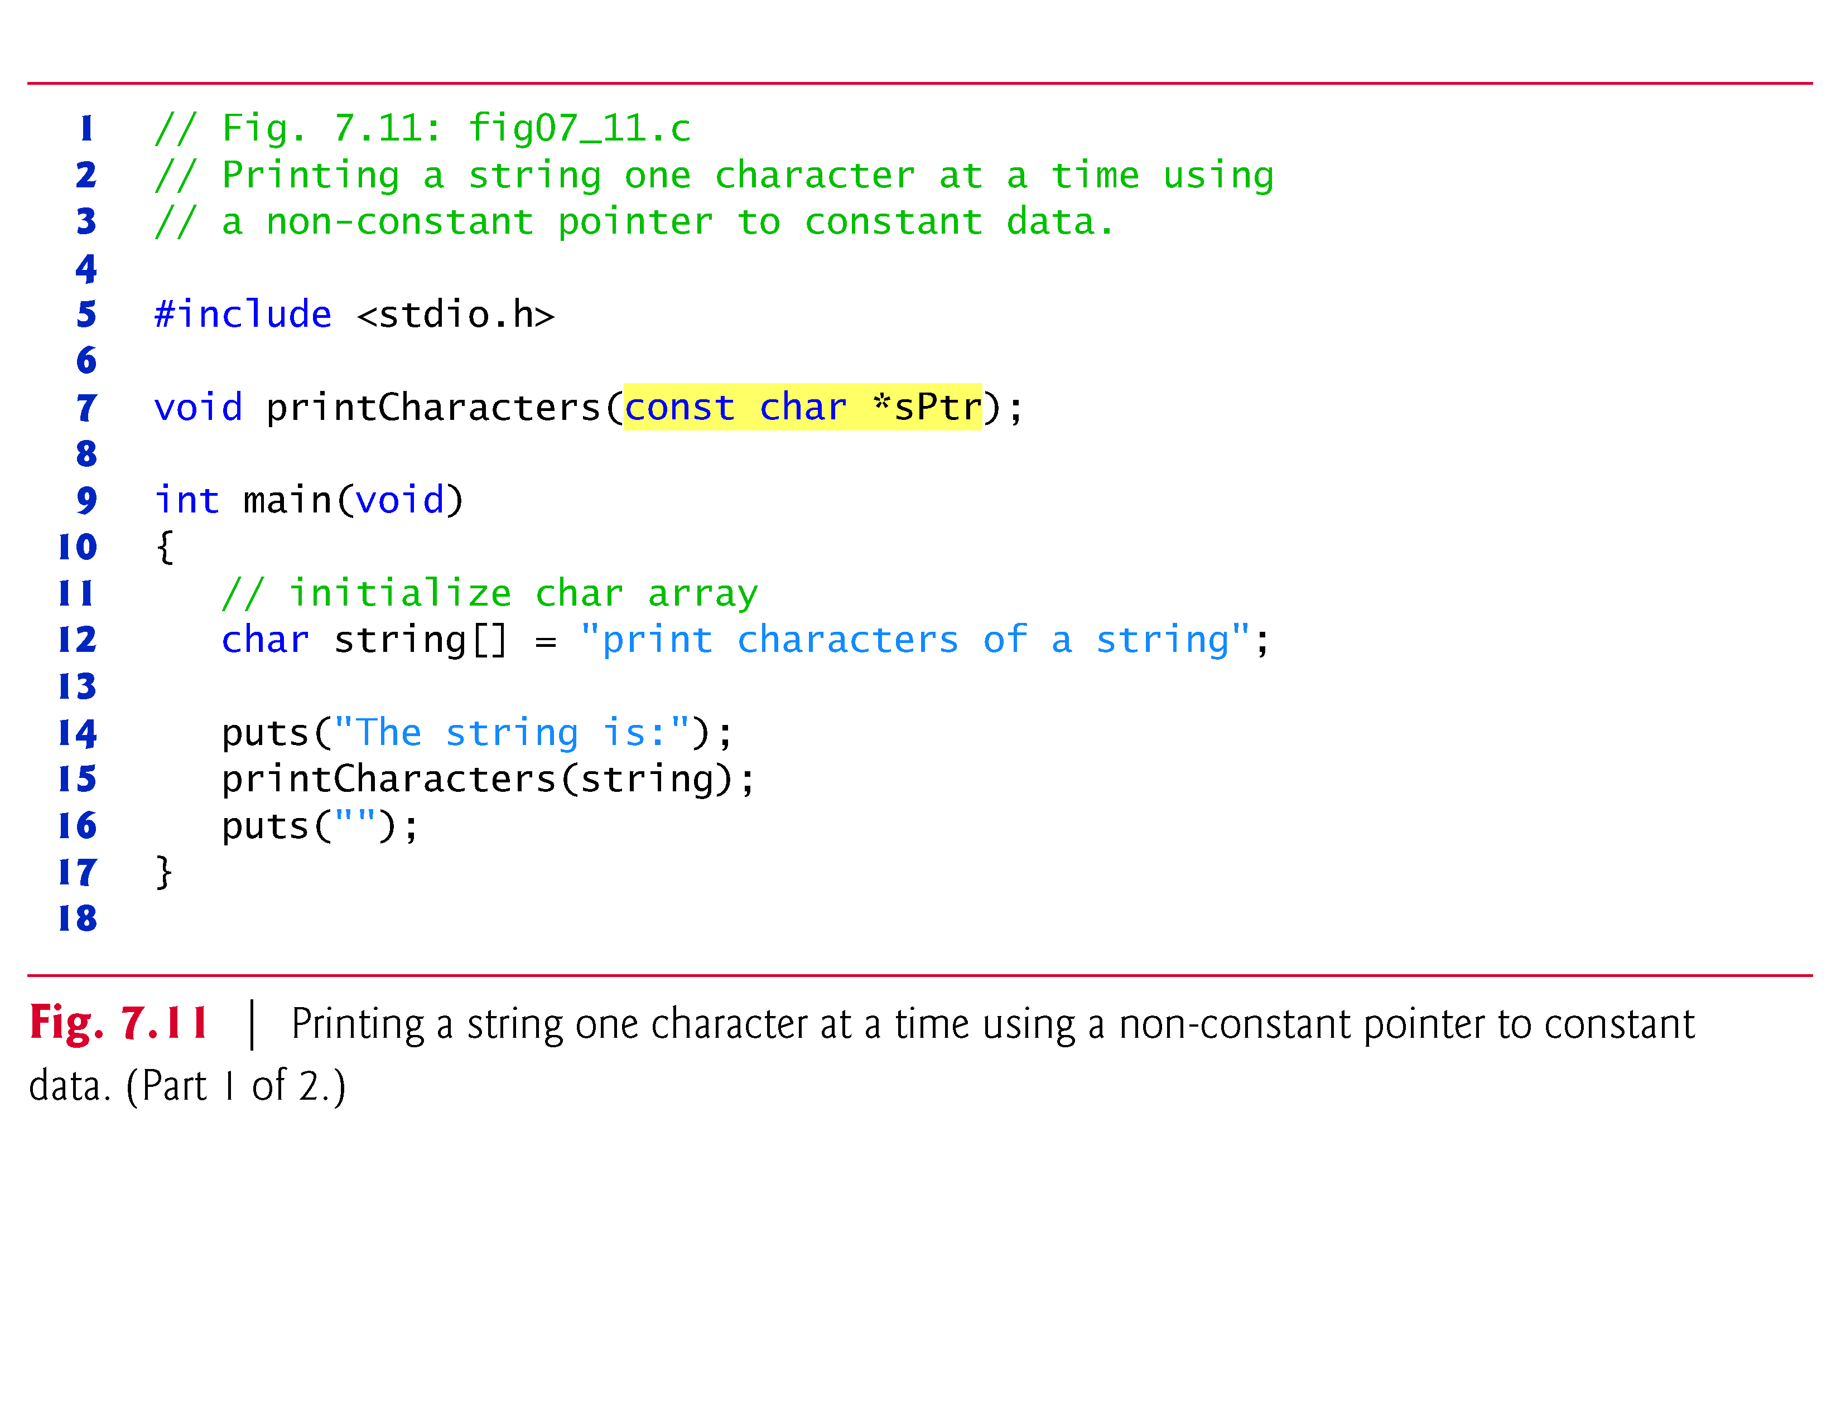

Slide 56
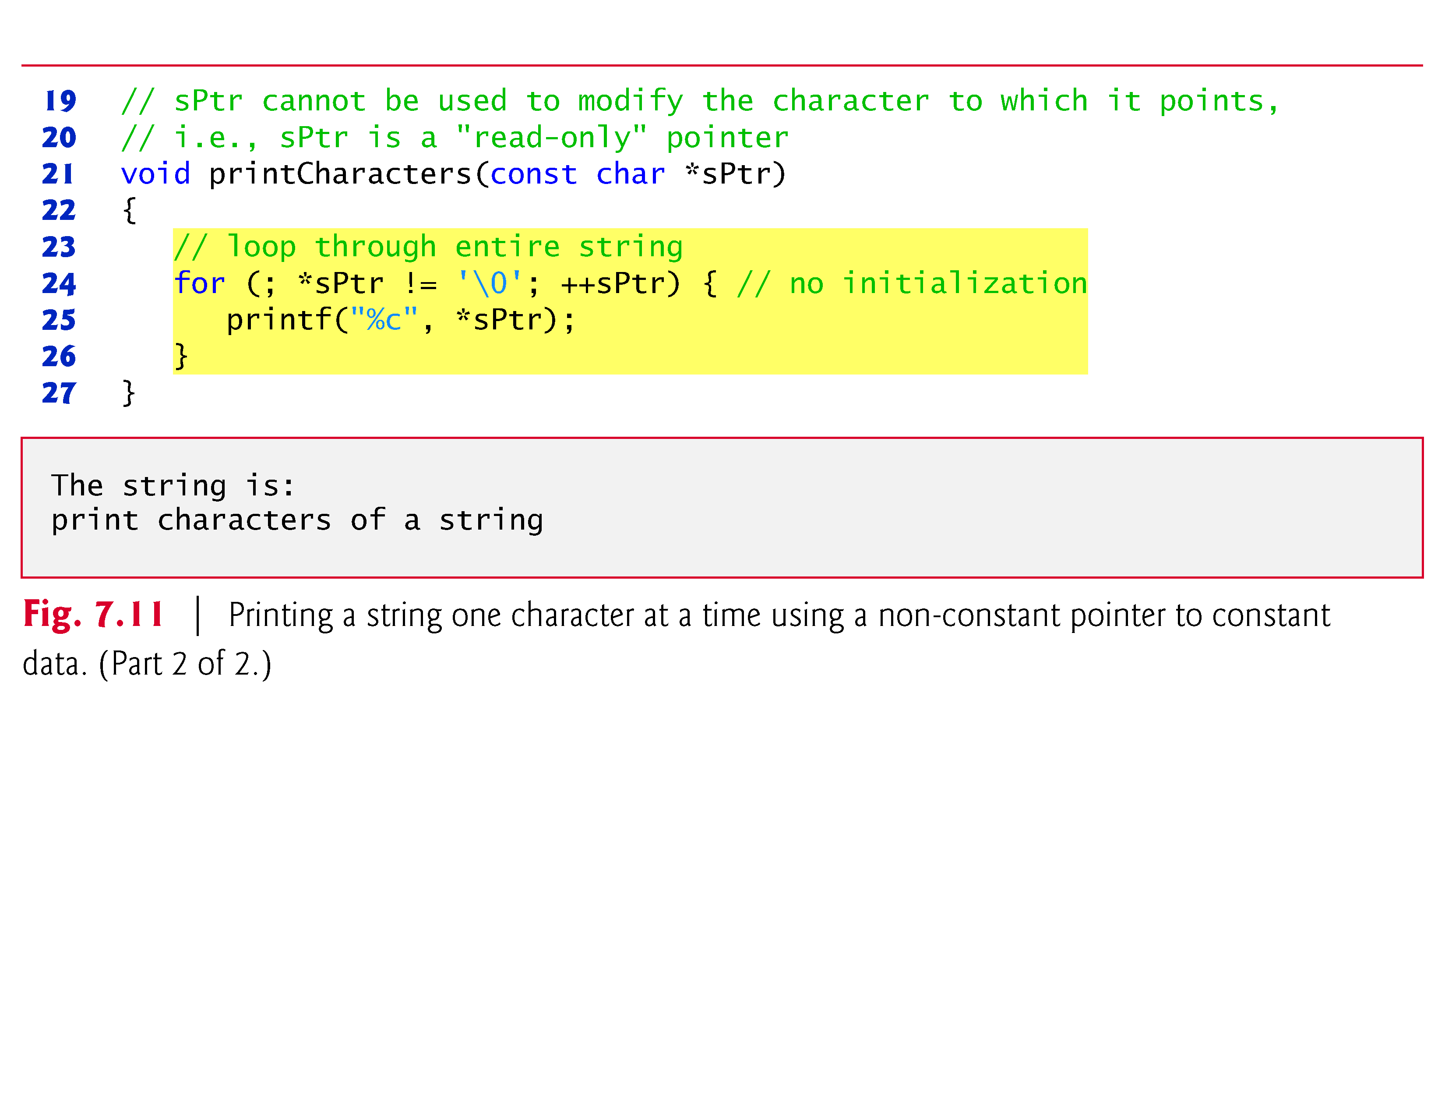

Slide 57
7.5.2 Printing a String One Character at a Time Using a Non-Constant Pointer to Constant Data (Cont.)
Figure 7.12 illustrates the attempt to compile a function that receives a non-constant pointer (xPtr) to constant data.
This function attempts to modify the data pointed to by xPtr—which results in a compilation error.

Slide 58
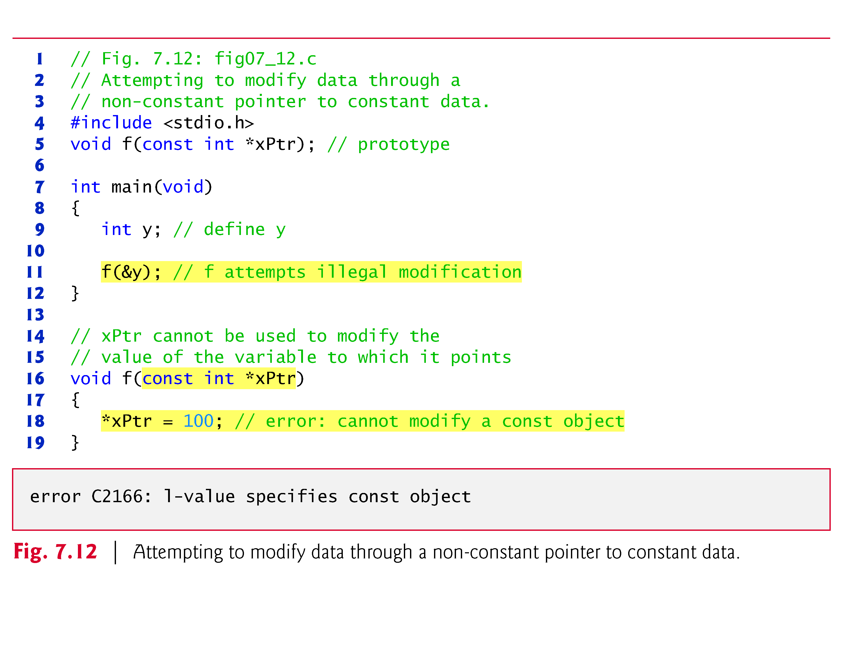

Slide 59
7.5.2 Printing a String One Character at a Time Using a Non-Constant Pointer to Constant Data (Cont.)
As you know, arrays are aggregate data types that store related data items of the same type under one name.
In Chapter 10, we’ll discuss another form of aggregate data type called a structure (sometimes called a record in other languages).
A structure is capable of storing related data items of different data types under one name (e.g., storing information about each employee of a company).
When a function is called with an array as an argument, the array is automatically passed to the function by reference.
However, structures are always passed by value—a copy of the entire structure is passed.

Slide 60
7.5.2 Printing a String One Character at a Time Using a Non-Constant Pointer to Constant Data (Cont.)
This requires the execution-time overhead of making a copy of each data item in the structure and storing it on the computer’s function call stack.
When structure data must be passed to a function, we can use pointers to constant data to get the performance of pass-by-reference and the protection of pass-by-value.
When a pointer to a structure is passed, only a copy of the address at which the structure is stored must be made.
On a machine with four-byte addresses, a copy of four bytes of memory is made rather than a copy of possibly large structure.

Slide 61
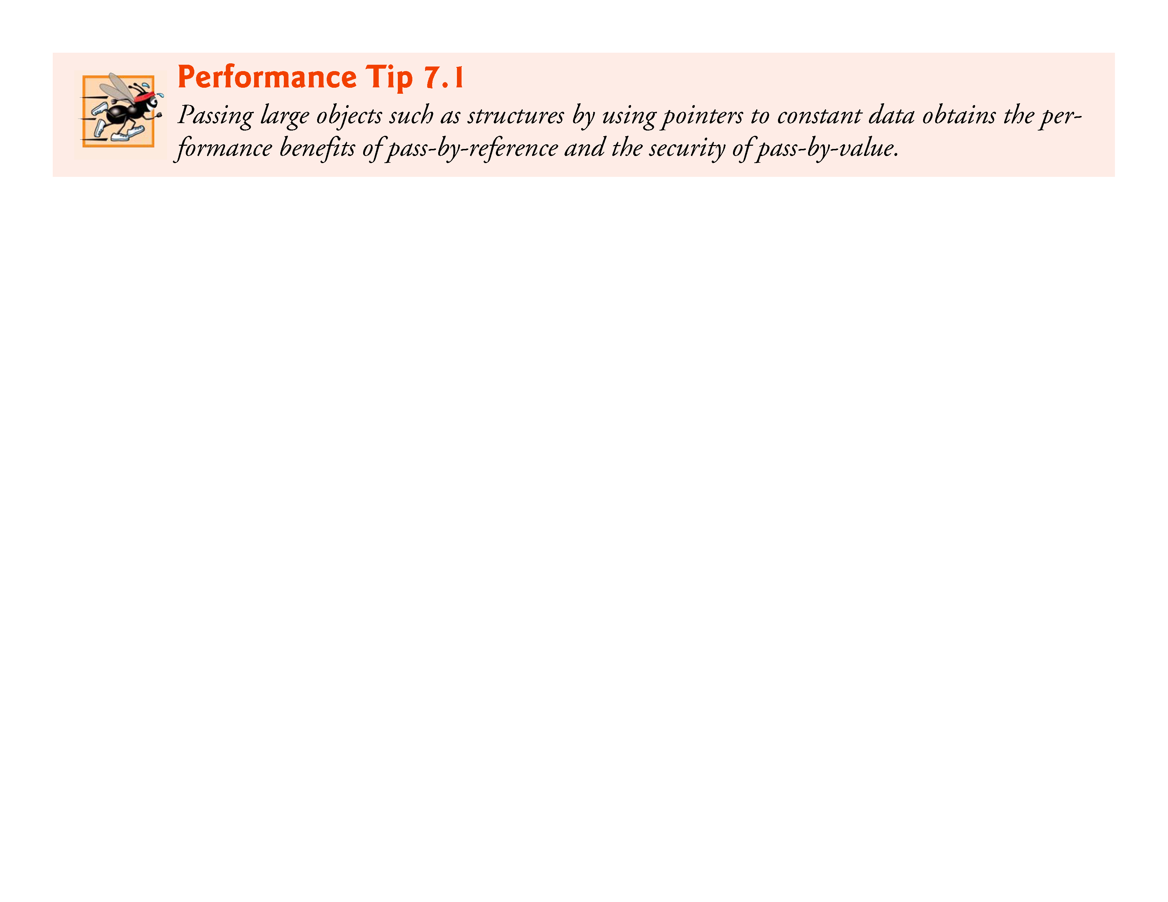

Slide 62
7.5.2 Printing a String One Character at a Time Using a Non-Constant Pointer to Constant Data (Cont.)
If memory is low and execution efficiency is a concern, use pointers.
If memory is in abundance and efficiency is not a major concern, pass data by value to enforce the principle of least privilege.
Remember that some systems do not enforce const well, so pass-by-value is still the best way to prevent data from being modified.

Slide 63
7.5.3 Attempting to Modify a Constant Pointer to Non-Constant Data
A constant pointer to non-constant data always points to the same memory location, and the data at that location can be modified through the pointer.
This is the default for an array name.
An array name is a constant pointer to the beginning of the array.
All data in the array can be accessed and changed by using the array name and array indexing.
A constant pointer to non-constant data can be used to receive an array as an argument to a function that accesses array elements using only array index notation.

Slide 64
7.5.3 Attempting to Modify a Constant Pointer to Non-Constant Data (Cont.)
Pointers that are declared const must be initialized when they’re defined (if the pointer is a function parameter, it’s initialized with a pointer that’s passed to the function).
Figure 7.13 attempts to modify a constant pointer.
Pointer ptr is defined to be of type int * const.
The definition is read from right to left as “ptr is a constant pointer to an integer.” The pointer is initialized with the address of integer variable x.
The program attempts to assign the address of y to ptr, but the compiler generates an error message.

Slide 65
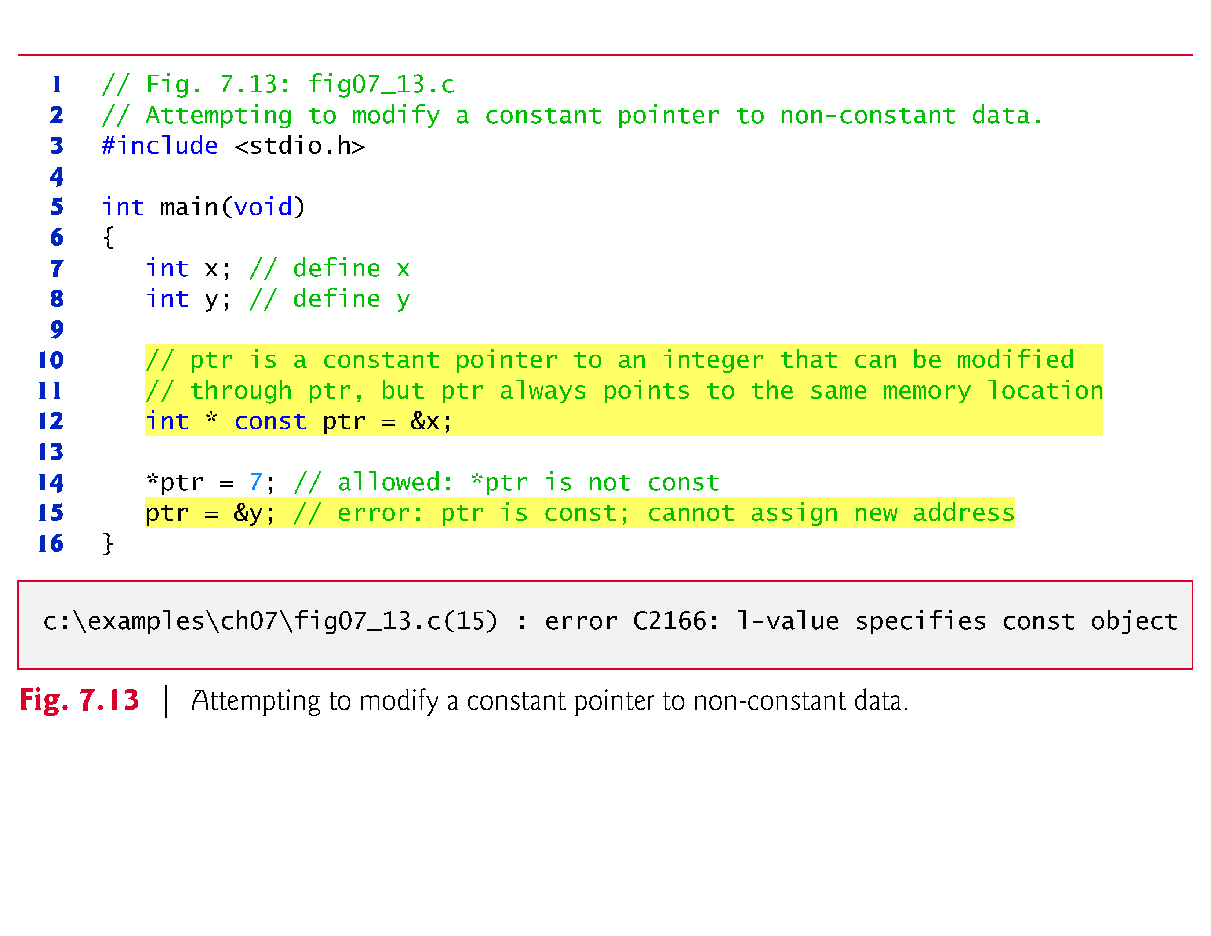

Slide 66
7.5.4 Attempting to Modify a Constant Pointer to Constant Data
The least access privilege is granted by a constant pointer to constant data.
Such a pointer always points to the same memory location, and the data at that memory location cannot be modified.
This is how an array should be passed to a function that only looks at the array using array index notation and does not modify the array.

Slide 67
7.5 Using the const Qualifier with Pointers (Const.)
Figure 7.14 defines pointer variable ptr to be of type const int *const, which is read from right to left as “ptr is a constant pointer to an integer constant.”
The figure shows the error messages generated when an attempt is made to modify the data to which ptr points and when an attempt is made to modify the address stored in the pointer variable

Slide 68
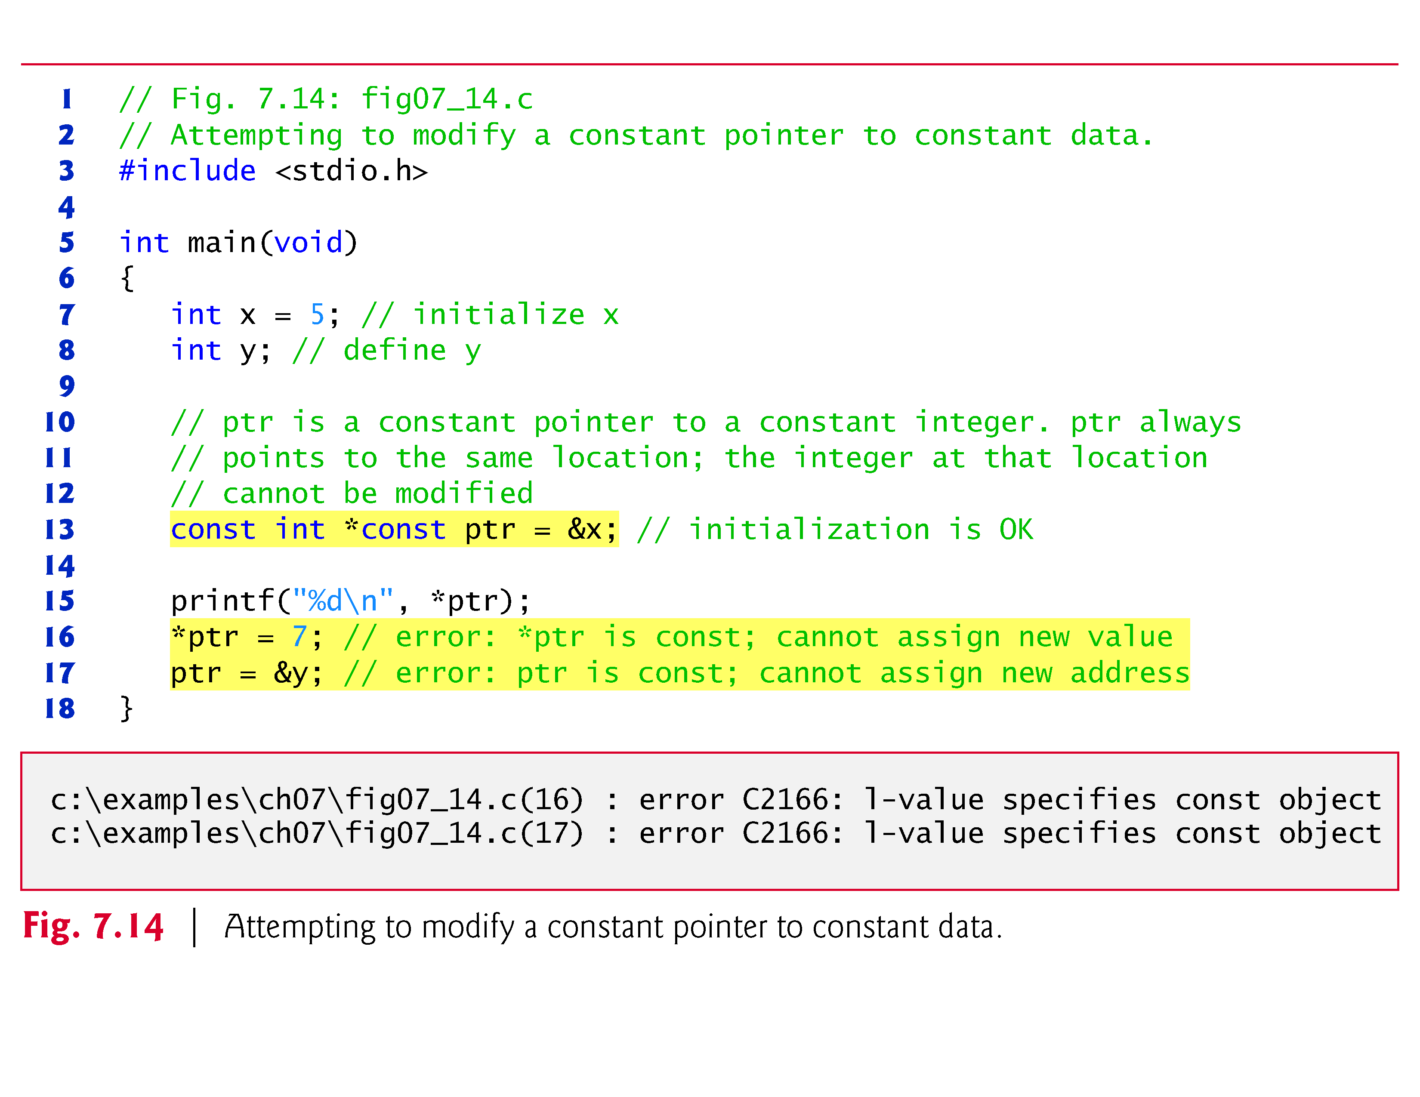

Slide 69
7.6 Bubble Sort Using Pass-by-Reference
Let’s improve the bubble sort program of Fig. 6.15 to use two functions—bubbleSort and swap.
Function bubbleSort sorts the array.
It calls function swap to exchange the array elements array[j] and array[j + 1]
Remember that C enforces information hiding between functions, so swap does not have access to individual array elements in bubbleSort.
Because bubbleSort wants swap to have access to the array elements to be swapped, bubbleSort passes each of these elements by reference to swap—the address of each array element is passed explicitly.

Slide 70
7.6 Bubble Sort Using Pass-by-Reference (Cont.)
Although entire arrays are automatically passed by reference, individual array elements are scalars and are ordinarily passed by value.
Therefore, bubbleSort uses the address operator (&) on each of the array elements in the swap call to effect pass-by-reference as follows
swap(&array[j], &array[j + 1]);
Function swap receives &array[j] in pointer variable element1Ptr.

Slide 71
7.6 Bubble Sort Using Pass-by-Reference (Cont.)
Even though swap—because of information hiding—is not allowed to know the name array[j], swap may use *element1Ptr as a synonym for array[j]—when swap references *element1Ptr, it’s actually referencing array[j] in bubbleSort.
Similarly, when swap references *element2Ptr, it’s actually referencing array[j + 1] in bubbleSort.

Slide 72
7.6 Bubble Sort Using Pass-by-Reference (Cont.)
Even though swap is not allowed to say
int hold = array[j]; array[j] = array[j + 1]; array[j + 1] = hold;
precisely the same effect is achieved by
int hold = *element1Ptr; *element1Ptr = *element2Ptr; *element2Ptr = hold;

Slide 73
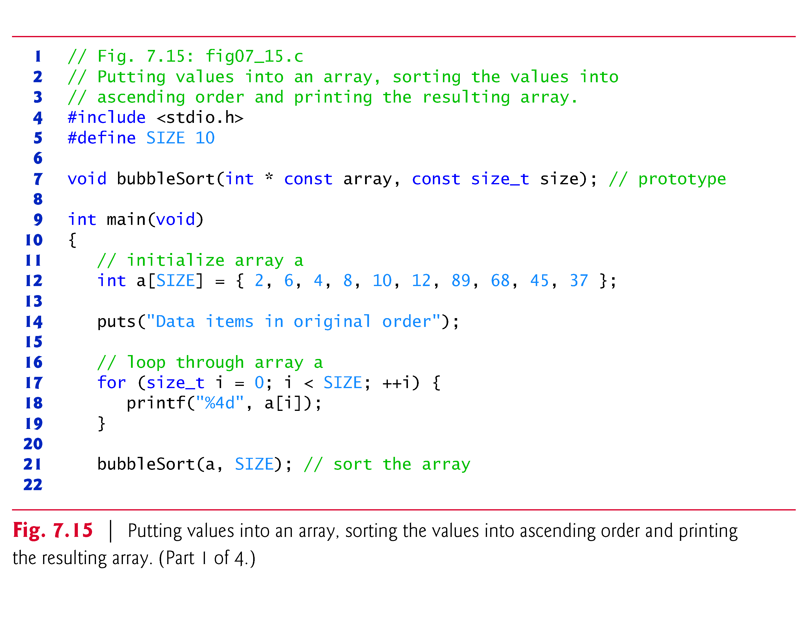

Slide 74
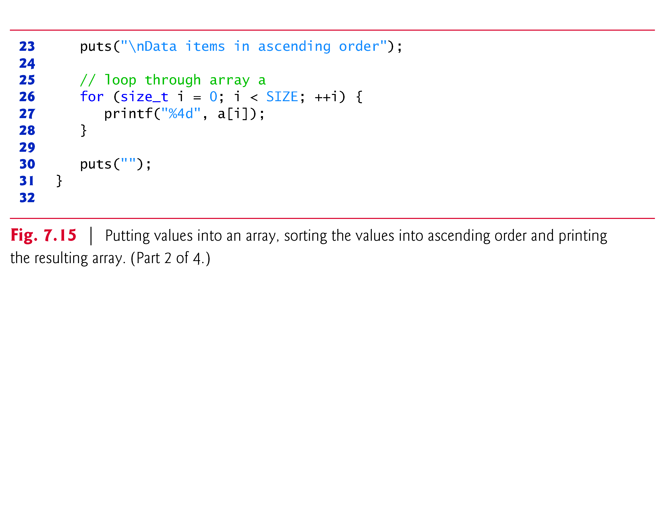

Slide 75
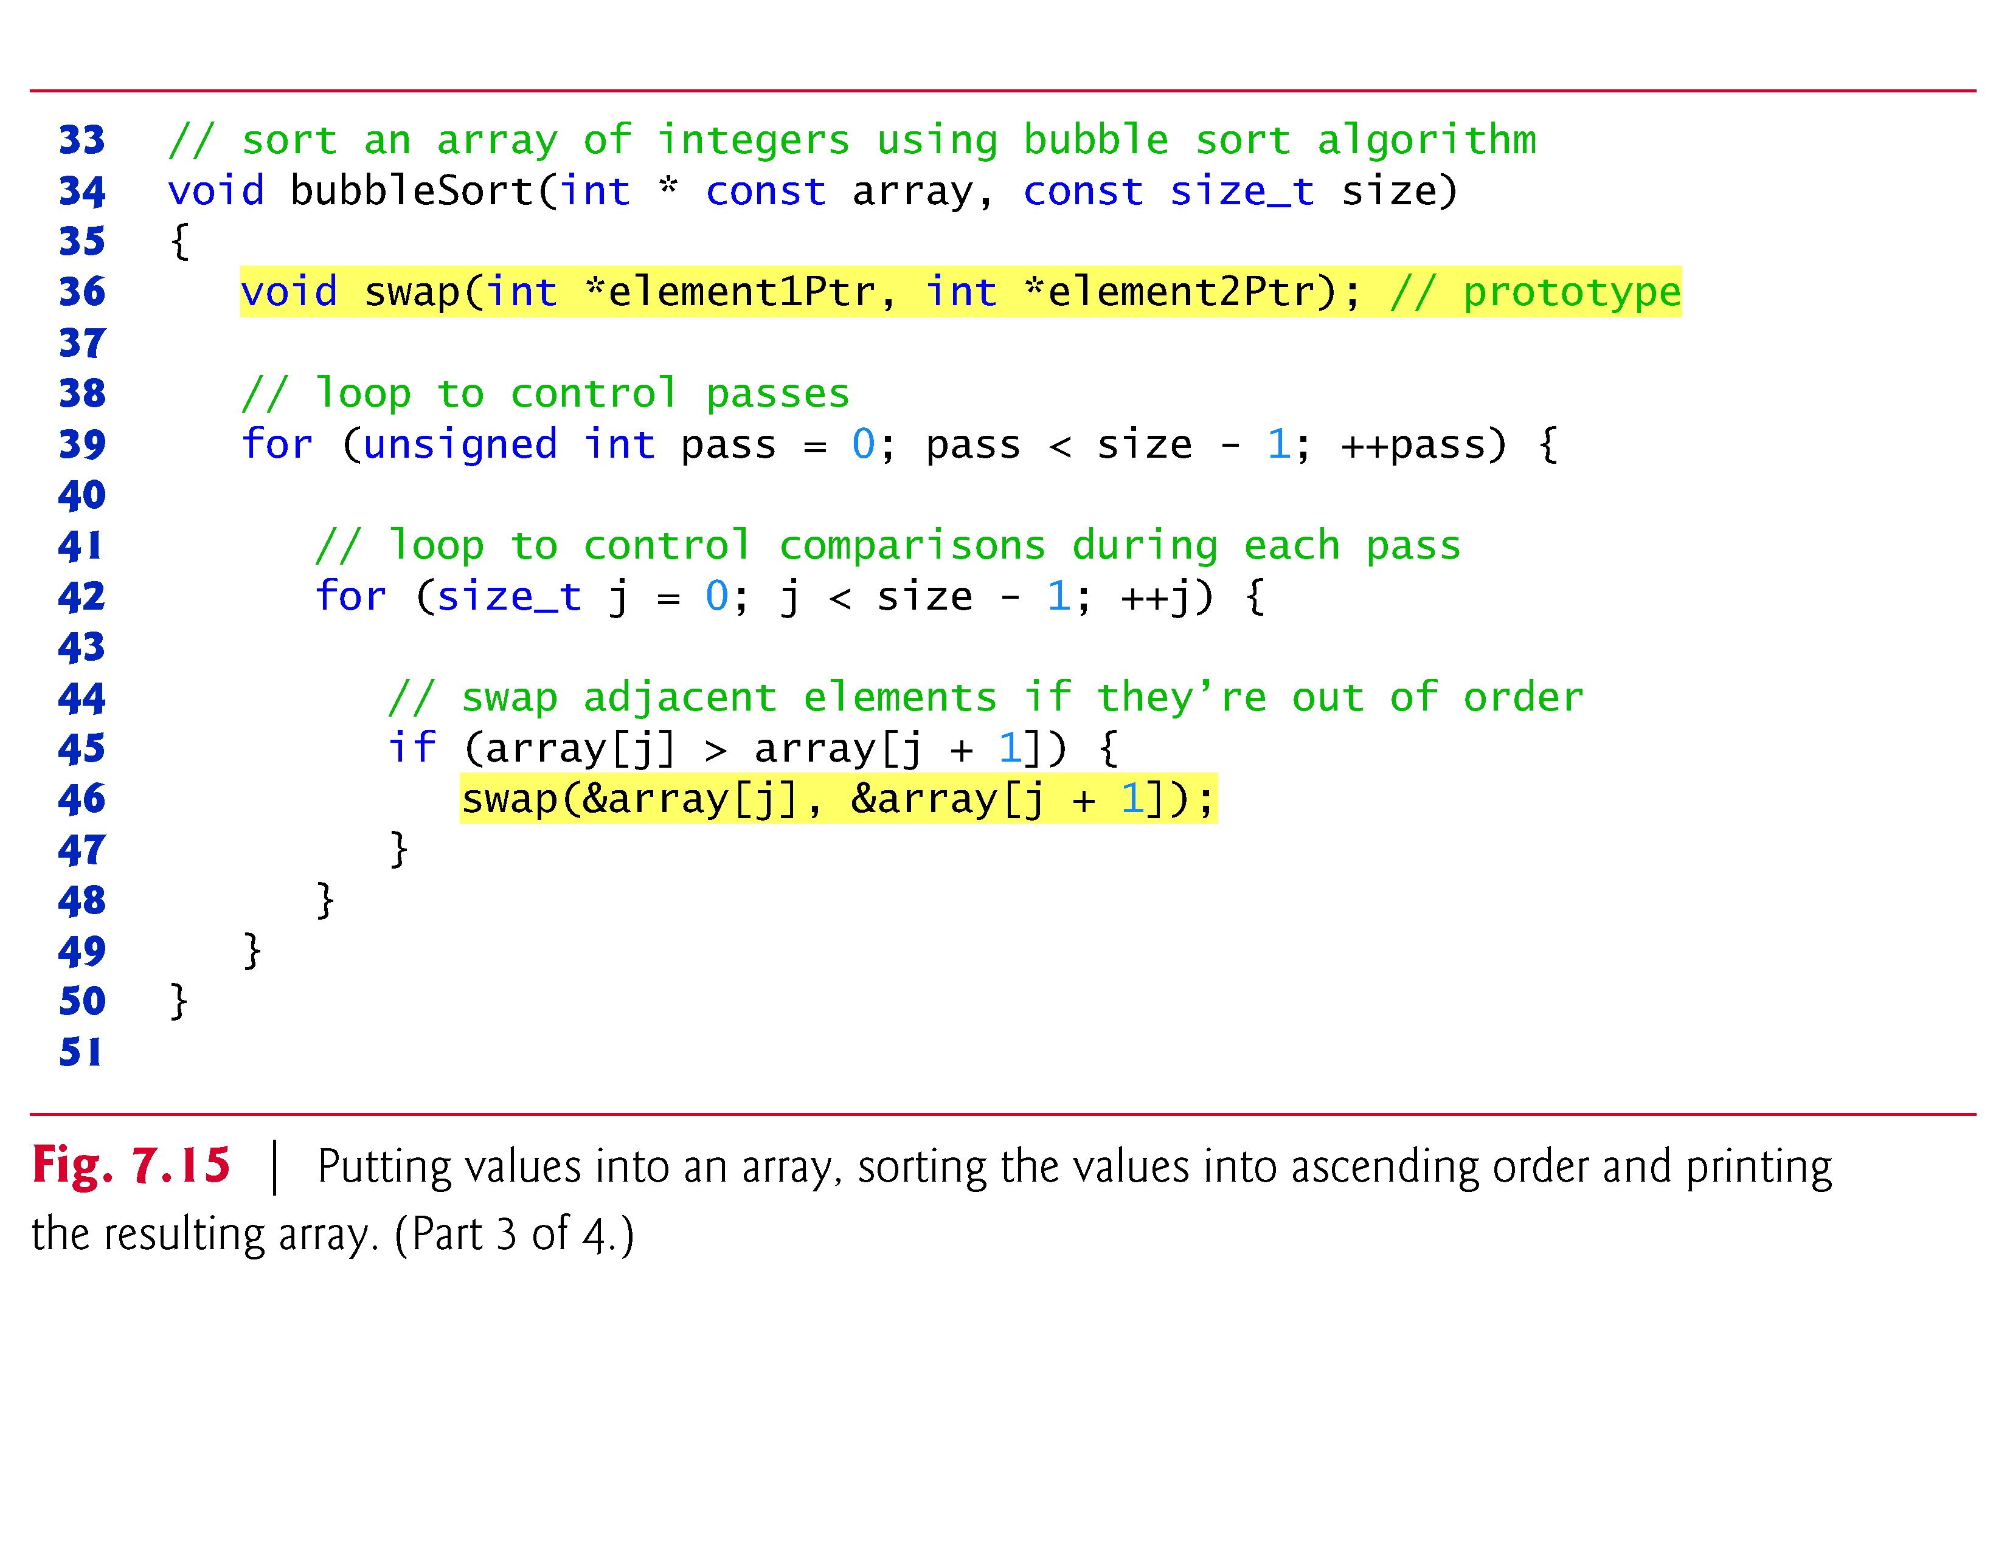

Slide 76
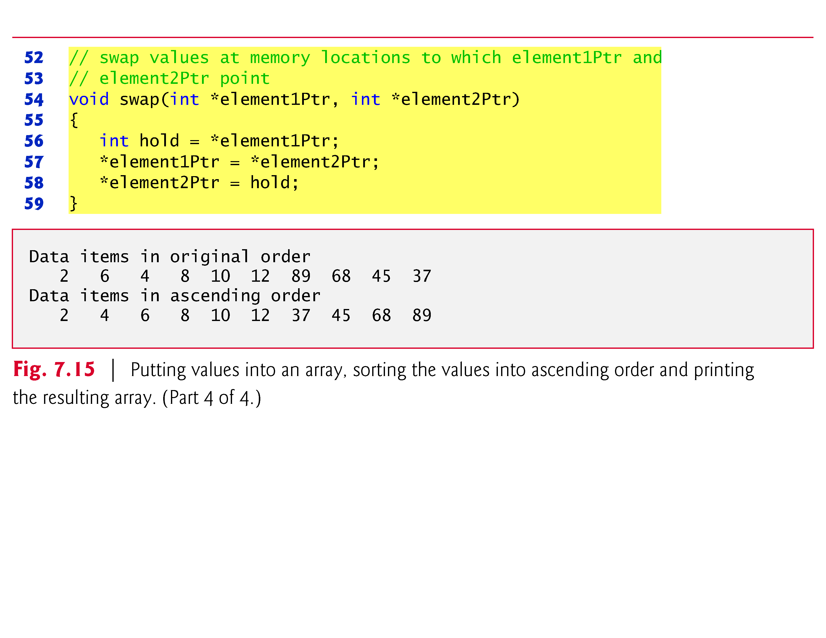

Slide 77
7.6 Bubble Sort Using Pass-by-Reference (Cont.)
Several features of function bubbleSort should be noted.
The function header declares array as int * const array rather than int array[] to indicate that bubbleSort receives a one-dimensional array as an argument (again, these notations are interchangeable).
Parameter size is declared const to enforce the principle of least privilege.
Although parameter size receives a copy of a value in main, and modifying the copy cannot change the value in main, bubbleSort does not need to alter size to accomplish its task.

Slide 78
7.6 Bubble Sort Using Pass-by-Reference (Cont.)
The size of the array remains fixed during the execution of function bubbleSort.
Therefore, size is declared const to ensure that it’s not modified.
The prototype for function swap is included in the body of function bubbleSort because bubbleSort is the only function that calls swap.

Slide 79
7.6 Bubble Sort Using Pass-by-Reference (Cont.)
Placing the prototype in bubbleSort restricts proper calls of swap to those made from bubbleSort.
Other functions that attempt to call swap do not have access to a proper function prototype, so the compiler generates one automatically.
This normally results in a prototype that does not match the function header (and generates a compilation warning or error) because the compiler assumes int for the return type and the parameter types.

Slide 80
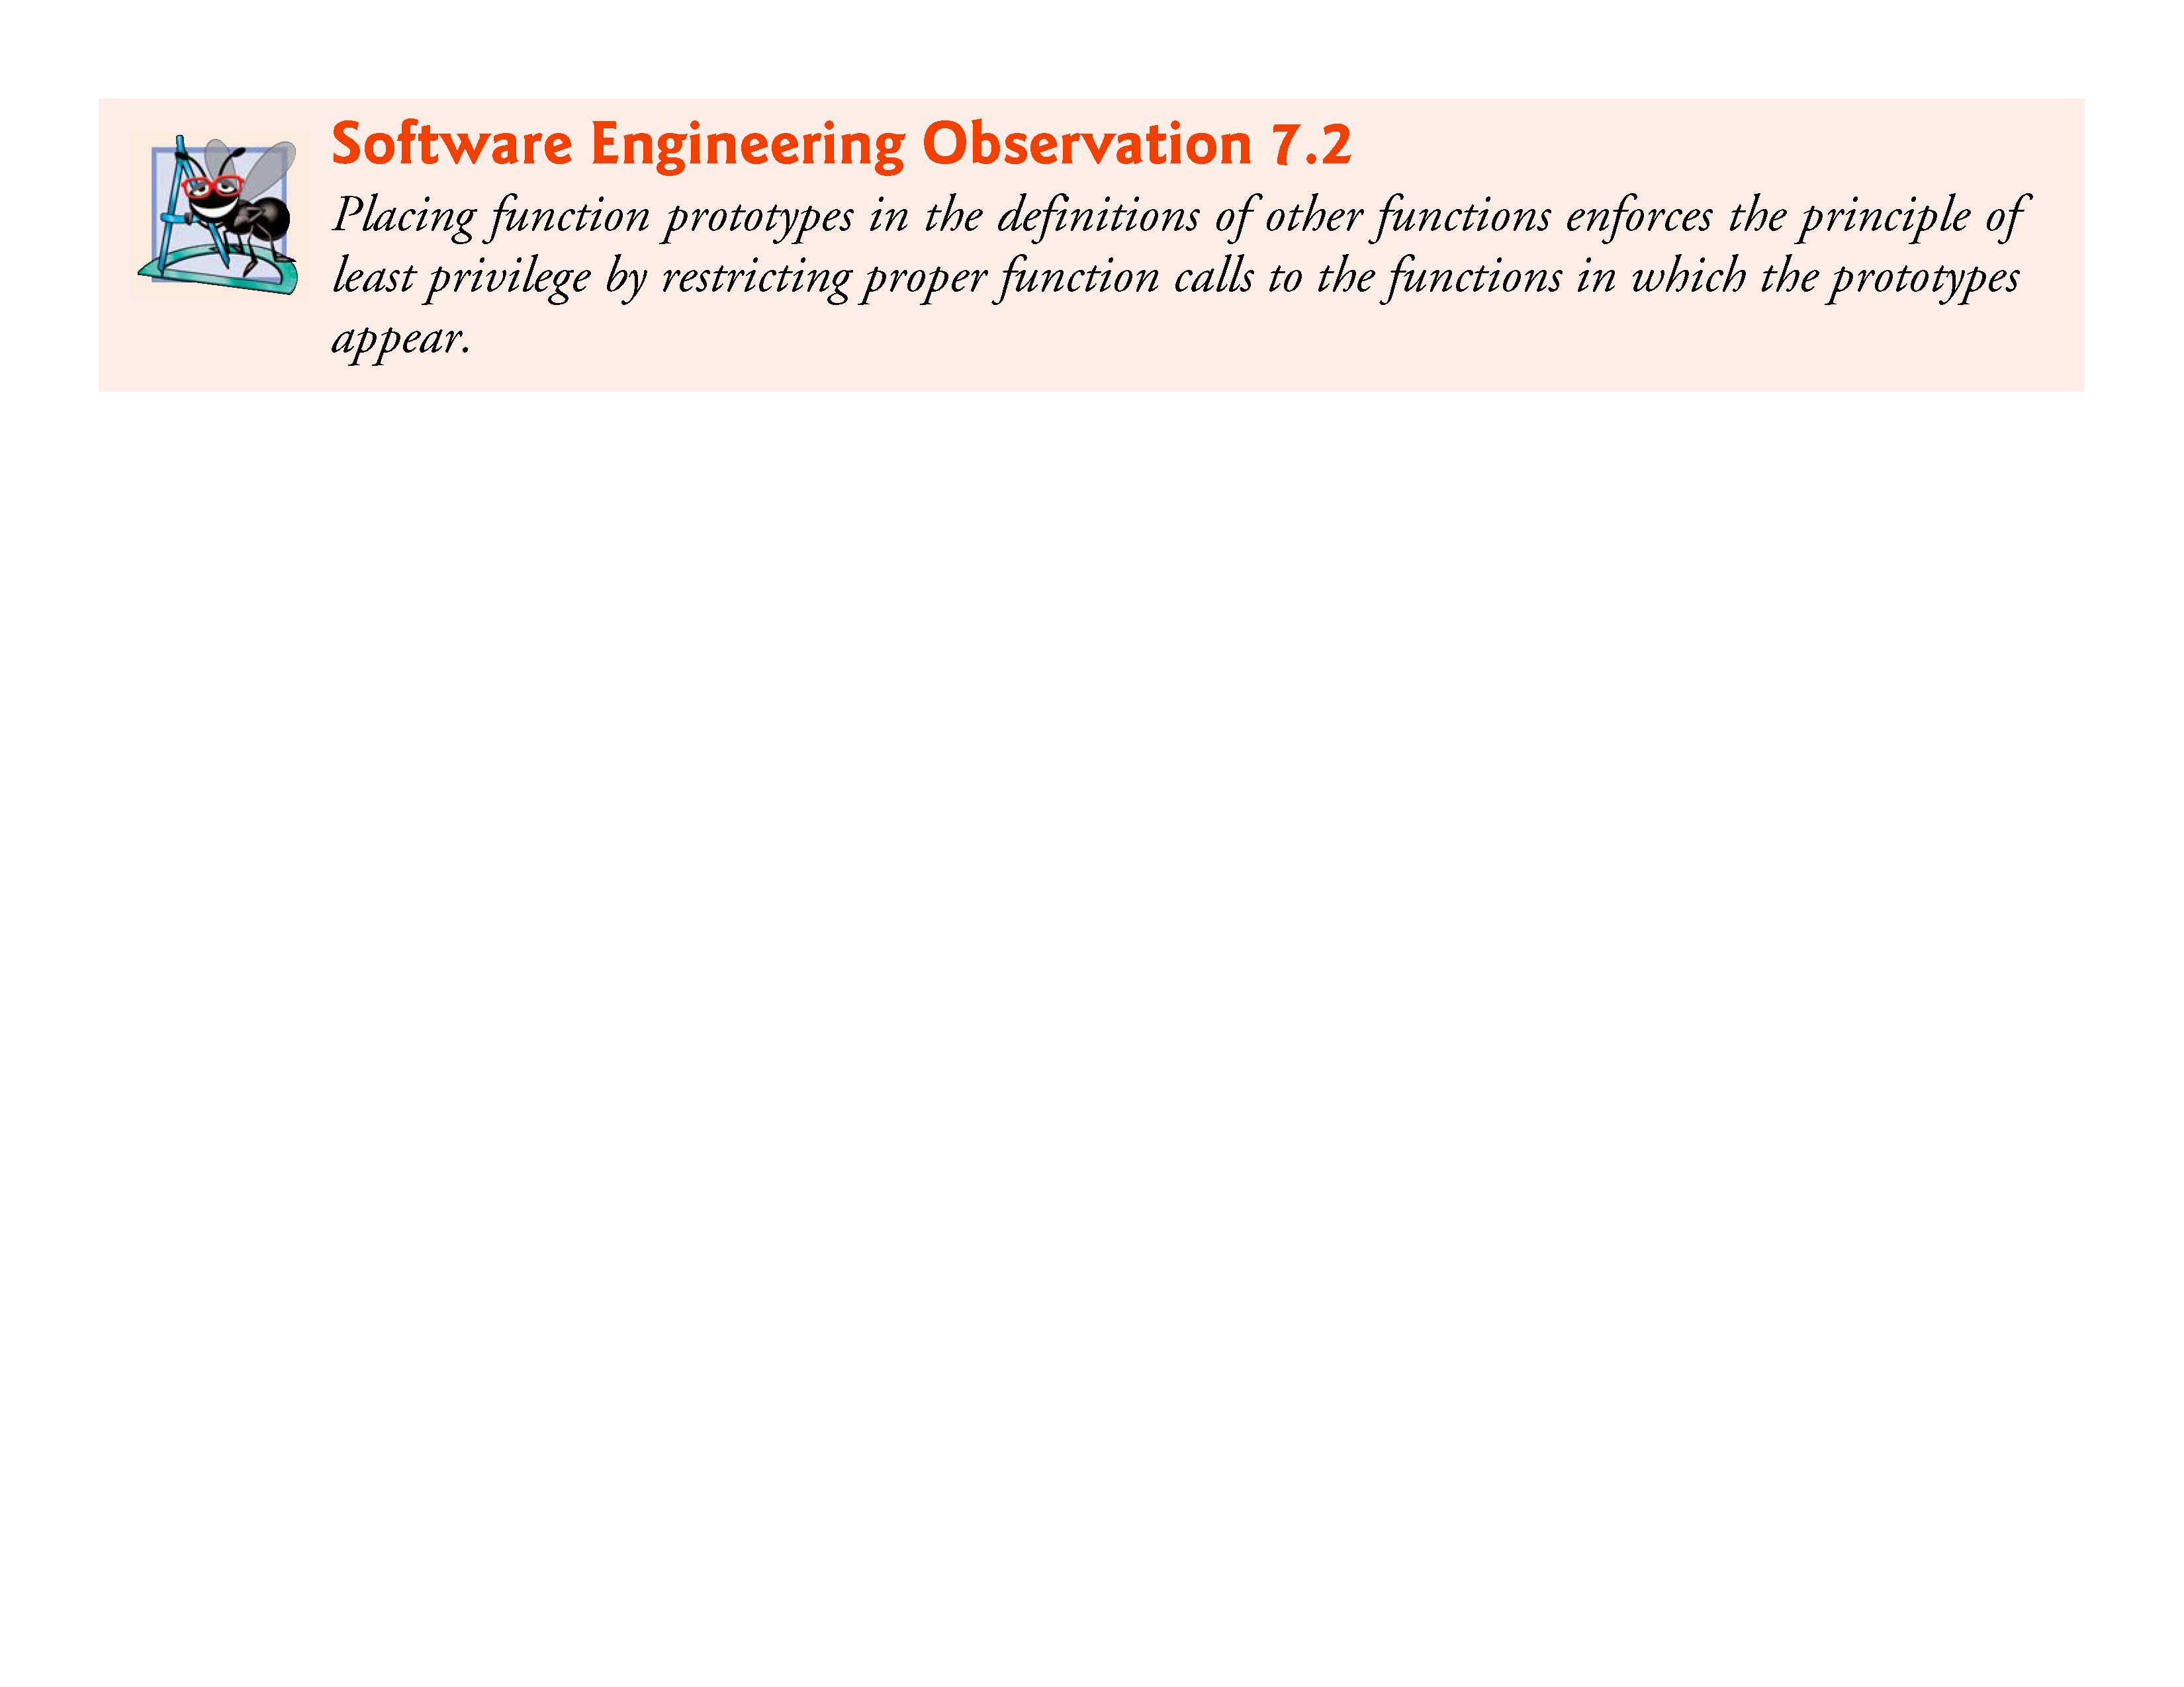

Slide 81
7.6 Bubble Sort Using Pass-by-Reference (Cont.)
Function bubbleSort receives the size of the array as a parameter
The function must know the size of the array to sort the array.
When an array is passed to a function, the memory address of the first element of the array is received by the function.
The address, of course, does not convey the number of elements in the array.
Therefore, you must pass the array size to the function.
Another common practice is to pass a pointer to the beginning of the array and a pointer to the location just beyond the end of the array—as you’ll learn in Section 7.8, the difference of the two pointers is the length of the array and the resulting code is simpler

Slide 82
7.6 Bubble Sort Using Pass-by-Reference (Cont.)
In the program, the size of the array is explicitly passed to function bubbleSort.
There are two main benefits to this approach—software reusability and proper software engineering.
By defining the function to receive the array size as an argument, we enable the function to be used by any program that sorts one-dimensional integer arrays of any size.

Slide 83
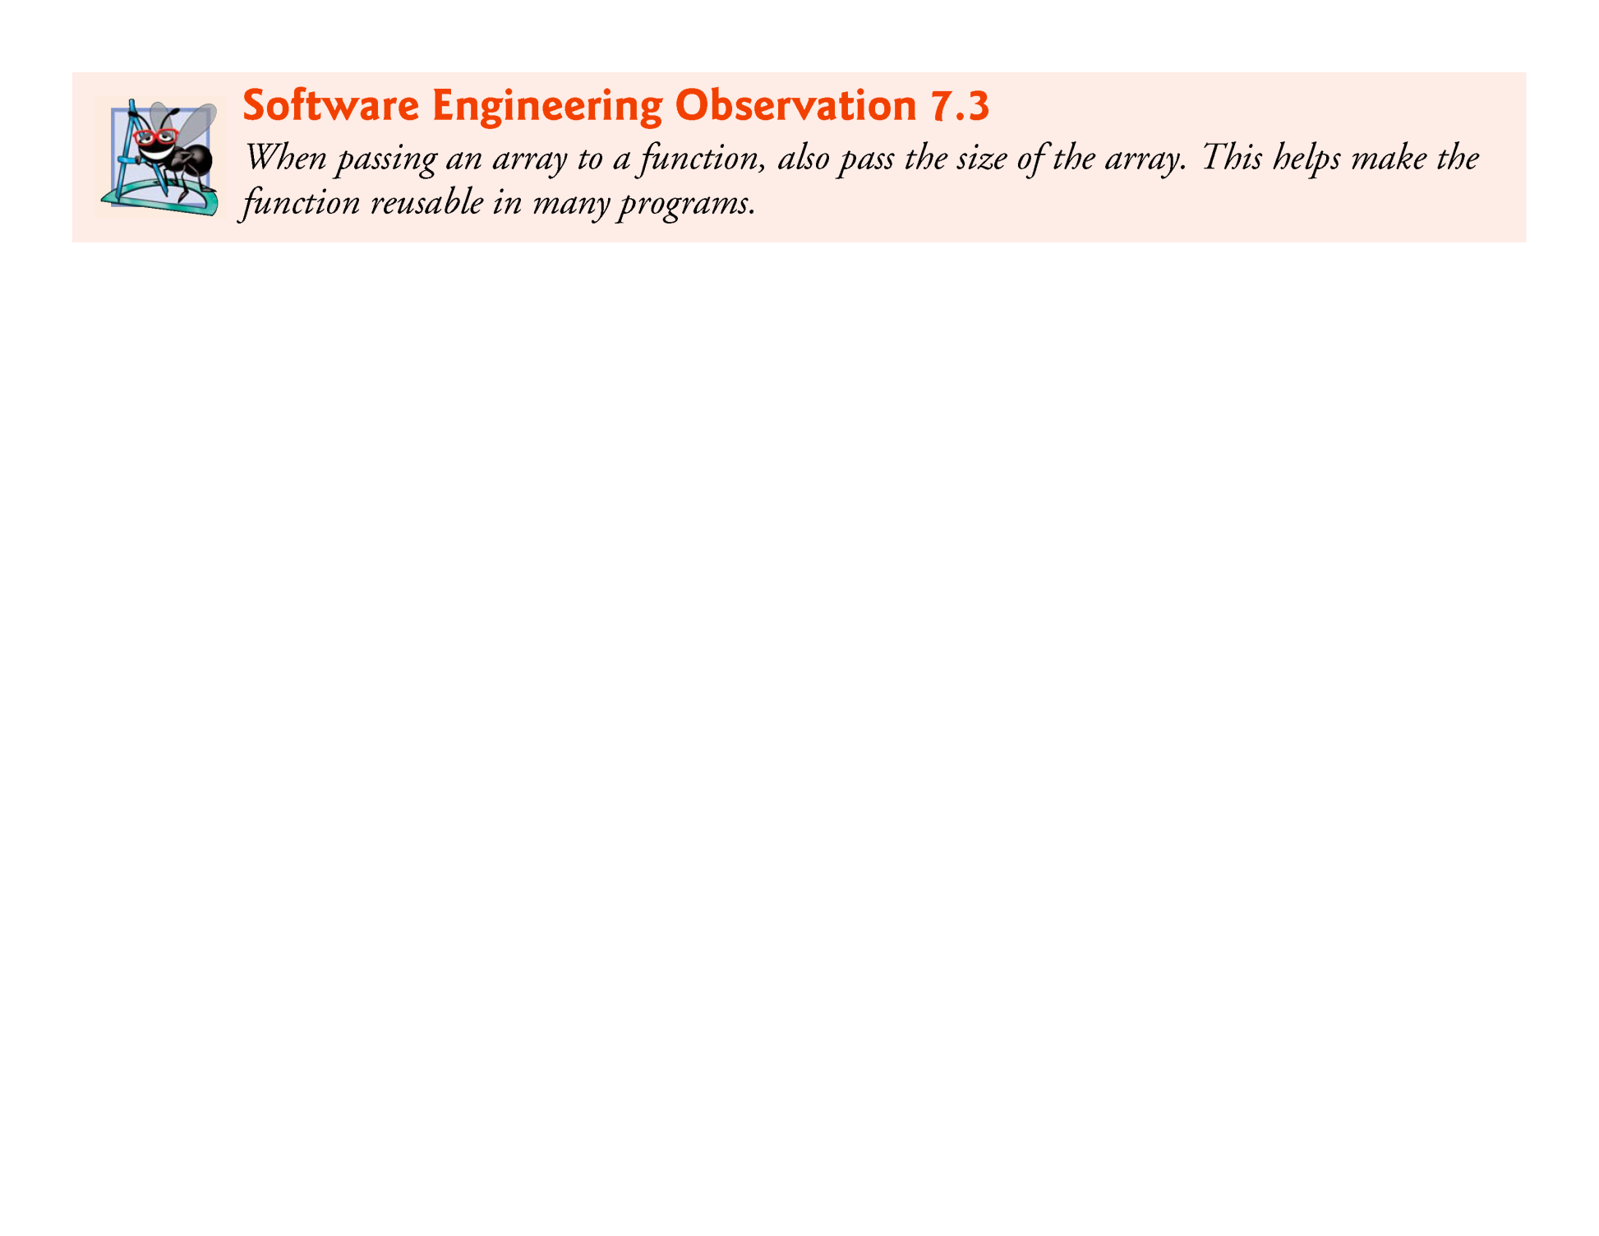

Slide 84
7.6 Bubble Sort Using Pass-by-Reference (Cont.)
We could have stored the array’s size in a global variable that’s accessible to the entire program.
This would be more efficient, because a copy of the size is not made to pass to the function.
However, other programs that require an integer array-sorting capability may not have the same global variable, so the function cannot be used in those programs.

Slide 85
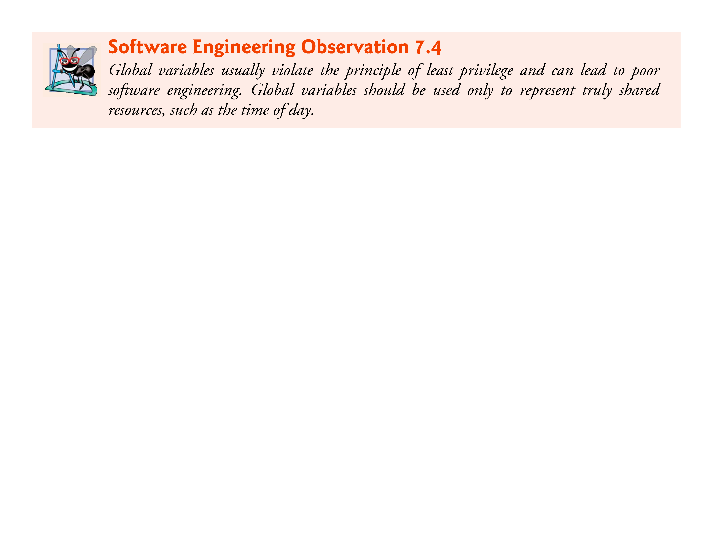

Slide 86
7.6 Bubble Sort Using Pass-by-Reference (Cont.)
The size of the array could have been programmed directly into the function.
This restricts the use of the function to an array of a specific size and significantly reduces its reusability.
Only programs processing one-dimensional integer arrays of the specific size coded into the function can use the function.

Slide 87
7.7 sizeof Operator
C provides the special unary operator sizeof to determine the size in bytes of an array (or any other data type) .
When applied to the name of an array as in Fig. 7.16, the sizeof operator returns the total number of bytes in the array as type size_t.
Variables of type float on this computer are stored in 4 bytes of memory, and array is defined to have 20 elements.
Therefore, there are a total of 80 bytes in array.

Slide 88
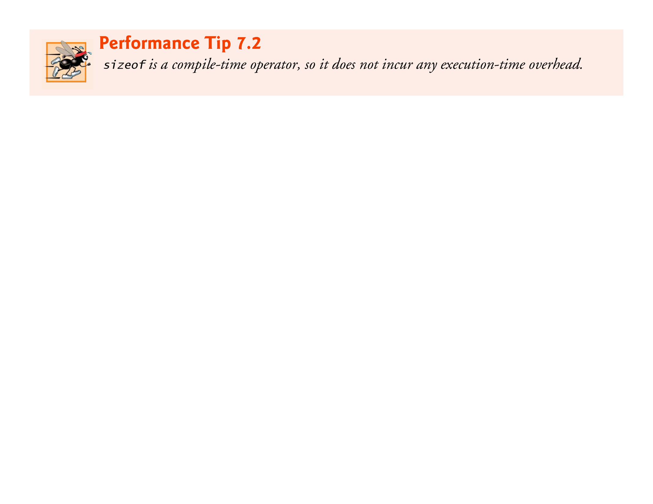

Slide 89
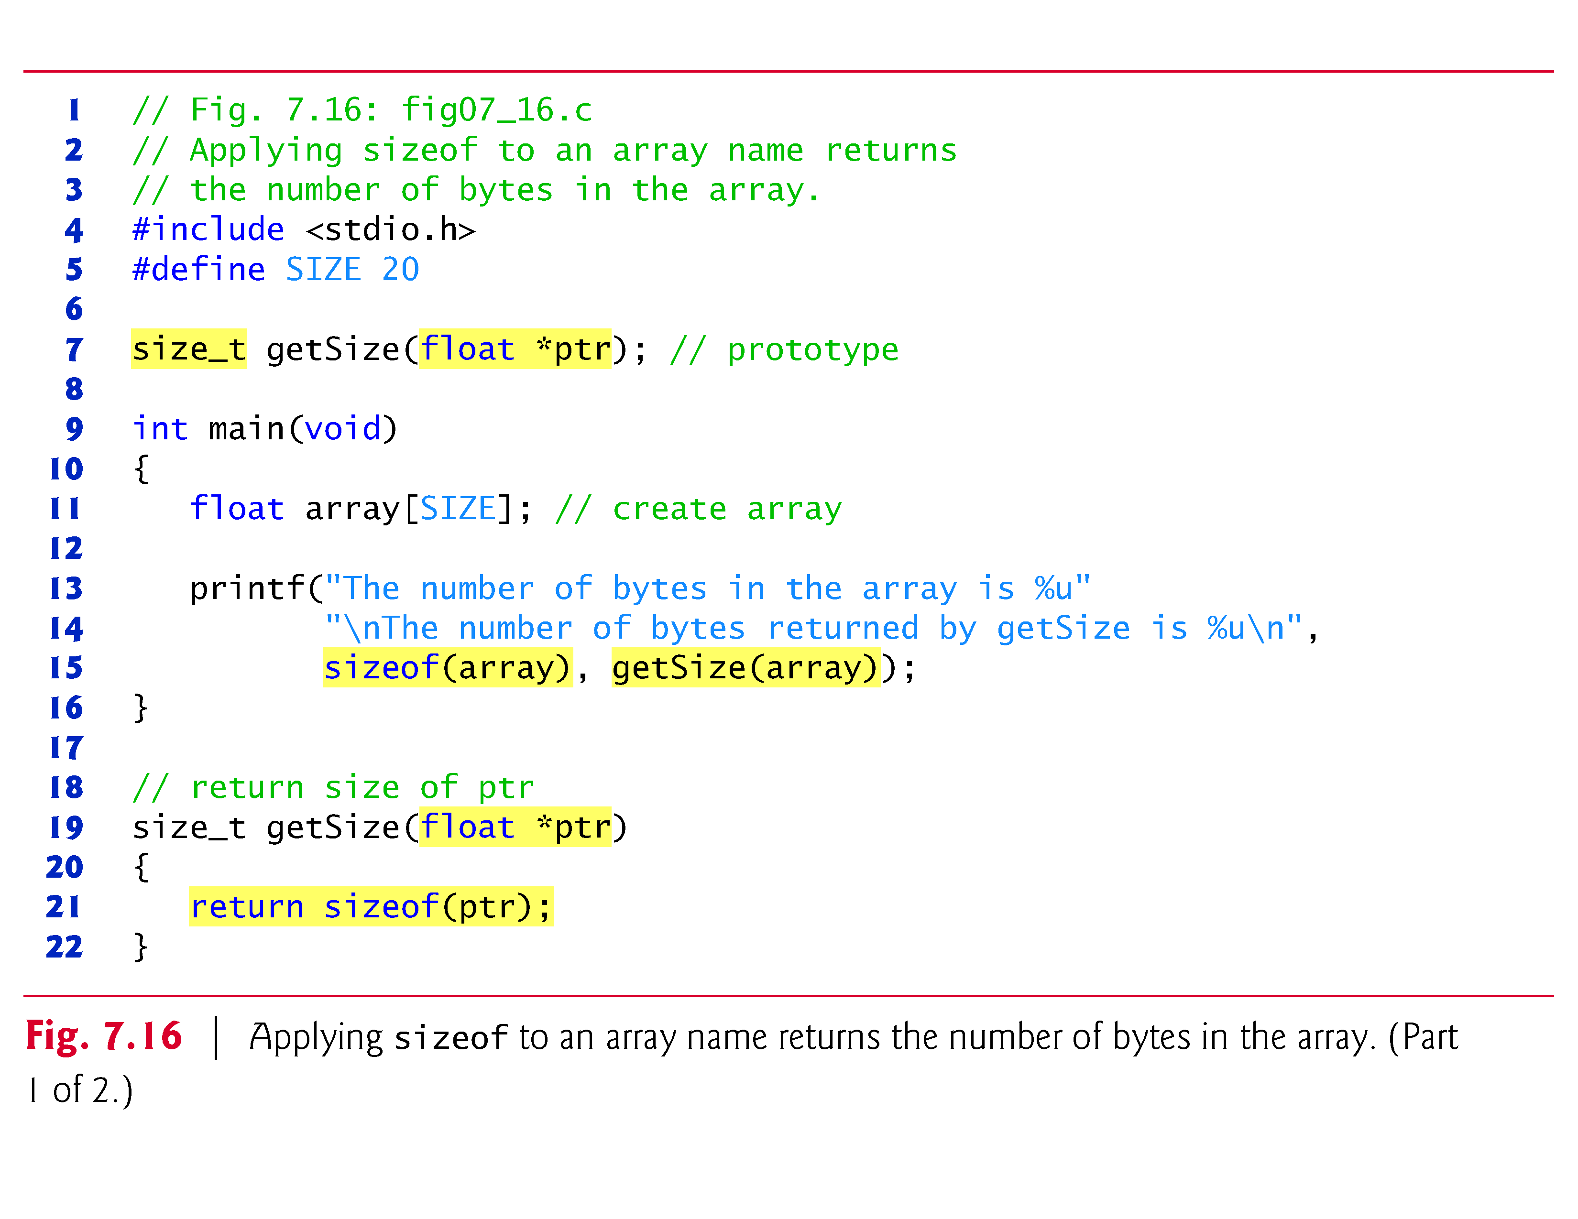

Slide 90
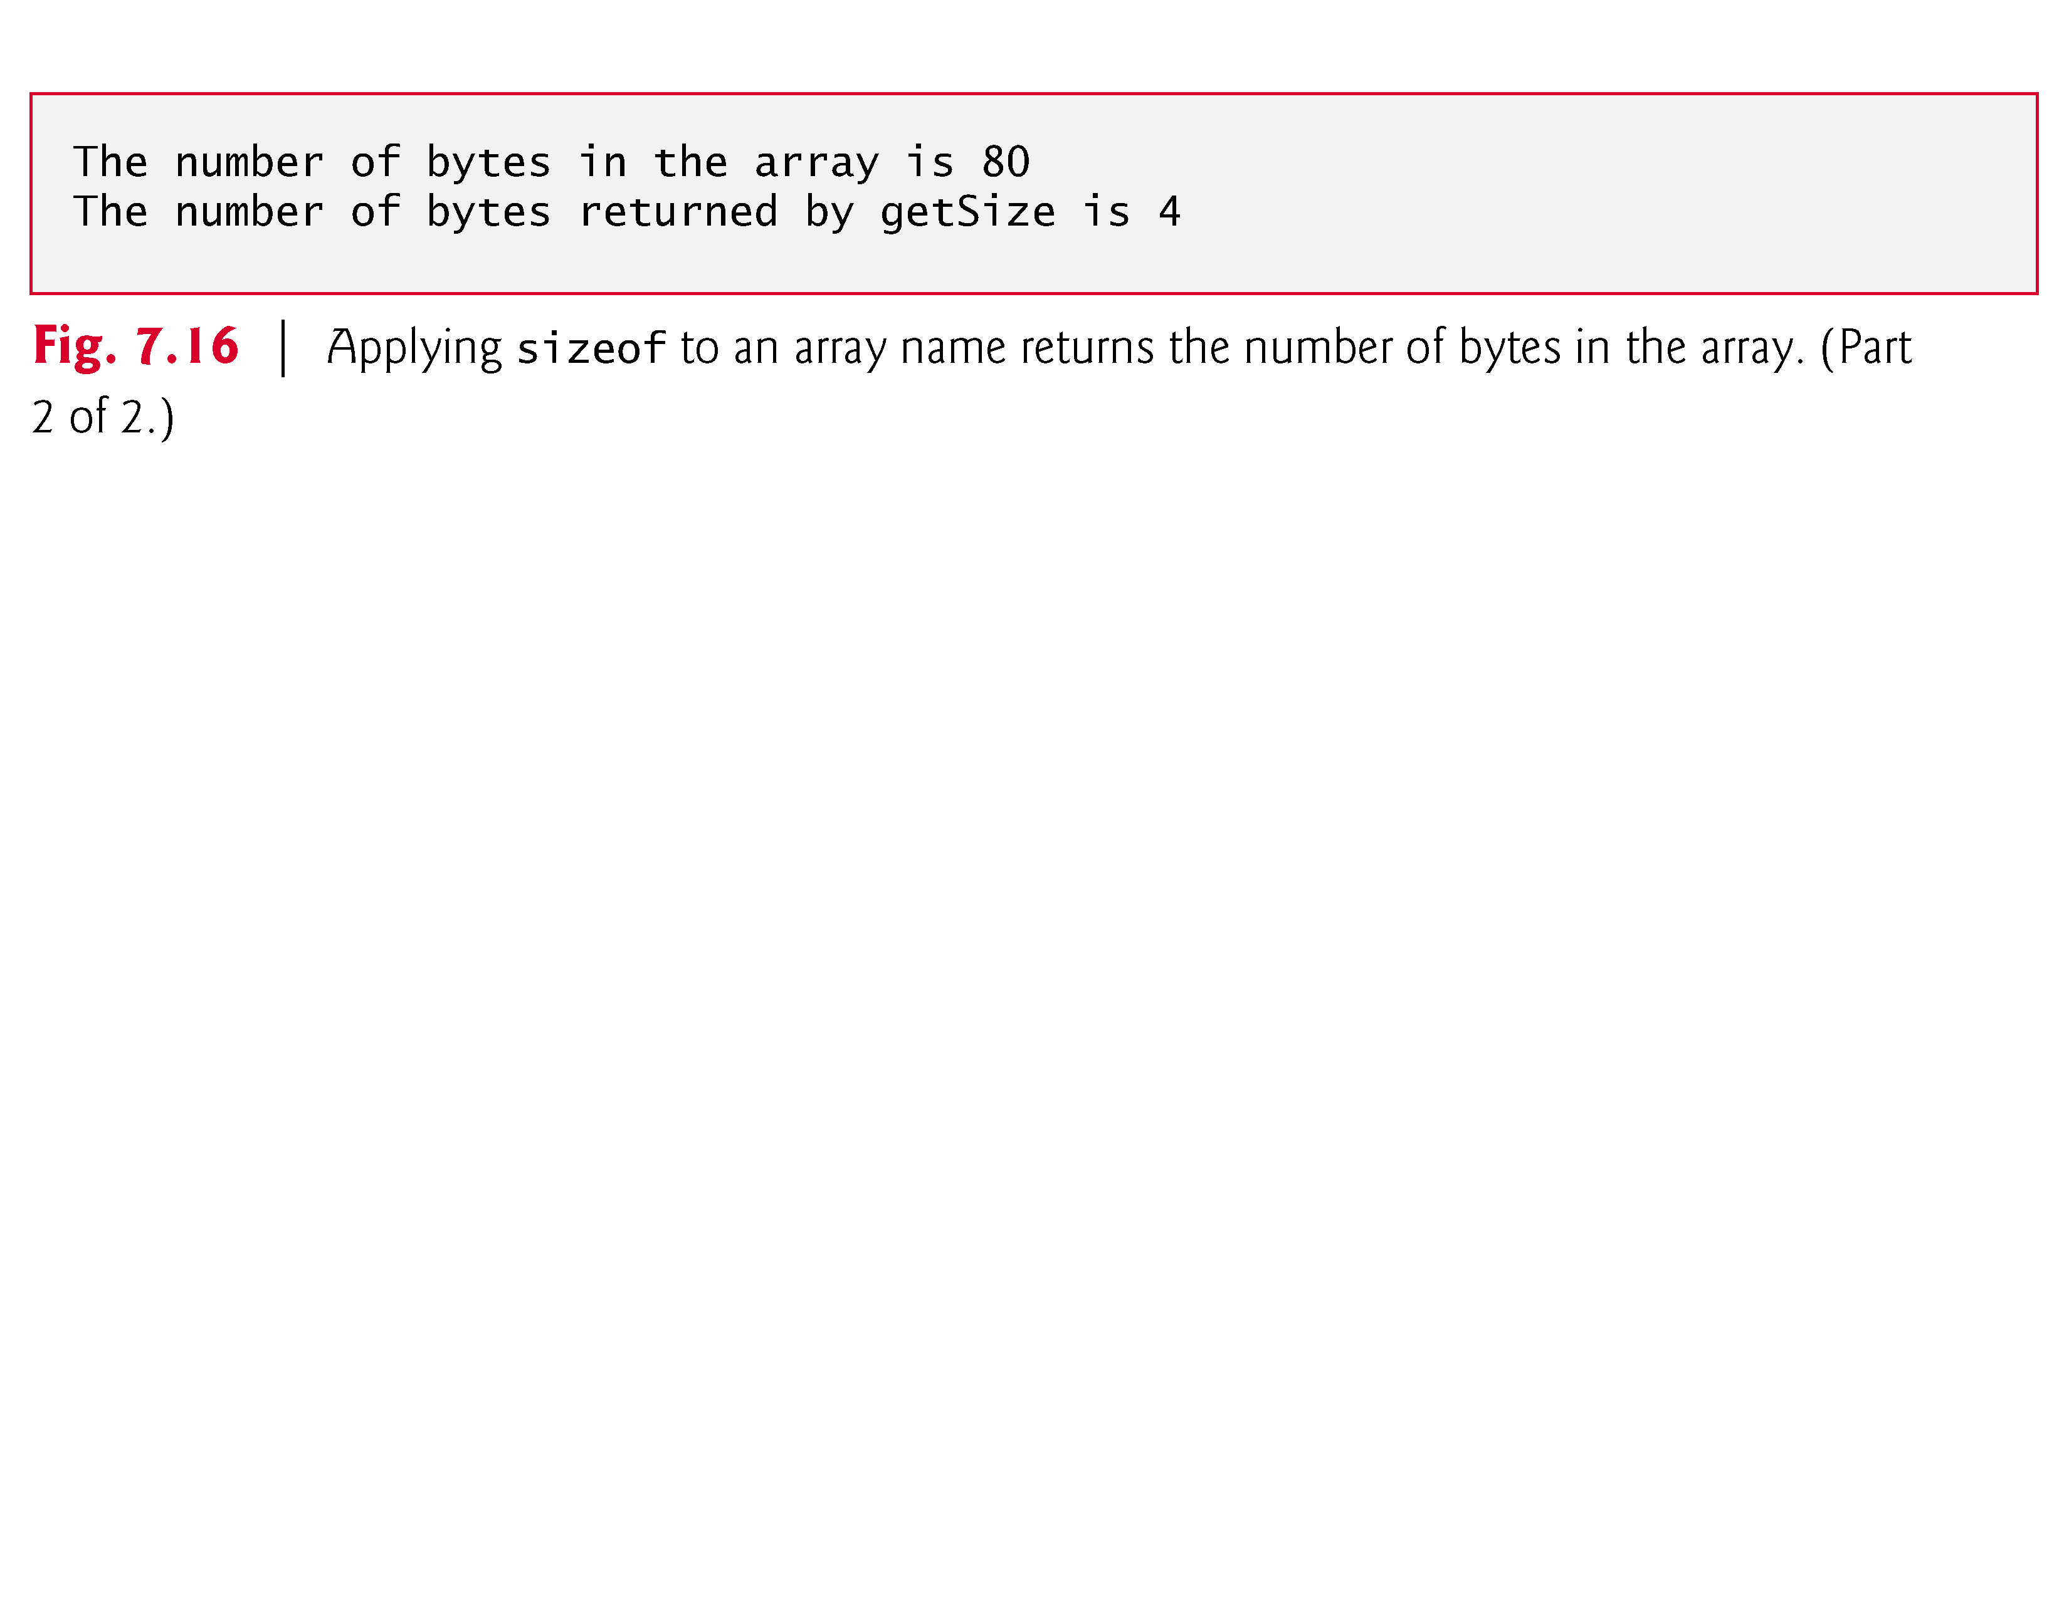

Slide 91
7.7 sizeof Operator (Cont.)
The number of elements in an array also can be determined with sizeof.
For example, consider the following array definition:
double real[22];
Variables of type double normally are stored in 8 bytes of memory.
Thus, array real contains a total of 176 bytes.
To determine the number of elements in the array, the following expression can be used:
sizeof(real) / sizeof(real[0])

Slide 92
7.7 sizeof Operator (Cont.)
The expression determines the number of bytes in array real and divides that value by the number of bytes used in memory to store the first element of array real (a double value).

Slide 93
7.7 sizeof Operator (Cont.)
Even though function getSize receives an array of 20 elements as an argument, the function’s parameter ptr is simply a pointer to the array’s first element.
When you use sizeof with a pointer, it returns the size of the pointer, not the size of the item to which it points.
The size of a pointer on our system is 4 bytes, so getSize returned 4.
Also, the calculation shown above for determining the number of array elements using sizeof works only when using the actual array, not when using a pointer to the array.

Slide 94
7.7 sizeof Operator (Cont.)
Determining the Sizes of the Standard Types, an Array and a Pointer
Figure 7.17 calculates the number of bytes used to store each of the standard data types.
The results of this program are implementation dependent and often differ across platforms and sometimes across different compilers on the same platform.

Slide 95
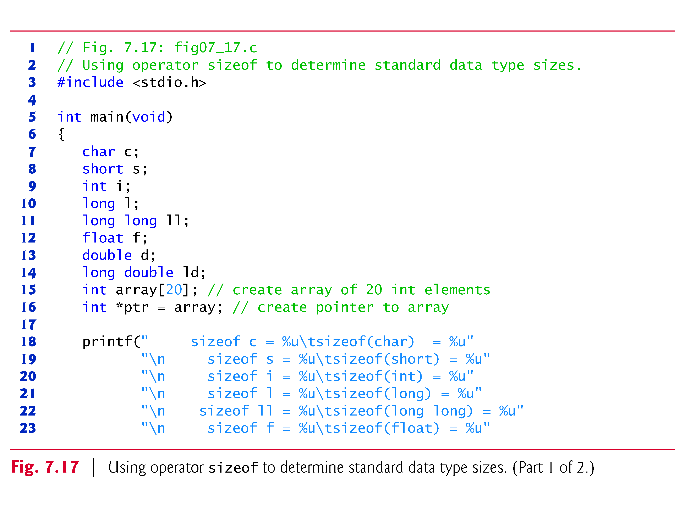

Slide 96
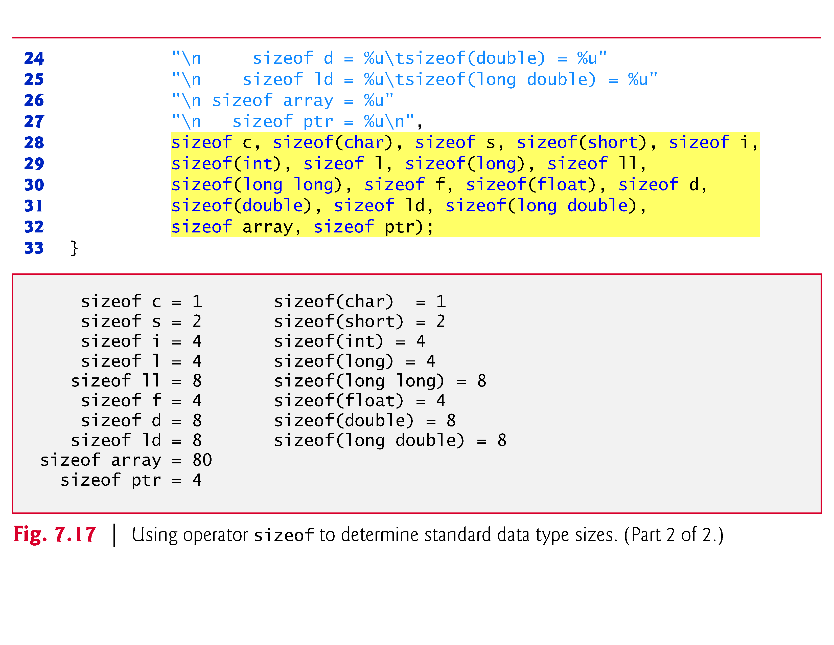

Slide 97
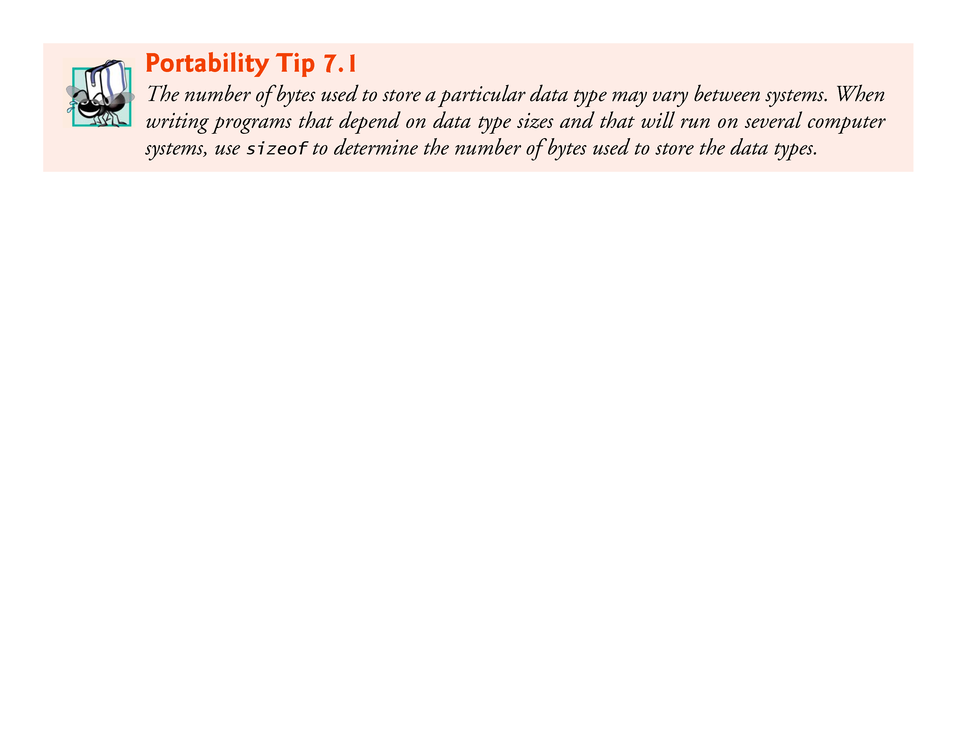

Slide 98
7.7 sizeof Operator (Cont.)
Operator sizeof can be applied to any variable name, type or value (including the value of an expression).
When applied to a variable name (that’s not an array name) or a constant, the number of bytes used to store the specific type of variable or constant is returned.
The parentheses are required when a type is supplied as size_of’s operand.

Slide 99
7.8 Pointer Expressions and Pointer Arithmetic
Pointers are valid operands in arithmetic expressions, assignment expressions and comparison expressions.
However, not all the operators normally used in these expressions are valid in conjunction with pointer variables.
This section describes the operators that can have pointers as operands, and how these operators are used.
A limited set of arithmetic operations may be performed on pointers.
A pointer may be incremented (++) or decremented (--), an integer may be added to a pointer (+ or +=), an integer may be subtracted from a pointer (- or -=) and one pointer may be subtracted from another—this last operation is meaningful only when both pointers point to elements of the same array.

Slide 100
7.8 Pointer Expressions and Pointer Arithmetic (Cont.)
Assume that array int v[5] has been defined and its first element is at location 3000 in memory.
Assume pointer vPtr has been initialized to point to v[0]—i.e., the value of vPtr is 3000.
Figure 7.18 illustrates this situation for a machine with 4-byte integers.
Variable vPtr can be initialized to point to array v with either of the statements

Slide 101
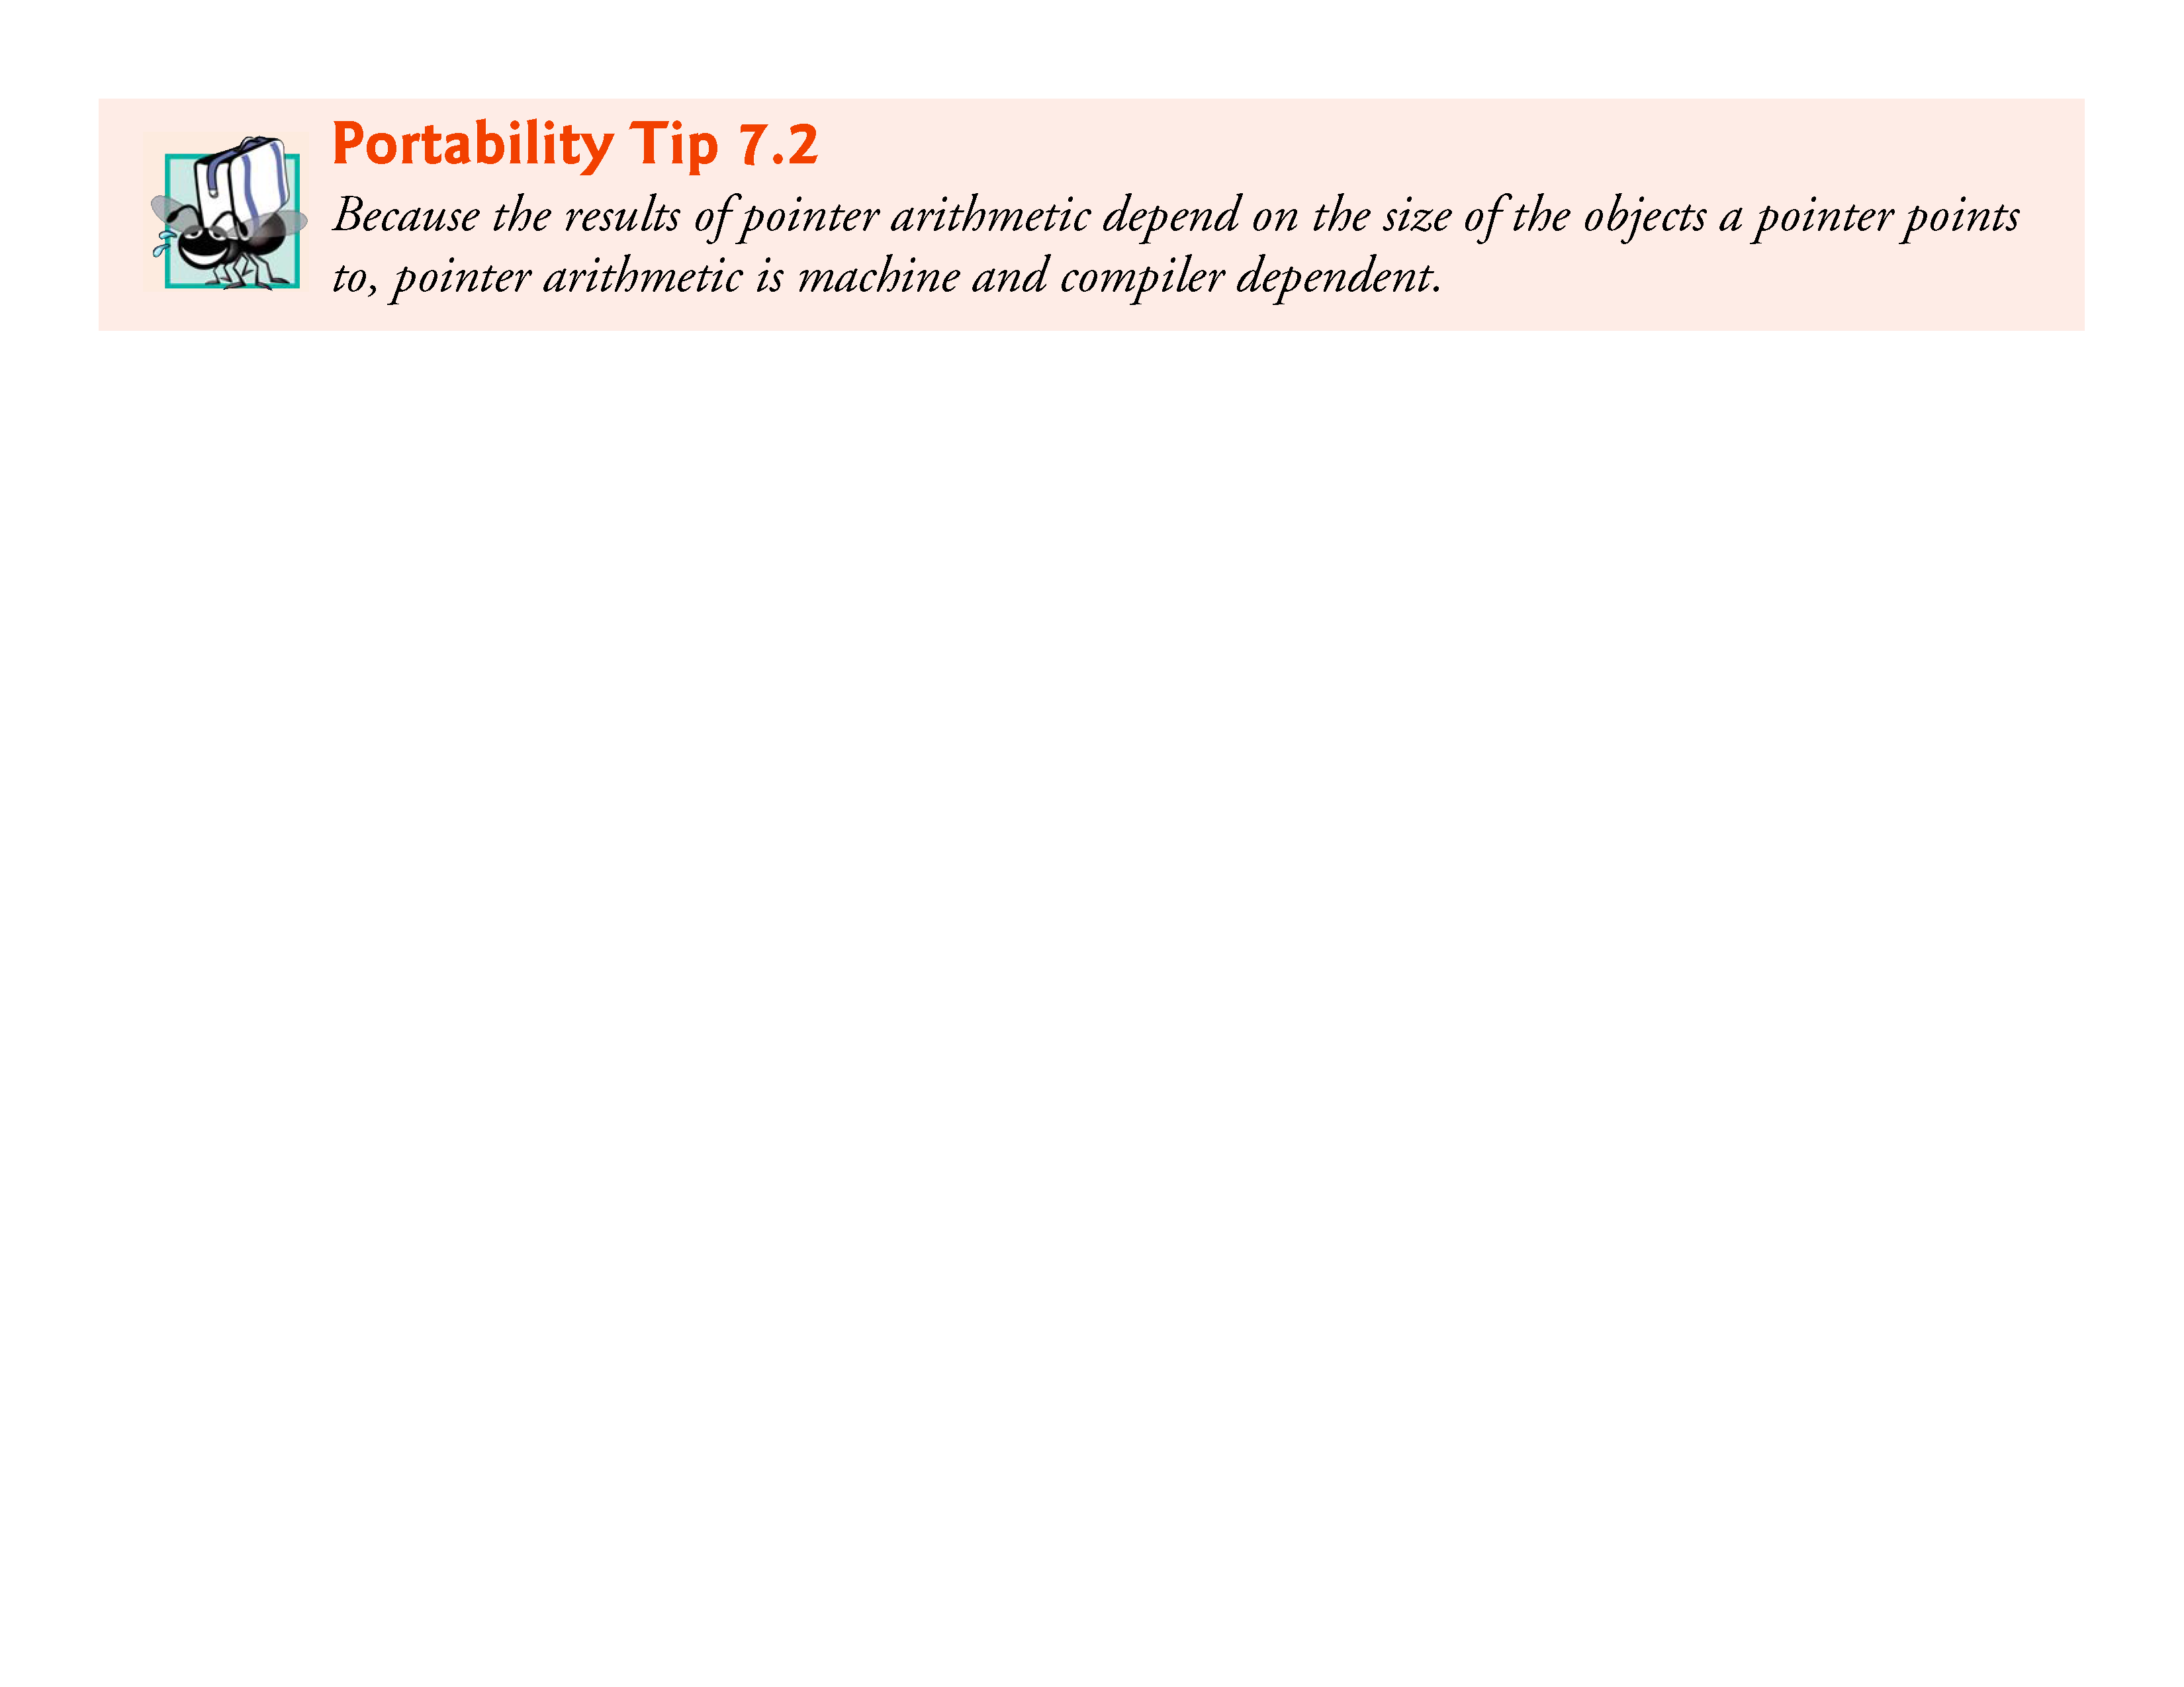

Slide 102
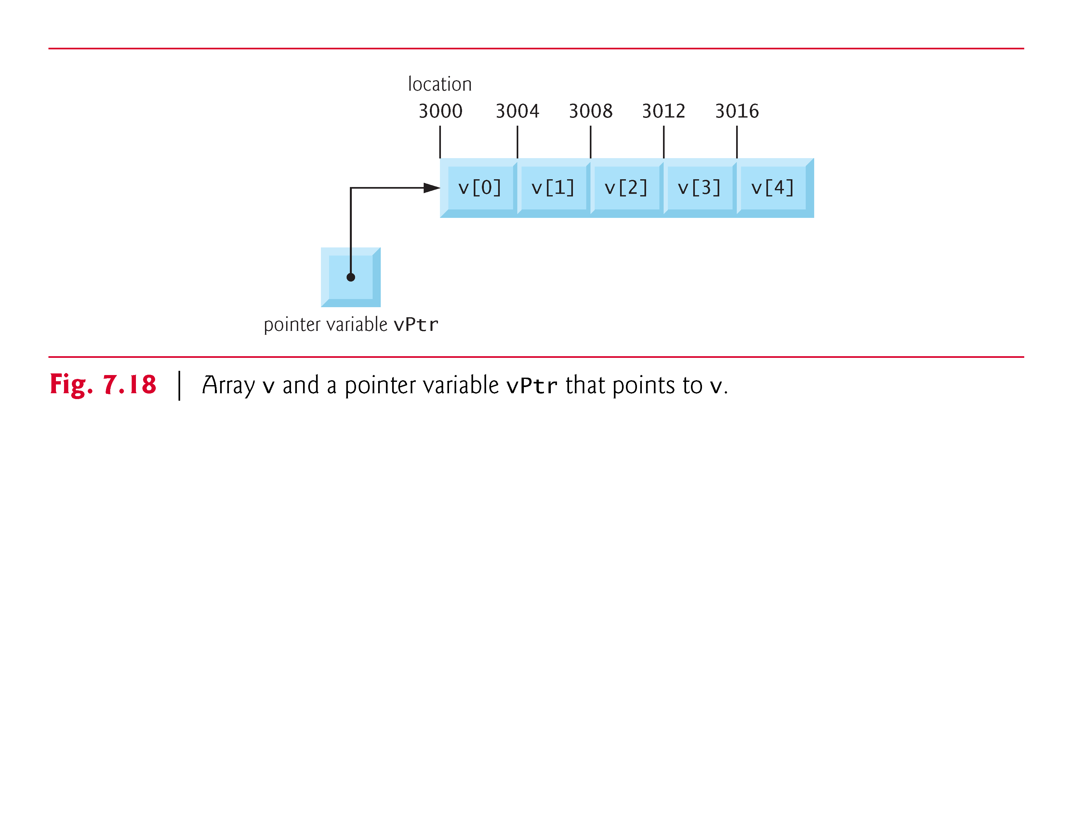

Slide 103
7.8 Pointer Expressions and Pointer Arithmetic (Cont.)
In conventional arithmetic, 3000 + 2 yields the value 3002.
This is normally not the case with pointer arithmetic.
When an integer is added to or subtracted from a pointer, the pointer is not incremented or decremented simply by that integer, but by that integer times the size of the object to which the pointer refers.
The number of bytes depends on the object’s data type.
For example, the statement
vPtr += 2;
would produce 3008 (3000 + 2 * 4), assuming an integer is stored in 4 bytes of memory.

Slide 104
7.8 Pointer Expressions and Pointer Arithmetic (Cont.)
In the array v, vPtr would now point to v[2] (Fig. 7.19).
If an integer is stored in 2 bytes of memory, then the preceding calculation would result in memory location 3004 (3000 + 2 * 2).
If the array were of a different data type, the preceding statement would increment the pointer by twice the number of bytes that it takes to store an object of that data type.
When performing pointer arithmetic on a character array, the results will be consistent with regular arithmetic, because each character is 1 byte long.

Slide 105
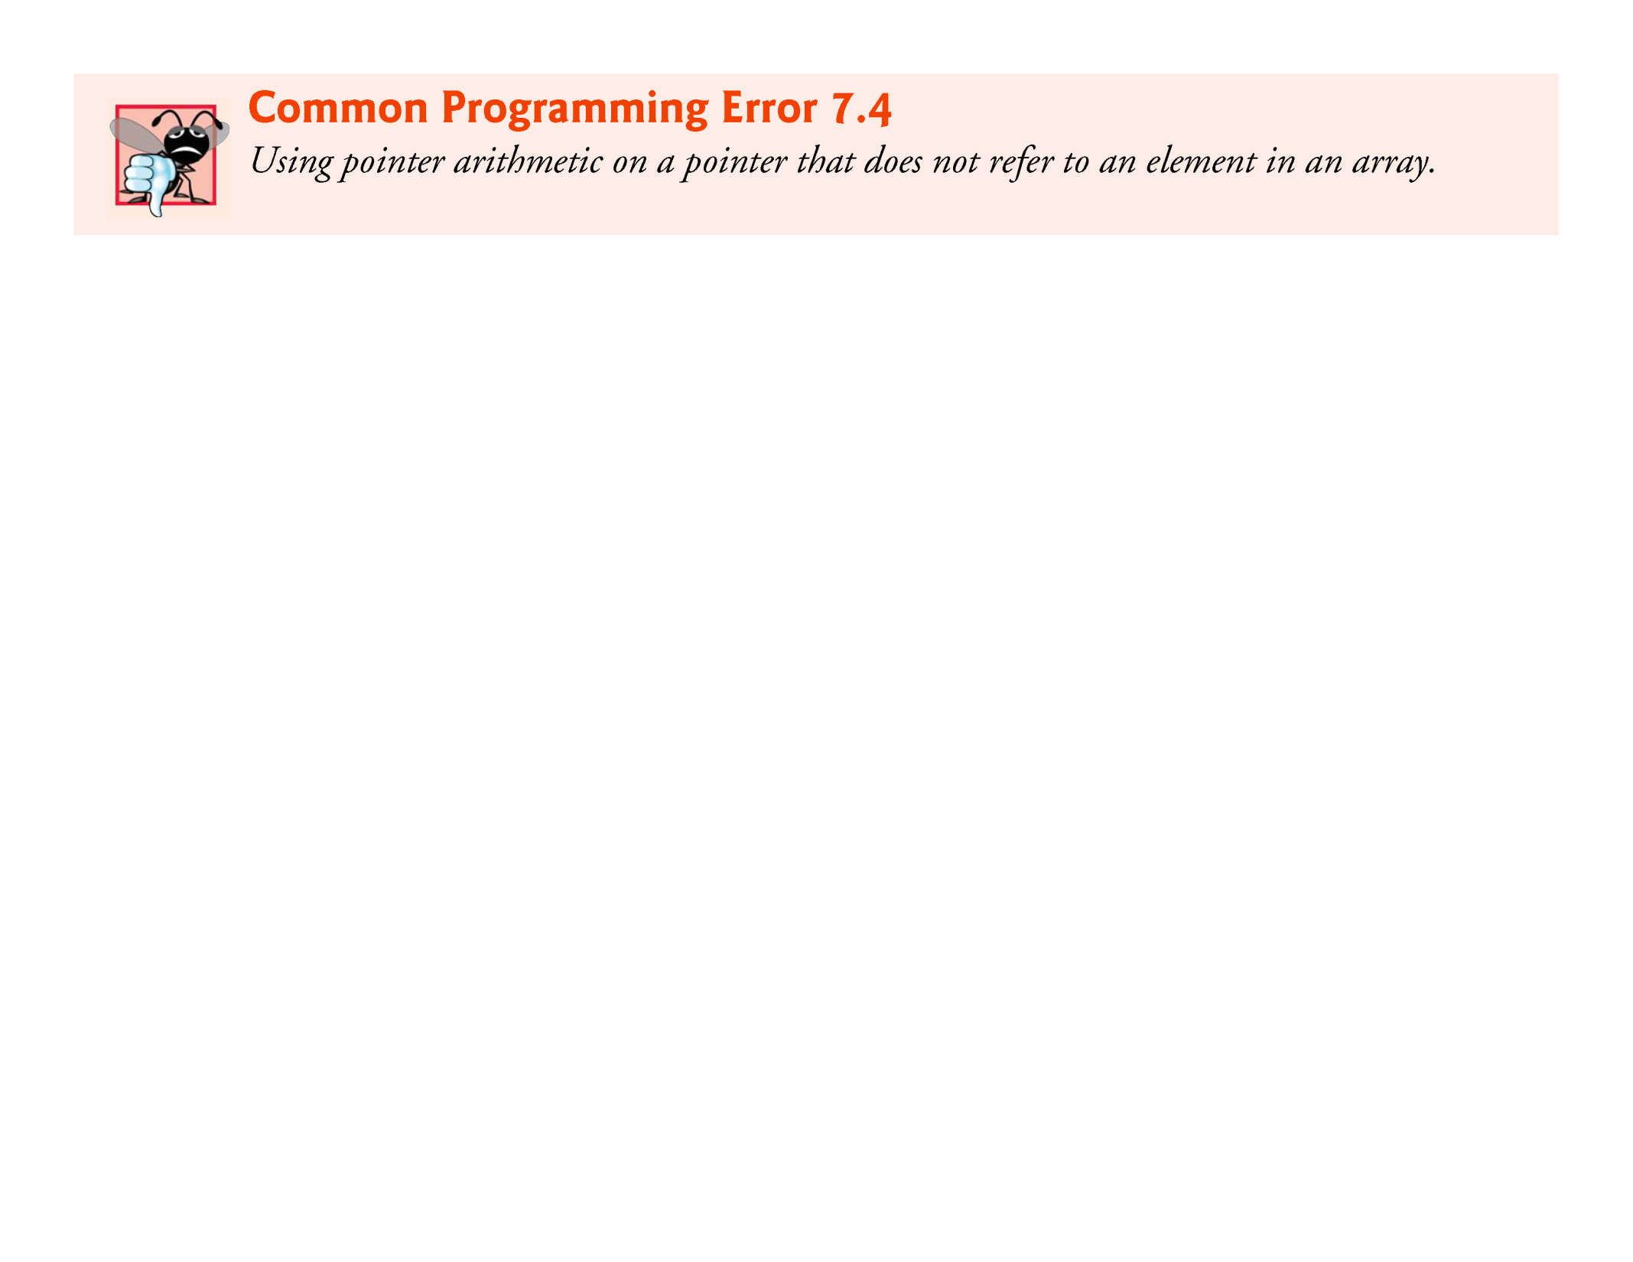

Slide 106
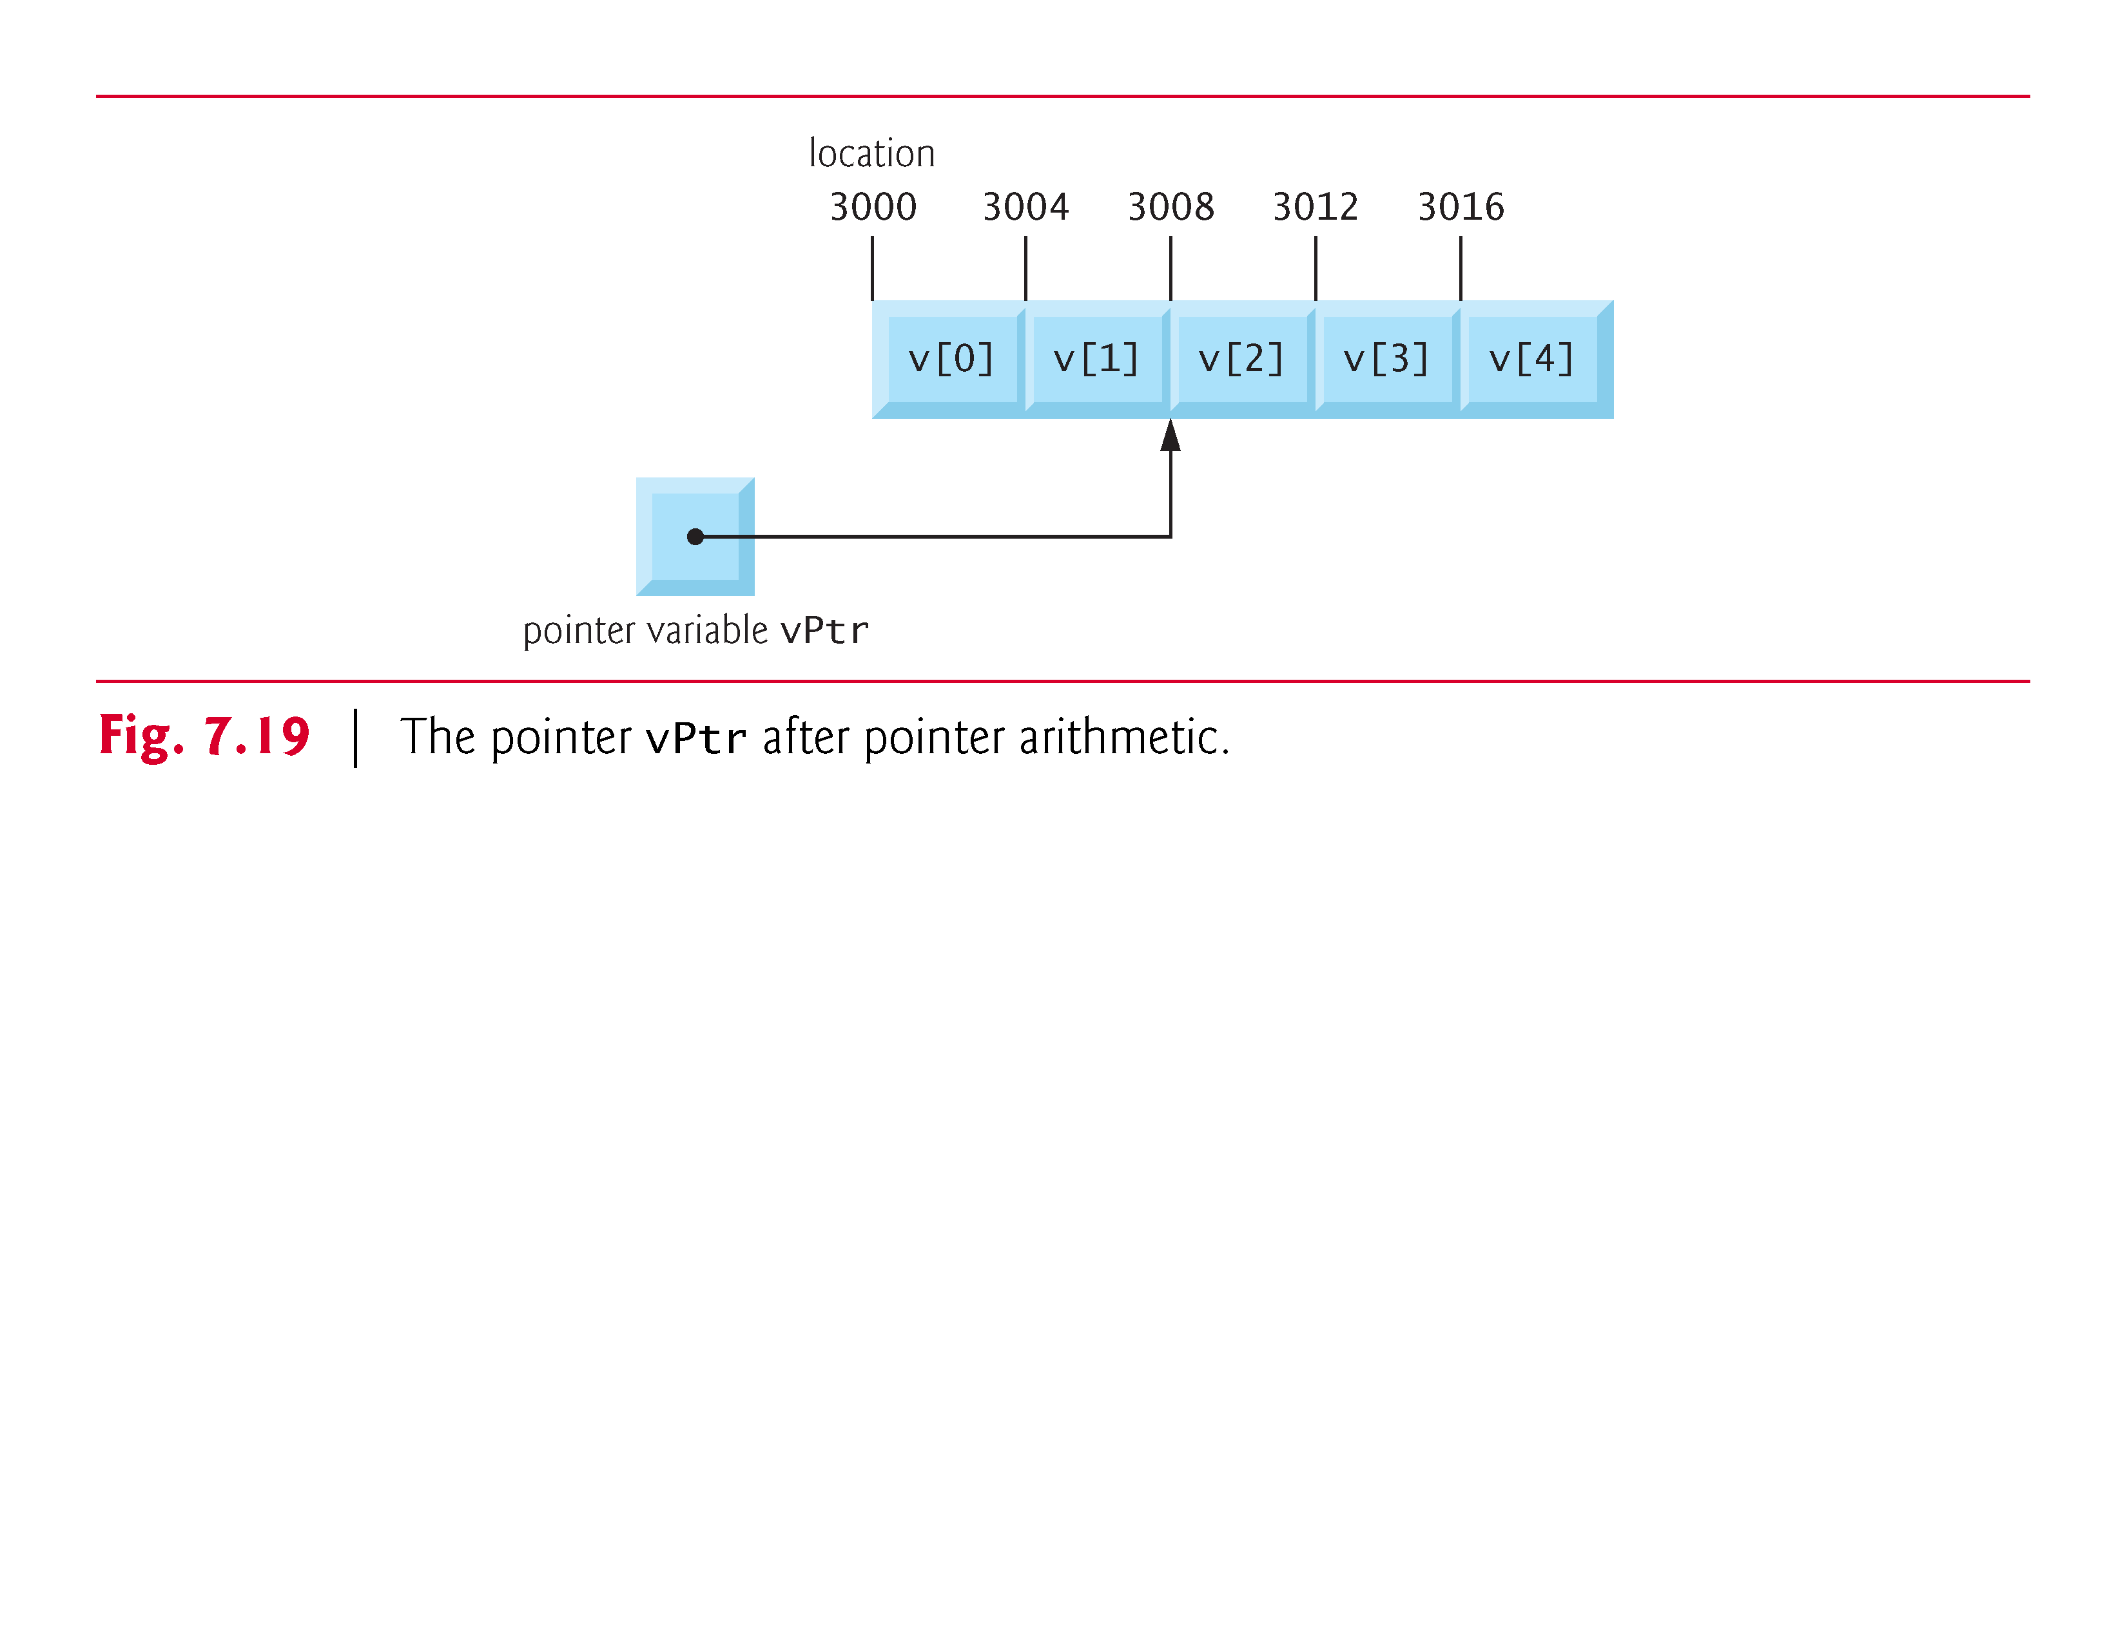

Slide 107
7.8 Pointer Expressions and Pointer Arithmetic (Cont.)
If vPtr had been incremented to 3016, which points to v[4], the statement
vPtr -= 4;
would set vPtr back to 3000—the beginning of the array.
If a pointer is being incremented or decremented by one, the increment (++) and decrement (--) operators can be used.
Either of the statements
++vPtr; vPtr++;
increments the pointer to point to the next location in the array.

Slide 108
7.8 Pointer Expressions and Pointer Arithmetic (Cont.)
Either of the statements
--vPtr; vPtr--;
decrements the pointer to point to the previous element of the array.
Pointer variables may be subtracted from one another.

Slide 109
7.8 Pointer Expressions and Pointer Arithmetic (Cont.)
For example, if vPtr contains the location 3000, and v2Ptr contains the address 3008, the statement
x = v2Ptr - vPtr;
would assign to x the number of array elements from vPtr to v2Ptr, in this case 2 (not 8).
Pointer arithmetic is undefined unless performed on an array.
We cannot assume that two variables of the same type are stored contiguously in memory unless they’re adjacent elements of an array.

Slide 110


Slide 111


Slide 112
7.8 Pointer Expressions and Pointer Arithmetic (Cont.)
A pointer can be assigned to another pointer if both have the same type.
The exception to this rule is the pointer to void (i.e., void *), which is a generic pointer that can represent any pointer type.
All pointer types can be assigned a pointer to void, and a pointer to void can be assigned a pointer of any type.
In both cases, a cast operation is not required.
A pointer to void cannot be dereferenced.

Slide 113
7.8 Pointer Expressions and Pointer Arithmetic (Cont.)
Consider this: The compiler knows that a pointer to int refers to 4 bytes of memory on a machine with 4-byte integers, but a pointer to void simply contains a memory location for an unknown data type—the precise number of bytes to which the pointer refers is not known by the compiler.
The compiler must know the data type to determine the number of bytes to be dereferenced for a particular pointer.

Slide 114


Slide 115


Slide 116


Slide 117
7.8 Pointer Expressions and Pointer Arithmetic (Cont.)
Pointers can be compared using equality and relational operators, but such comparisons are meaningless unless the pointers point to elements of the same array.
Pointer comparisons compare the addresses stored in the pointers.
A comparison of two pointers pointing to elements in the same array could show, for example, that one pointer points to a higher-numbered element of the array than the other pointer does.
A common use of pointer comparison is determining whether a pointer is NULL.

Slide 118
7.9 Relationship between Pointers and Arrays
Arrays and pointers are intimately related in C and often may be used interchangeably.
An array name can be thought of as a constant pointer.
Pointers can be used to do any operation involving array indexing.
Assume that integer array b[5] and integer pointer variable bPtr have been defined.
Because the array name (without an index) is a pointer to the first element of the array, we can set bPtr equal to the address of the first element in array b with the statement
bPtr = b;

Slide 119
7.9 Relationship between Pointers and Arrays (Cont.)
This statement is equivalent to taking the address of the array’s first element as follows:
bPtr = &b[0];
Array element b[3] can alternatively be referenced with the pointer expression
*(bPtr + 3)
The 3 in the expression is the offset to the pointer.
When the pointer points to the array’s first element, the offset indicates which array element should be referenced, and the offset value is identical to the array index.
This notation is referred to as pointer/offset notation.

Slide 120
7.9 Relationship between Pointers and Arrays (Cont.)
The parentheses are necessary because the precedence of * is higher than the precedence of +.
Without the parentheses, the above expression would add 3 to the value of the expression *bPtr (i.e., 3 would be added to b[0], assuming bPtr points to the beginning of the array).
Just as the array element can be referenced with a pointer expression, the address
&b[3]
can be written with the pointer expression
bPtr + 3
The array itself can be treated as a pointer and used in pointer arithmetic.

Slide 121
7.9 Relationship between Pointers and Arrays (Cont.)
For example, the expression
*(b + 3)
also refers to the array element b[3].
In general, all indexed array expressions can be written with a pointer and an offset.
In this case, pointer/offset notation was used with the name of the array as a pointer.
The preceding statement does not modify the array name in any way; b still points to the first element in the array.
Pointers can be indexed like arrays.

Slide 122
7.9 Relationship between Pointers and Arrays (Cont.)
If bPtr has the value b, the expression
bPtr[1]
refers to the array element b[1].
This is referred to as pointer/index notation.
Remember that an array name is essentially a constant pointer; it always points to the beginning of the array.
Thus, the expression
b += 3
is invalid because it attempts to modify the value of the array name with pointer arithmetic.

Slide 123


Slide 124
7.9 Relationship between Pointers and Arrays (Cont.)
Figure 7.20 uses the four methods we’ve discussed for referring to array elements—array indexing, pointer/offset with the array name as a pointer, pointer indexing, and pointer/offset with a pointer—to print the four elements of the integer array b.

Slide 125


Slide 126


Slide 127


Slide 128
7.9 Relationship between Pointers and Arrays (Cont.)
String Copying with Arrays and Pointers
To further illustrate the interchangeability of arrays and pointers, let’s look at the two string-copying functions—copy1 and copy2—in the program of Fig. 7.21.
Both functions copy a string into a character array.
After a comparison of the function prototypes for copy1 and copy2, the functions appear identical.
They accomplish the same task; but they’re implemented differently.

Slide 129


Slide 130


Slide 131
7.9 Relationship between Pointers and Arrays (Cont.)
Function copy1 uses array index notation to copy the string in s2 to the character array s1.
The function defines counter variable i as the array index.
The for statement header performs the entire copy operation—its body is the empty statement.
The header specifies that i is initialized to zero and incremented by one on each iteration of the loop.
The expression s1[i] = s2[i] copies one character from s2 to s1.
When the null character is encountered in s2, it’s assigned to s1, and the value of the assignment becomes the value assigned to the left operand (s1).

Slide 132
7.9 Relationship between Pointers and Arrays (Cont.)
The loop terminates when the null character is assigned from s1 to s2 (false).
Function copy2 uses pointers and pointer arithmetic to copy the string in s2 to the character array s1.
Again, the for statement header performs the entire copy operation.
The header does not include any variable initialization.
As in function copy1, the expression (*s1 = *s2) performs the copy operation.
Pointer s2 is dereferenced, and the resulting character is assigned to the dereferenced pointer *s1.

Slide 133
7.9 Relationship between Pointers and Arrays (Cont.)
After the assignment in the condition, the pointers are incremented to point to the next element of array s1 and the next character of string s2, respectively.
When the null character is encountered in s2, it’s assigned to the dereferenced pointer s1 and the loop terminates.
The first argument to both copy1 and copy2 must be an array large enough to hold the string in the second argument.
Otherwise, an error may occur when an attempt is made to write into a memory location that’s not part of the array.
Also, the second parameter of each function is declared as const char * (a constant string).

Slide 134
7.9 Relationship between Pointers and Arrays (Cont.)
In both functions, the second argument is copied into the first argument—characters are read from it one at a time, but the characters are never modified.
Therefore, the second parameter is declared to point to a constant value so that the principle of least privilege is enforced—neither function requires the capability of modifying the second argument, so neither function is provided with that capability.

Slide 135
7.10 Arrays of Pointers
Arrays may contain pointers.
A common use of an array of pointers is to form an array of strings, referred to simply as a string array.
Each entry in the array is a string, but in C a string is essentially a pointer to its first character.
So each entry in an array of strings is actually a pointer to the first character of a string.
Consider the definition of string array suit, which might be useful in representing a deck of cards.
const char *suit[4] = {"Hearts", "Diamonds", "Clubs", "Spades"};

Slide 136
7.10 Arrays of Pointers (Cont.)
The suit[4] portion of the definition indicates an array of 4 elements.
The char * portion of the declaration indicates that each element of array suit is of type “pointer to char.”
Qualifier const indicates that the strings pointed to by each element pointer will not be modified.
The four values to be placed in the array are "Hearts", "Diamonds", "Clubs" and "Spades".
Each is stored in memory as a null-terminated character string that’s one character longer than the number of characters between quotes.

Slide 137
7.10 Arrays of Pointers (Cont.)
The four strings are 7, 9, 6 and 7 characters long, respectively.
Although it appears as though these strings are being placed in the suit array, only pointers are actually stored in the array (Fig. 7.22).
Each pointer points to the first character of its corresponding string.
Thus, even though the suit array is fixed in size, it provides access to character strings of any length.
This flexibility is one example of C’s powerful data-structuring capabilities.

Slide 138


Slide 139
7.10 Arrays of Pointers (Cont.)
The suits could have been placed in a two-dimensional array, in which each row would represent a suit and each column would represent a letter from a suit name.
Such a data structure would have to have a fixed number of columns per row, and that number would have to be as large as the largest string.
Therefore, considerable memory could be wasted when storing a large number of strings of which most were shorter than the longest string.

Slide 140
7.11 Case Study: Card Shuffling and Dealing Simulation
In this section, we use random number generation to develop a card shuffling and dealing simulation program.
This program can then be used to implement programs that play specific card games.
To reveal some subtle performance problems, we’ve intentionally used suboptimal shuffling and dealing algorithms.
In this chapter’s exercises and in Chapter 10, we develop more efficient algorithms.
Using the top-down, stepwise refinement approach, we develop a program that will shuffle a deck of 52 playing cards and then deal each of the 52 cards.

Slide 141
7.11 Case Study: Card Shuffling and Dealing Simulation (Cont.)
The top-down approach is particularly useful in attacking larger, more complex problems than you’ve seen in earlier chapters.
We use 4-by-13 two-dimensional array deck to represent the deck of playing cards (Fig. 7.23).
The rows correspond to the suits—row 0 corresponds to hearts, row 1 to diamonds, row 2 to clubs and row 3 to spades.
The columns correspond to the face values of the cards—0 through 9 correspond to ace through ten, and columns 10 through 12 correspond to jack, queen and king.
We shall load string array suit with character strings representing the four suits, and string array face with character strings representing the thirteen face values.

Slide 142


Slide 143
7.11 Case Study: Card Shuffling and Dealing Simulation (Cont.)
This simulated deck of cards may be shuffled as follows.
First the array deck is cleared to zeros.
Then, a row (0–3) and a column (0–12) are each chosen at random.
The number 1 is inserted in array element deck[row][column] to indicate that this card will be the first one dealt from the shuffled deck.
This process continues with the numbers 2, 3, …, 52 being randomly inserted in the deck array to indicate which cards are to be placed second, third, …, and fifty-second in the shuffled deck.

Slide 144
7.11 Case Study: Card Shuffling and Dealing Simulation (Cont.)
As the deck array begins to fill with card numbers, it’s possible that a card will be selected again—i.e., deck[row] [column] will be nonzero when it’s selected.
This selection is simply ignored and other rows and columns are repeatedly chosen at random until an unselected card is found.
Eventually, the numbers 1 through 52 will occupy the 52 slots of the deck array.
At this point, the deck of cards is fully shuffled.

Slide 145
7.11 Case Study: Card Shuffling and Dealing Simulation (Cont.)
This shuffling algorithm can execute indefinitely if cards that have already been shuffled are repeatedly selected at random.
This phenomenon is known as indefinite postponement.
In this chapter’s exercises, we discuss a better shuffling algorithm that eliminates the possibility of indefinite postponement.

Slide 146


Slide 147
7.11 Case Study: Card Shuffling and Dealing Simulation (Cont.)
To deal the first card, we search the array for deck[row][column] equal to 1.
This is accomplished with nested for statements that vary row from 0 to 3 and column from 0 to 12.
What card does that element of the array correspond to?
The suit array has been preloaded with the four suits, so to get the suit, we print the character string suit[row].
Similarly, to get the face value of the card, we print the character string face[column].
We also print the character string " of ".

Slide 148
7.11 Case Study: Card Shuffling and Dealing Simulation (Cont.)
Printing this information in the proper order enables us to print each card in the form "King of Clubs", "Ace of Diamonds" and so on.
Let’s proceed with the top-down, stepwise refinement process.
The top is simply
Shuffle and deal 52 cards
Our first refinement yields:
Initialize the suit array Initialize the face array Initialize the deck array Shuffle the deck Deal 52 cards

Slide 149
7.11 Case Study: Card Shuffling and Dealing Simulation (Cont.)
“Shuffle the deck” may be expanded as follows:
For each of the 52 cards Place card number in randomly selected unoccupied slot of deck
“Deal 52 cards” may be expanded as follows:
For each of the 52 cards Find card number in deck array and print face and suit of card

Slide 150
7.11 Case Study: Card Shuffling and Dealing Simulation (Cont.)
Incorporating these expansions yields our complete second refinement:
Initialize the suit array Initialize the face array Initialize the deck array For each of the 52 cards Place card number in randomly selected unoccupied slot of deck For each of the 52 cards Find card number in deck array and print face and suit of card

Slide 151
7.11 Case Study: Card Shuffling and Dealing Simulation (Cont.)
“Place card number in randomly selected unoccupied slot of deck” may be expanded as:
Choose slot of deck randomly While chosen slot of deck has been previously chosen Choose slot of deck randomly Place card number in chosen slot of deck
“Find card number in deck array and print face and suit of card” may be expanded as:
For each slot of the deck array If slot contains card number Print the face and suit of the card

Slide 152
7.11 Case Study: Card Shuffling and Dealing Simulation (Cont.)
Incorporating these expansions yields our third refinement:
Initialize the suit array Initialize the face array Initialize the deck array For each of the 52 cards Choose slot of deck randomly While slot of deck has been previously chosen Choose slot of deck randomly Place card number in chosen slot of deck For each of the 52 cards For each slot of deck array If slot contains desired card number Print the face and suit of the card

Slide 153
7.11 Case Study: Card Shuffling and Dealing Simulation (Cont.)
This completes the refinement process.
This program is more efficient if the shuffle and deal portions of the algorithm are combined so that each card is dealt as it’s placed in the deck.
We’ve chosen to program these operations separately because normally cards are dealt after they’re shuffled (not while they’re being shuffled).

Slide 154
7.11 Case Study: Card Shuffling and Dealing Simulation (Cont.)
The card shuffling and dealing program is shown in Fig. 7.24, and a sample execution is shown in Fig. 7.25.
Conversion specifier %s is used to print strings of characters in the calls to printf.
The corresponding argument in the printf call must be a pointer to char (or a char array).
The format specification "%5s of %-8s" prints a character string right justified in a field of five characters followed by " of " and a character string left justified in a field of eight characters.
The minus sign in %-8s signifies left justification.

Slide 155


Slide 156


Slide 157


Slide 158


Slide 159


Slide 160
7.11 Case Study: Card Shuffling and Dealing Simulation (Cont.)
There’s a weakness in the dealing algorithm.
Once a match is found, the two inner for statements continue searching the remaining elements of deck for a match.
We correct this deficiency in this chapter’s exercises and in a Chapter 10 case study.

Slide 161
7.12 Pointers to Functions
A pointer to a function contains the address of the function in memory.
In Chapter 6, we saw that an array name is really the address in memory of the first element of the array.
Similarly, a function name is really the starting address in memory of the code that performs the function’s task.
Pointers to functions can be passed to functions, returned from functions, stored in arrays and assigned to other function pointers.

Slide 162
7.12 Pointers to Functions (Cont.)
To illustrate the use of pointers to functions, Fig. 7.26 presents a modified version of the bubble sort program in Fig. 7.15.
The new version consists of main and functions bubble, swap, ascending and descending.
Function bubbleSort receives a pointer to a function—either function ascending or function descending—as an argument, in addition to an integer array and the size of the array.

Slide 163
7.12 Pointers to Functions (Cont.)
The program prompts the user to choose whether the array should be sorted in ascending or in descending order.
If the user enters 1, a pointer to function ascending is passed to function bubble, causing the array to be sorted into increasing order.
If the user enters 2, a pointer to function descending is passed to function bubble, causing the array to be sorted into decreasing order.
The output of the program is shown in Fig. 7.27.

Slide 164


Slide 165


Slide 166


Slide 167


Slide 168


Slide 169
7.12 Pointers to Functions (Cont.)
The following parameter appears in the function header for bubble
int (*compare)(int a, int b)
This tells bubble to expect a parameter (compare) that’s a pointer to a function that receives two integer parameters and returns an integer result.

Slide 170
7.12 Pointers to Functions (Cont.)
Parentheses are needed around *compare to group the * with compare to indicate that compare is a pointer.
If we had not included the parentheses, the declaration would have been
int *compare(int a, int b)
which declares a function that receives two integers as parameters and returns a pointer to an integer.

Slide 171
7.12 Pointers to Functions (Cont.)
The third parameter in the prototype could have been written as
int (*)(int, int);
without the function-pointer name and parameter names.
The function passed to bubble is called in an if statement as follows:
if ((*compare)(work[count], work[count + 1]))
Just as a pointer to a variable is dereferenced to access the value of the variable, a pointer to a function is dereferenced to use the function.

Slide 172
7.12 Pointers to Functions (Cont.)
The call to the function could have been made without dereferencing the pointer as in
if (compare(work[count], work[count + 1]))
which uses the pointer directly as the function name.
We prefer the first method of calling a function through a pointer because it explicitly illustrates that compare is a pointer to a function that’s dereferenced to call the function.
The second method of calling a function through a pointer makes it appear as if compare is an actual function.
This may be confusing to a programmer reading the code who would like to see the definition of function compare and finds that it’s never defined in the file.

Slide 173
7.12 Pointers to Functions (Cont.)
Using Function Pointers to Create a Menu-Driven System
A common use of function pointers is in text-based menu-driven systems.
A user is prompted to select an option from a menu (possibly from 1 to 5) by typing the menu item’s number.
Each option is serviced by a different function.
Pointers to each function are stored in an array of pointers to functions.
The user’s choice is used as an index in the array, and the pointer in the array is used to call the function.

Slide 174
7.12 Pointers to Functions (Cont.)
Figure 7.28 provides a generic example of the mechanics of defining and using an array of pointers to functions.
We define three functions—function1, function2 and function3—that each take an integer argument and return nothing.
We store pointers to these three functions in array f

Slide 175


Slide 176


Slide 177


Slide 178
7.12 Pointers to Functions (Cont.)
The definition is read beginning at the leftmost set of parentheses, “f is an array of 3 pointers to functions that each take an int as an argument and return void.” The array is initialized with the names of the three functions.
When the user enters a value between 0 and 2, the value is used as the index into the array of pointers to functions.
In the function call, f[choice] selects the pointer at location choice in the array.
The pointer is dereferenced to call the function, and choice is passed as the argument to the function.
Each function prints its argument’s value and its function name to demonstrate that the function is called correctly.

Slide 179
7.13 Secure C Programming
printf_s, scanf_s and Other Secure Functions
A key feature of functions like printf_s and scanf_s that makes them more secure is that they have runtime constraints requiring their pointer arguments to be non-NULL.
The functions check these runtime constraints before attempting to use the pointers.
Any NULL pointer argument is considered to be a constraint violation and causes the function to fail and return a status notification.

Slide 180
7.13 Secure C Programming (Cont.)
In a scanf_s, if any of the pointer arguments (including the format-control string) are NULL, the function returns EOF.
In a printf_s, if the format-control string or any argument that corresponds to a %s is NULL, the function stops outputting data and returns a negative number.

Slide 181
7.13 Secure C Programming (Cont.)
Other CERT Guidelines Regarding Pointers
Misused pointers lead to many of the most common security vulnerabilities in systems today.
CERT provides various guidelines to help you prevent such problems.
If you’re building industrial-strength C systems, you should familiarize yourself with the CERT C Secure Coding Standard at www.securecoding.cert.org.
The following guidelines apply to pointer programming techniques that we presented in this chapter:

Slide 182
7.13 Secure C Programming (Cont.)
EXP34-C: Dereferencing NULL pointers typically causes programs to crash, but CERT has encountered cases in which dereferencing NULL pointers can allow attackers to execute code.
DCL13-C: Section 7.5 discussed uses of const with pointers. If a function parameter points to a value that will not be changed by the function, const should be used to indicate that the data is constant. For example, to represent a pointer to a string that will not be modified, use const char * as the pointer parameter’s type.
MSC16-C: This guideline discusses techniques for encrypting function pointers to help prevent attackers from overwriting them and executing attack code.

